Slide 1


Slide 2
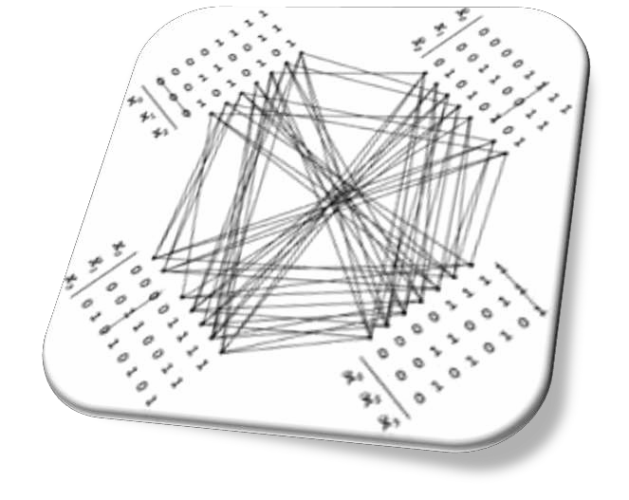
Topics to be covered
◆ Introduction
◆ Addition and Subtraction
◆ Multiplication Algorithms
◆ Division Algorithms
◆ Floating-point Arithmetic operations
◆ Decimal Arithmetic Unit
◆ Decimal Arithmetic operations

Slide 3
Introduction
Arithmetic instructions in digital computers manipulate data to produce results necessary for the solutions of computational problems. These instructions perform arithmetic calculations and are responsible for the bulk of activity involved in processing data in a computer.
The four basic arithmetic operations are addition,subtraction,multiplication and
division.
From these four basic operations , it is possible to formulate other arithmetic functions and solve problems by means of numerical analysis methods.
An arithmetic processor is the pat of a processor unit that executes arithmetic
operations.
An arithmetic instruction may specify binary or decimal data, and in each case the data may be in fixed-point or floating point form.
Negative numbers may be in signed magnitude or signed compliment
representation.
Fixed point numbers may represents integers or fractions.

Slide 4
What is algorithm?
The solution to any problem that is stated by a finite number of well-
defined procedural steps is called an Algorithm.
In this class we develop the various arithmetic algorithms and show the
procedure for implementing them with digital hardware
we consider addition,subtraction,multiplication,and division for the following types of data:
Fixed point binary data in signed-magnitude representation
Fixed point binary data in signed-2’s compliment representation
Floating point binary data
Binary-coded decimal(BCD) data

Slide 5
Addition and Subtraction
The addition and subtraction algorithm for data represented in signed magnitude and again data represented in signed-2’s complement.
It is important to realize that the adopted representation for negative numbers refers to the representation of numbers in the register before and after the execution of the arithmetic operations.
Addition and Subtraction with Signed-magnitude Data:
The representation of numbers in signed-magnitude is familiar because it is used in everyday arithmetic calculation. The procedure for adding or subtracting two signed binary numbers with paper and pencils simple and straight-forward. A review of this procedure will be helpful for deriving the hardware algorithm.

Slide 6
Cont.……..
We designated the magnitude of the two numbers by A and B. when the signed numbers are added or subtracted, we find that there are eight different conditions to consider, depending on the sign of the numbers and the operation performed. These conditions are listed in the first column of the table below. The other column in the table show the actual operation to be performed with the magnitude of the numbers.
The last column is needed to prevent negative zero. In other words ,when
two equal numbers are subtracted, the result should be +0 not -0.
The algorithms for addition and subtraction are derived from the table and can be stated as follows (the words inside parentheses should be used for the subtraction algorithm)
Addition (subtraction) algorithm: when the signs of A and B are identical (different), add the two magnitude and attach the sign of A to the result. When the sign of A and B are different (identical),compare the magnitudes.

Slide 7
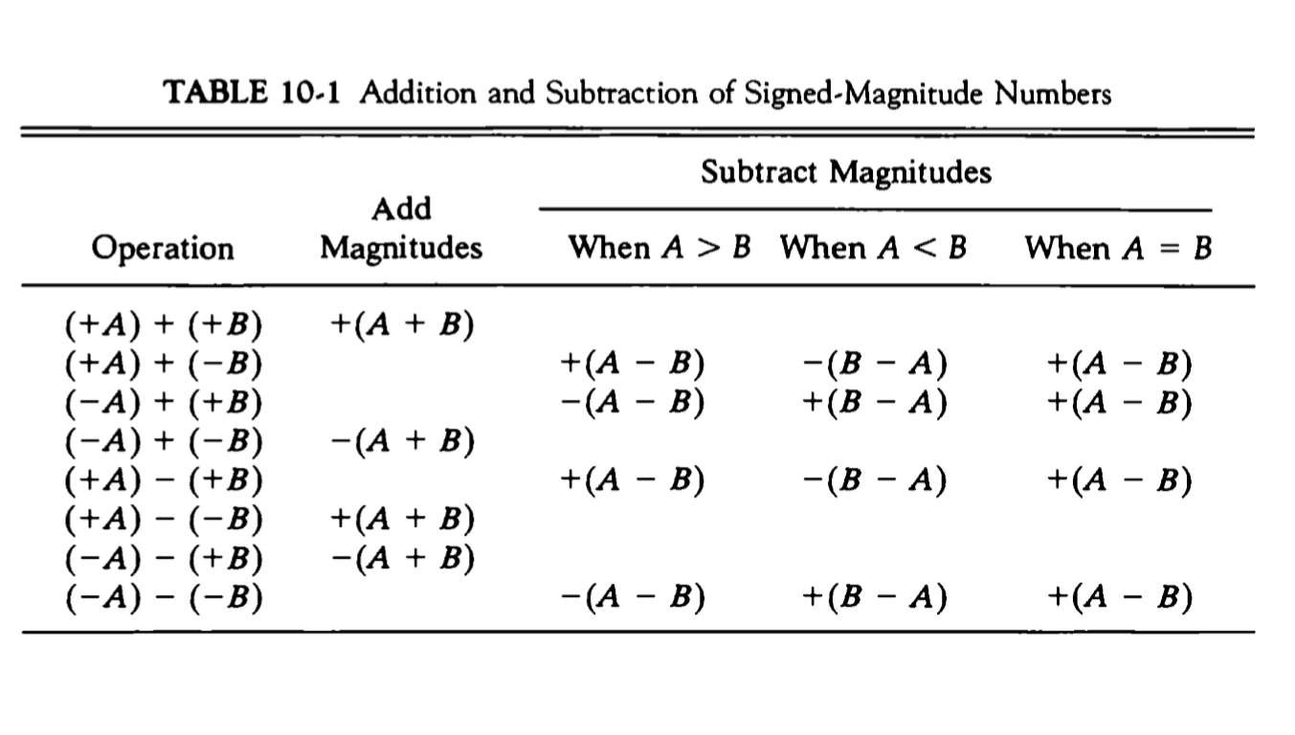

Slide 8
Hardware implementation
To implement the two arithmetic operations with hardware,it is first necessary that the two numbers be stored in registers. Let A and B be two registers that hold the magnitude of the numbers, and A_{s} and B_{s} be two flipflops that hold the corresponding signs. The results of the operation may be transferred to a third register however, a saving achieved if the result is transferred into A and A_{s} . thus A and A_{s} together from an accumulator register.
Consider now the hardware implementation of the algorithms above. First, a parallel adder is needed to perform the micro operation A+B. second, comparator circuit is needed to establish if A>B, A=B, or A<B. third, two parallel subtractor circuits are needed to perform the micro operation A-B and B-A. The sign relationship can be determined from an exclusive-OR gate with A_{s} and B_{s} as inputs.

Slide 9
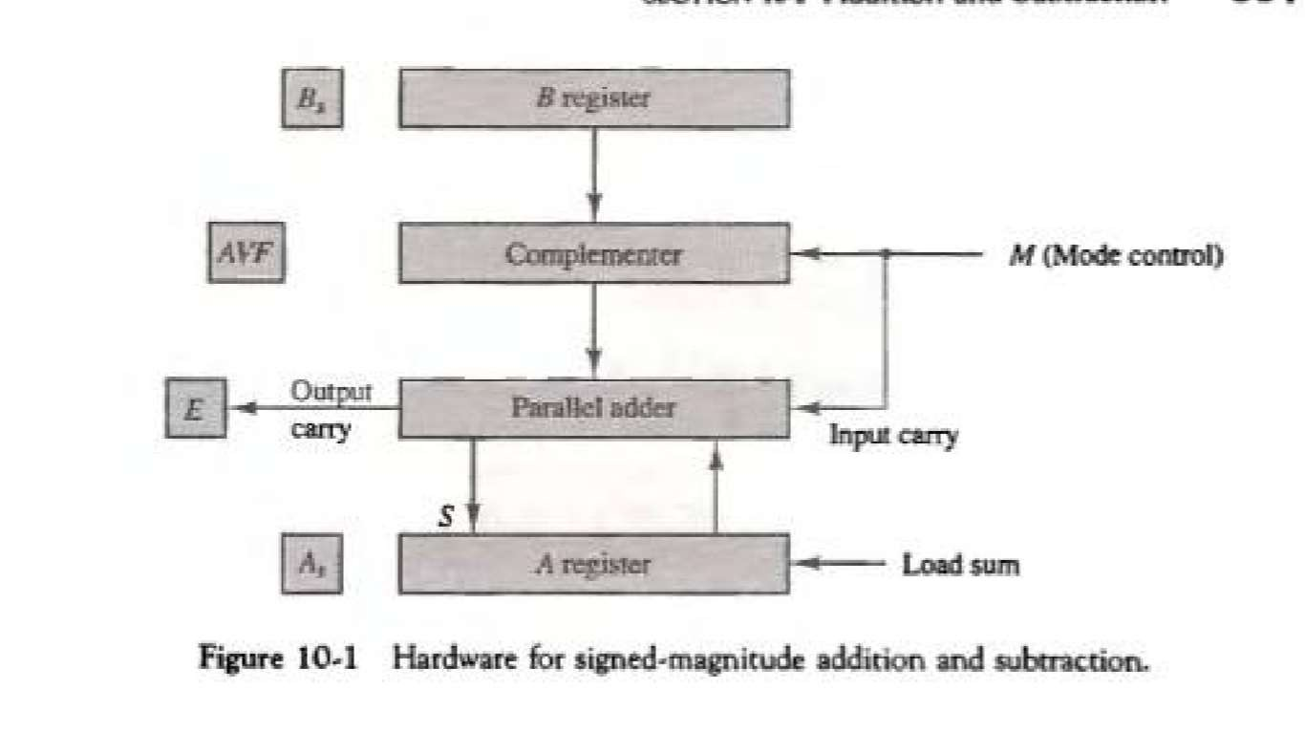
The output carry is transferred to flip-flop E.
The complementer consists of exclusive-OR gates and the parallel adder consists of full adder circuit.

Slide 10
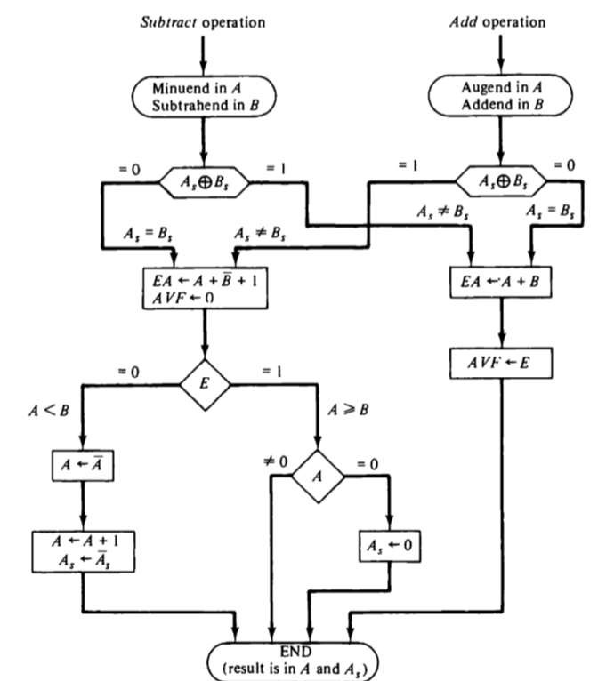
Hardware algorithm

Slide 11
The two signs A_{s} and B_{s} are compared by an exclusive-OR gate .
For an add operation, identical signs dictate that the magnitudes be added, for subtract operation different signs dictate that the magnitudes be added. The magnitudes are added with a micro operation E A←A+B.. Where E A is a register that combines E and A .
For A 0 indicates that A<B, for this case it is necessary to take the 2’s compliment of the value in A .this operation can be done with one micro operation A←Ā+1.
However , we assume that A register as circuits for micro operation compliment and increment, so the 2’s compliment is obtain from these two micro operations…
The value in AVF provides an overflow indication. The final value of E is immaterial.

Slide 12
Addition and Subtraction with signed2’s complement data
The left most bit of binary number represents the sign bit; 0 for positive and 1 for negative. If the sign bit is 1, the entire the entire number is represented in 2’s compliment form.
The addition of two numbers in signed-2’s complement form consists of adding the number with the sign bits treated the same as the other bits of the number . A carry out of the sign bit position is discarded .
The subtraction consists of first taking the 2’s compliment of the subtrahend and then adding it to the minuend
When two numbers of n digits each are added and the sum occupies n+1 Digits,
we say that an overflow occurred.
When the two carries are applied to an exclusive-OR gate, the overflow is detected when the output of the gate is equal to 1.

Slide 13
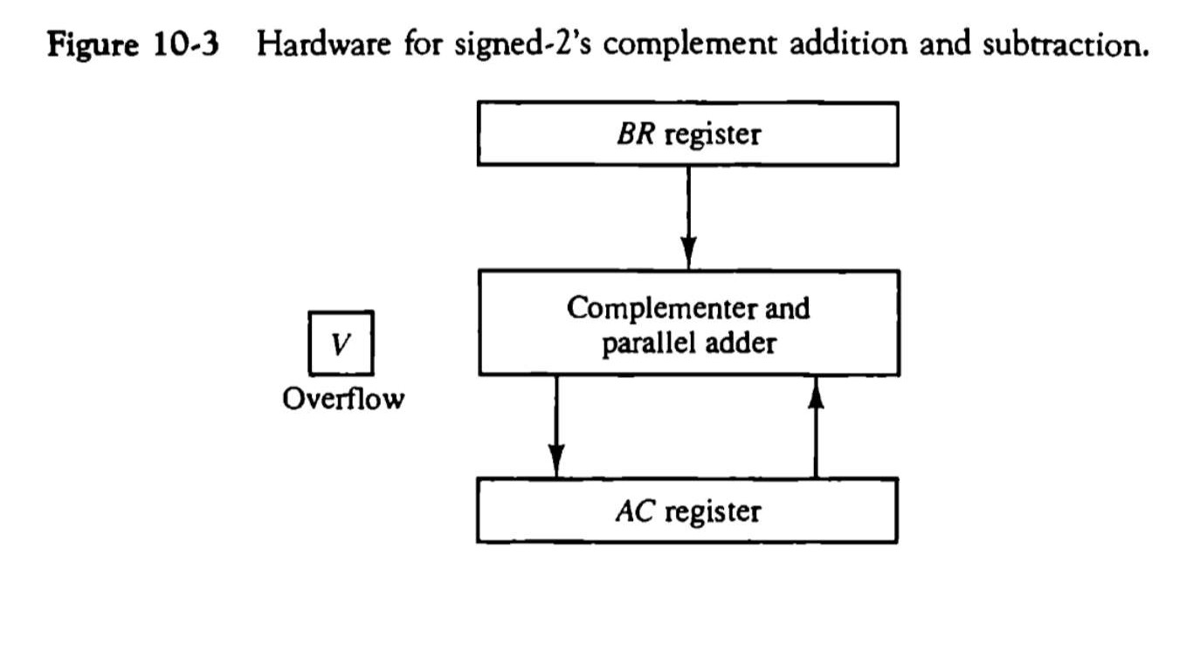
◆ The left most bit in AC and BR represents the sign bits of the numbers
◆ The over flow flip-flops V is set to 1 if there is an overflow. The output carry in this case is discarded.

Slide 14
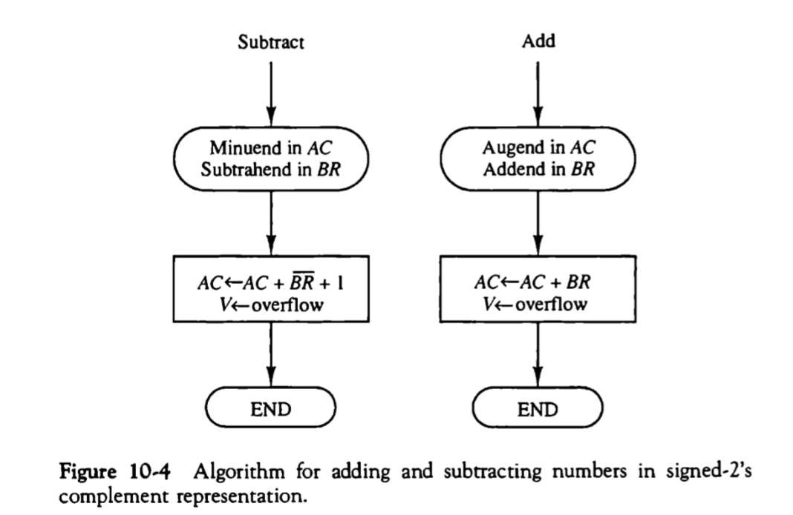
◆ The sum is obtained by adding the contents of AC and BR(including their sign bits). The overflow bit V is set to 1 if the ex-OR of the last two carries is 1,and it is cleared to 0 otherwise.

Slide 15
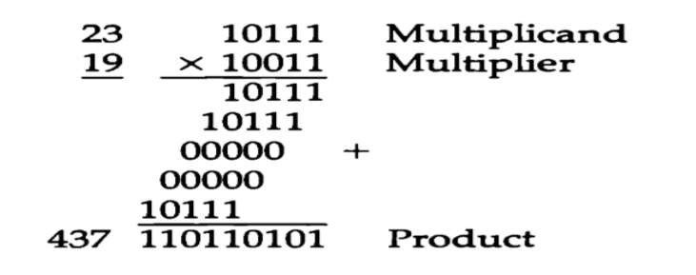
Multiplication algorithms:-
multiplication of two fixed point binary numbers in signed magnitude representation is done with paper and pencil of successive shift and add operation
if the multiplier bit is a 1,the multiplicand is copied down; otherwise zero are copied down.

Slide 16
Hardware Implementation for Signed-Magnitude data
◆ When multiplication is implemented in a digital computer, it is convenient to change the process slightly. First instead of providing register to store and add simultaneously as many binary numbers as there are bits in the multiplier , as it is convenient to provide an adder for the summation of only two binary numbers and successively accumulate the partial products in a register. Second instead of shifting the multiplicand to the left , the partial product is shifted to the right
◆ The hardware for multiplication consists of the equipment shown in fig. plus two are more registers.
◆ These registers are together with registers A and B..
◆ The multiplier stored in the Q register and its sign in Q_{s} The sequence counter SC is initially set to a number equal to the number of bits in the multiplier. The counter is decremented by 1 after forming each partial product
◆ The sum of A and B forms a partial product which is transferred to the EA
register .

Slide 17
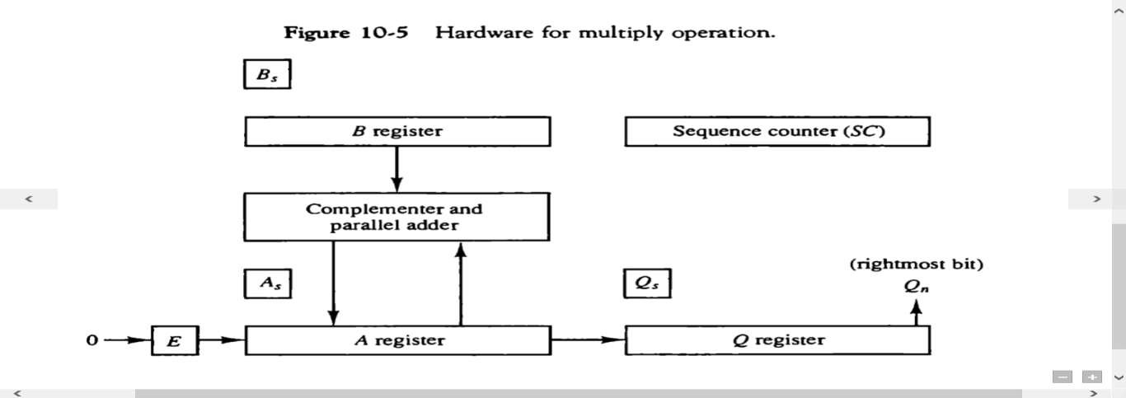
The shift will be denoted by the statement shr EAQ to designate the
right shift depicted .
The least significant bit of A is shifted into the most significant position of Q.

Slide 18
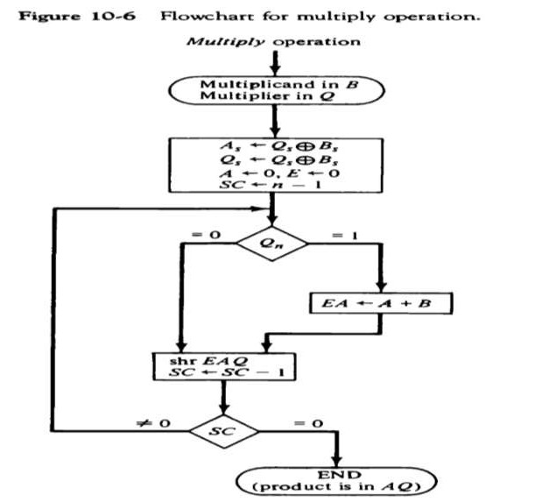
Hardware Algorithm
Below fig.is a flowchart of the hardware multiply algorithm.. Initially the multiplicand is in B and the multiplier in Q there corresponding signs are in B_{s} and Q_{s} .,respectively.
Register A and E are cleared and the sequence counter SG is set to a number equal to the number of bits of the multiplier.
After the initialization , the low order bit of the multiplier is in Qn is tested .if it is 1,the multiplicand In B is added to the present partial product in A . If it is 0, nothing is done .
Register EAQ shifted once to the right to form the new partial product.
The process stops when SC=0.
Note that the partial product formed in A is shifted into Q
one bit at a time and eventually replaces multiplier.
The final product is available in both A and Q,with A holding the most significant bits and Q holding the least significant bits.

Slide 19

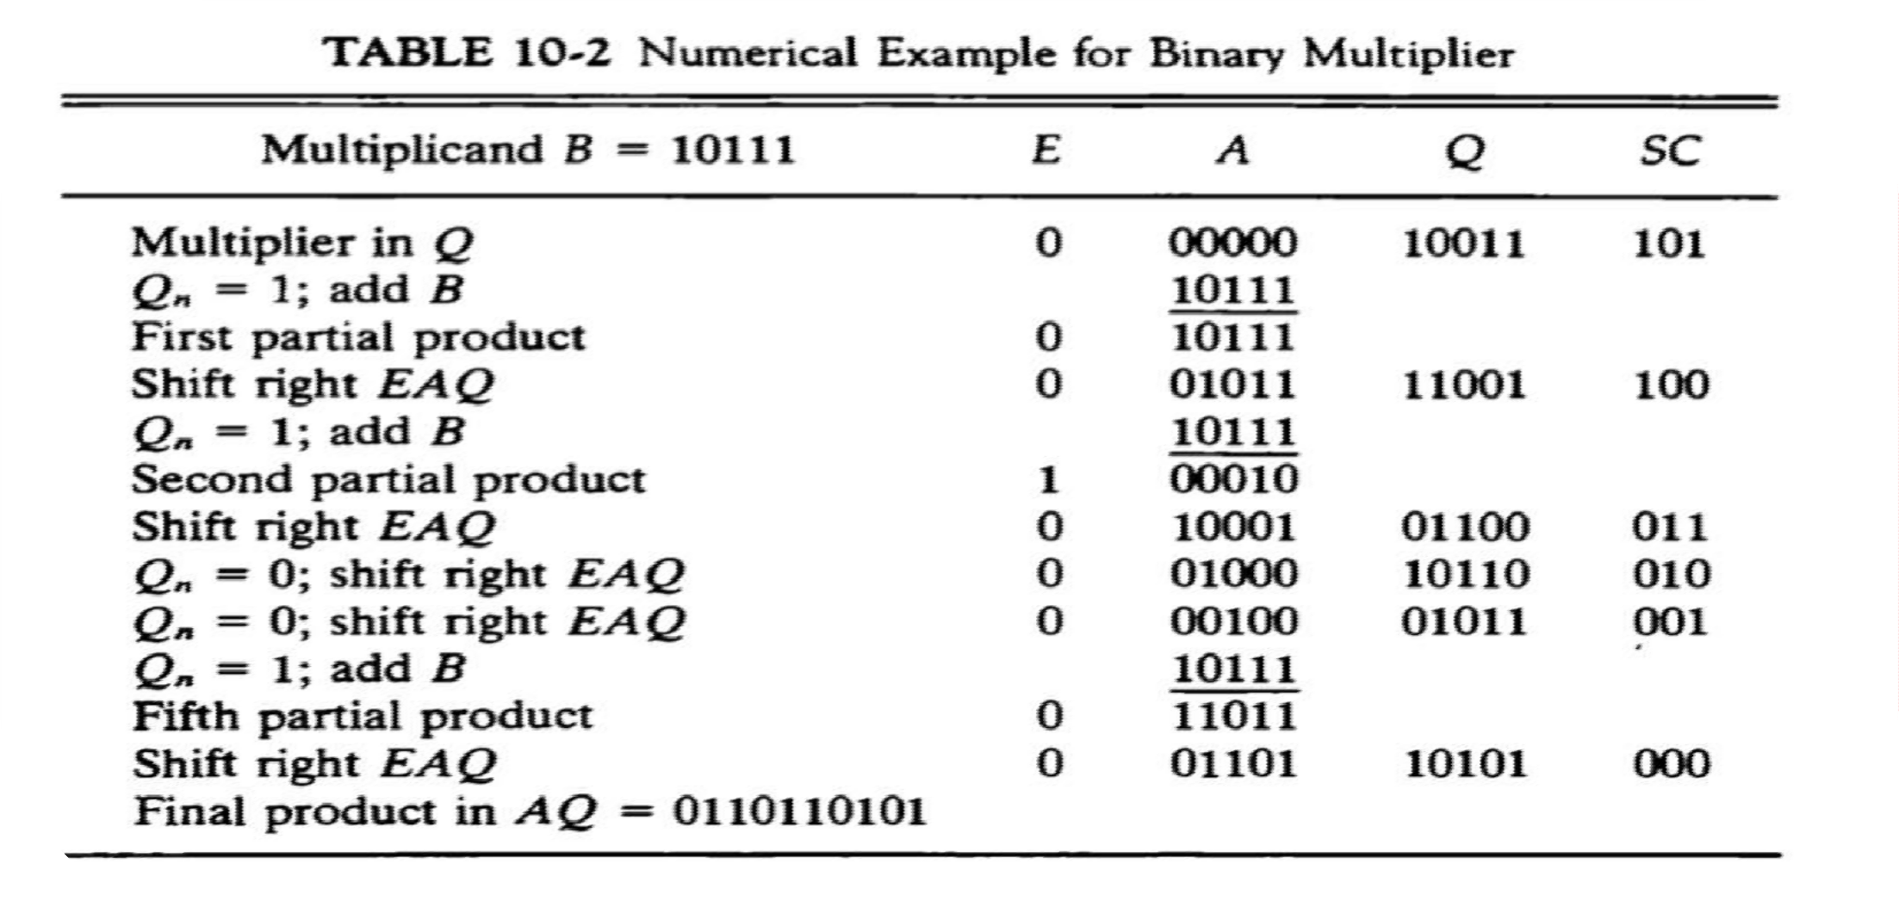
Booth Multiplication Algorithm
◆ Booth Algorithm gives a procedure for multiplying binary integers in signed-2’s compliment
representation .

Slide 20
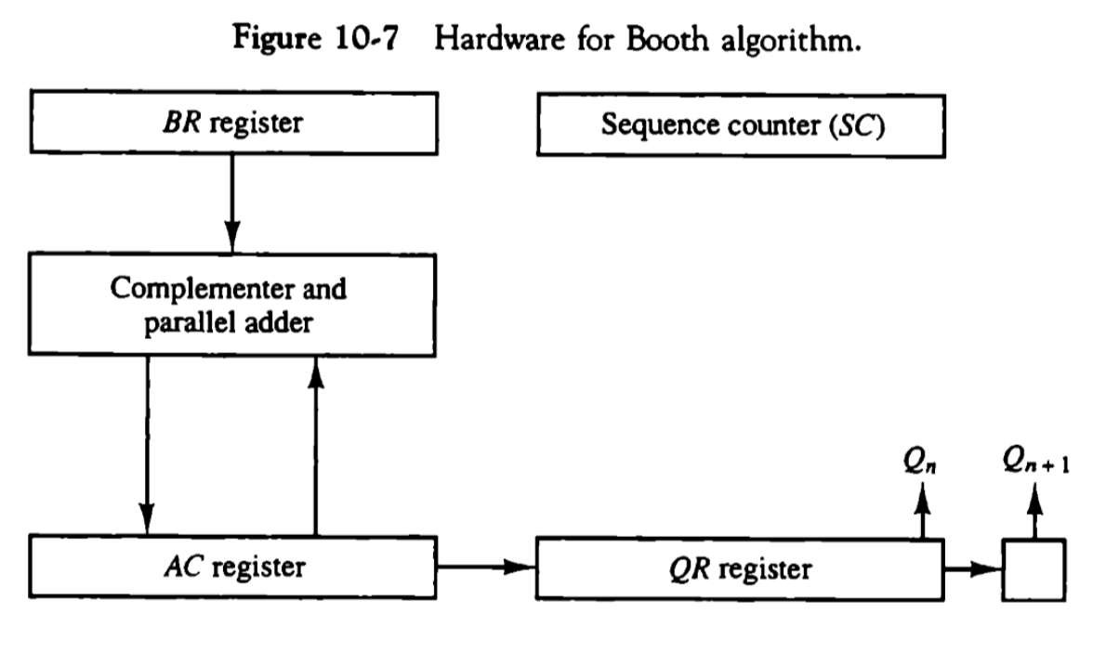
Hardware for booth algorithm
◆ The algorithm requires the register configuration as shown in fig.

Slide 21
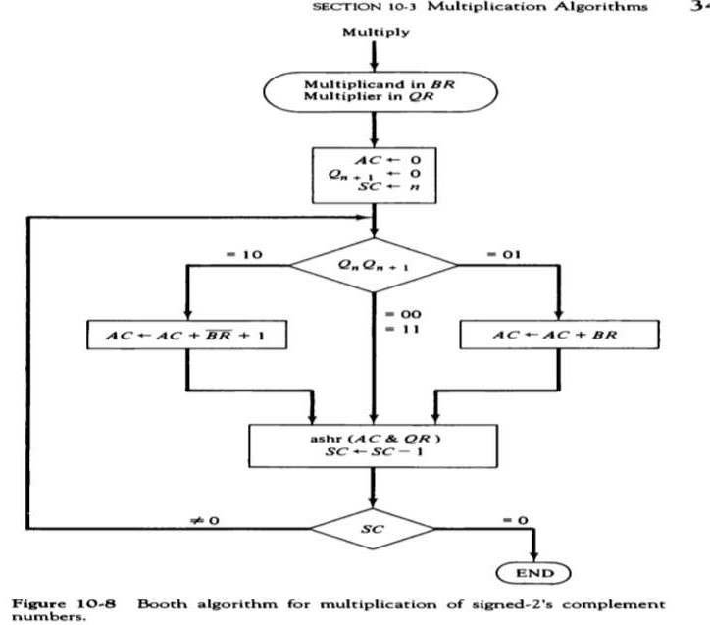
Booth algorithm for multiplication of signed-2’s compliment
The two bits of multiplier in Qn and Qn+1 are inspected . If the two bits are equal to 10 it means that the first 1 in a string of 1’s has been encountered
The final value of Qn+1 is the original sign bit of the multiplier and should not be take as part of the product
n

Slide 22

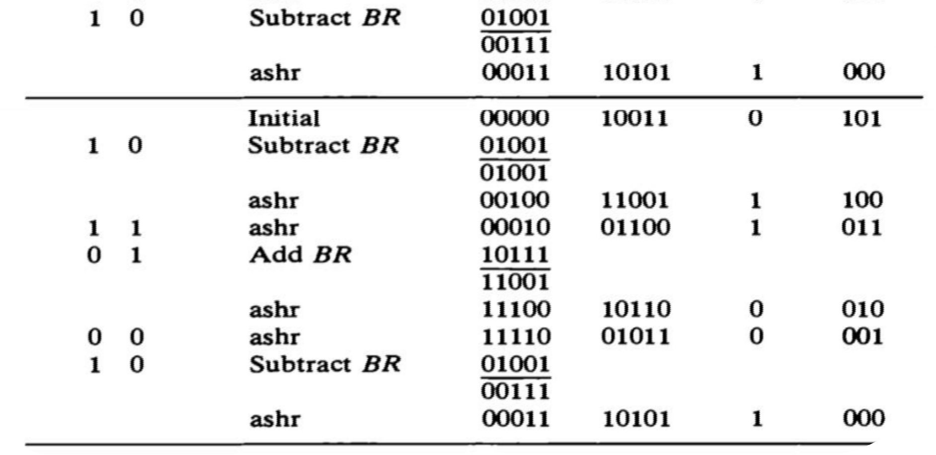
Array multiplier
◆ The multiplication of the two binary numbers can be done with one micro-operation by means of a combinational circuit that forms the product bits all at once. This is a fast way of multiplying two numbers since all it takes is the time for the signals to propagate through the gate that form the multiplication array.

Slide 23
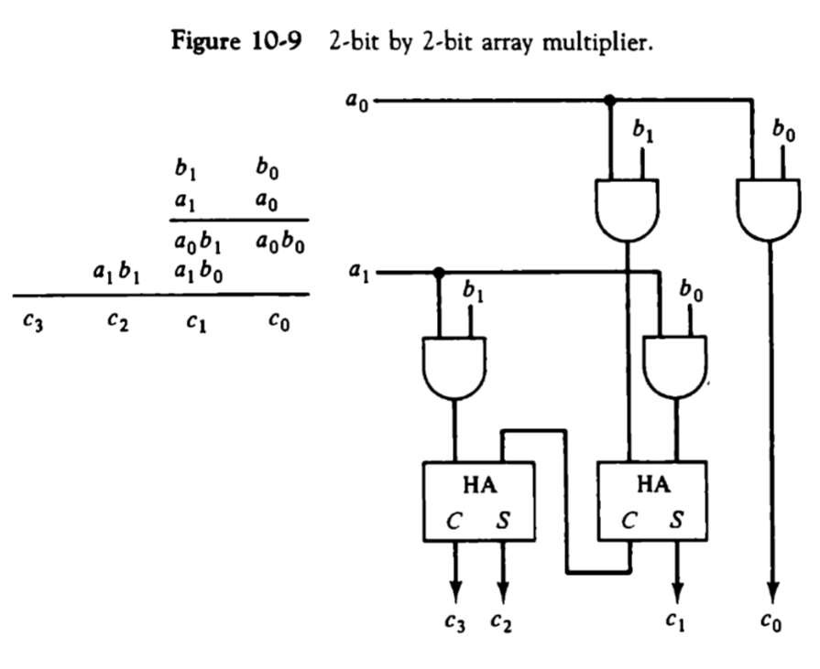
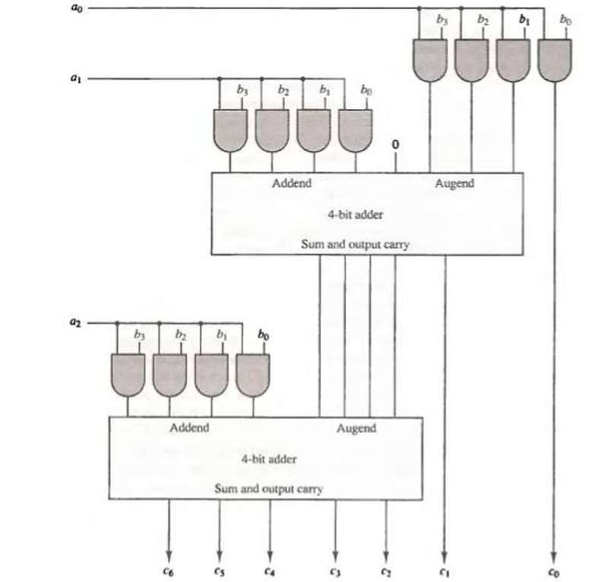
4 bit by 3 bit array multiplexer

Slide 24

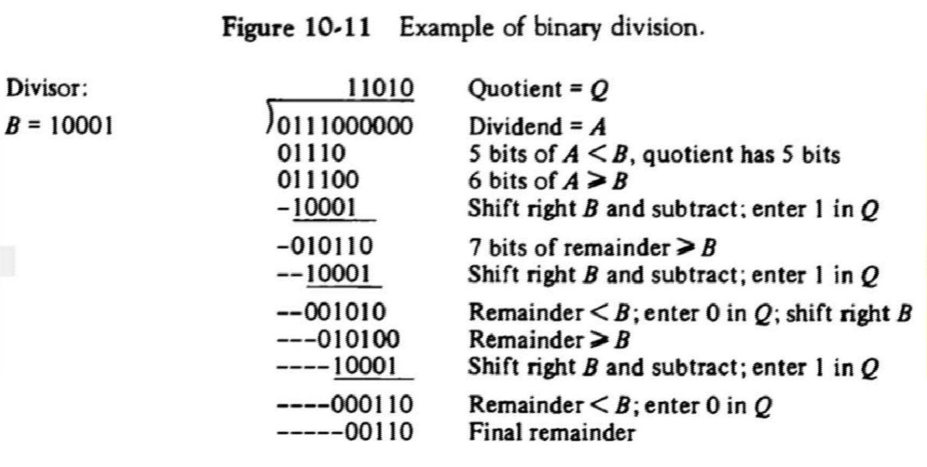
Division Algorithm
◆ Division of two fixed-point binary numbers in signed magnitude representation is done with paper and pencil by a process of successive compare ,shift ,and subtract operations ..
Hardware implantation of signed magnitude data

Slide 25
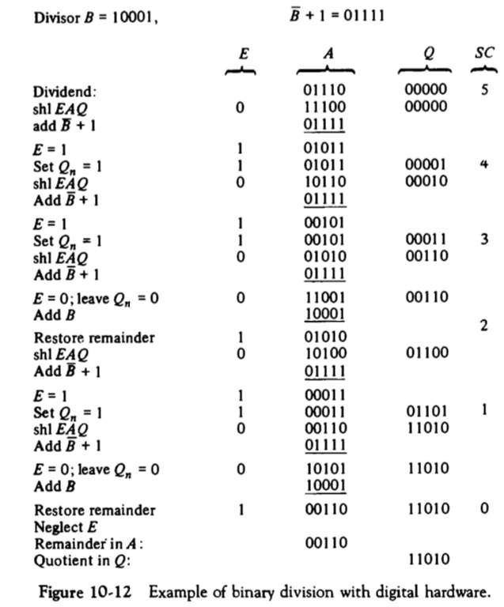
Example of binary division with digital hardware
Instead of shifting the divisor to the right, the dividend or partial remainder, is shifted to the left, thus leaving the two numbers in the required relative position, subtraction may be achieved by adding A to the 2’s compliment of B.
EAQ is shifted to the left with 0 instead of Qn and the previous value of E lost.
The divisor is stored in the B register and the double
length dividend is stored in register A and Q
The information about relative magnitude is available in E. if E=1,it signifies that A ≥B. A quotient bit 1 is inserted into Qn and the partial remainder is shifted left to repeat the process. If E=0, it signifies that A<B so the quotient in Qn remains a 0.
The sign of the remainder is the same as the sign of the dividend .

Slide 26
Divide overflow
◆ This occurs because any dividend will be greater than or equal to zero.
◆ Over flow condition is usually detected when a special flip-flop is set .
Which will call it a divide overflow flip-flop and label it DVF
◆ The occurrence of a divide overflow can be handled in variety of ways
◆ In some computers it is the responsibility of the programmers to check if DVF is set after each divide instruction
◆ The occurrence of a divide overflow stopped the computer and this condition was referred to as a DIVIDE STOP.
◆ The best way to avoid a divide overflow is to use floating point data
◆ The divide overflow can be handled very simply if numbers are in floating point representation.

Slide 27
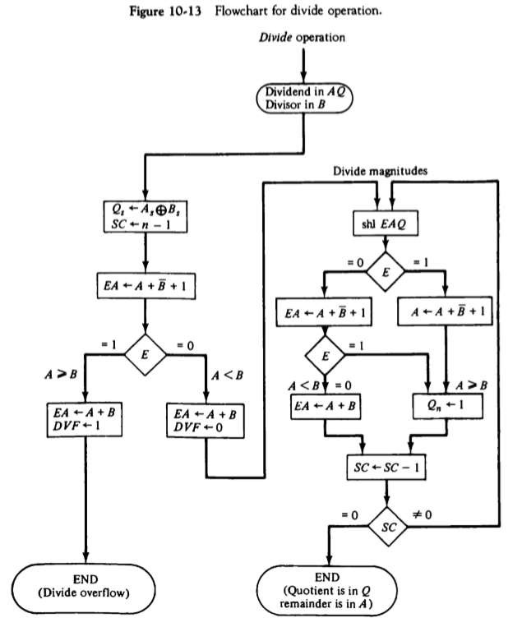
Hardware algorithm
The dividend is in A and Q and the divisor in B. The sign of the results transferred into Qs to be part of quotient.
A divide overflow condition is tested by subtracting divisor in B from half of the bits of the dividend stored in A. if A≥B, the divide overflow flip-flop DVF set and the operation is terminated prematurely.
By doing the process as shown in the flowchart the quotient magnitude is formed in register Q and the remainder is found in the register A. The quotient sign is in Qs and the sign of the remainder in As is the same as the original sign of the dividend.

Slide 28
What is restoring method?
The hardware method just described is called the RESTORING METHOD. The reason for the name is that the partial remainder is restored by adding the divisor to the negative difference. Two other methods are available for dividing numbers, the COMPARISION method and the NONRESTORING method. In the comparison method A and B are compared prior to the subtraction operation .
◆ No restoring method B is not added if the difference is negative but
instead, the negative difference is shifted left and then B is added.
◆

Slide 29
Floating point Arithmetic operation
◆ Floating point number in computer register consists of two parts: a mantissa m and exponent e --------> m X r^{e}
◆ A floating point number that has a 0 in the most significant position of the mantissa is said to have an UNDERFLOW. To normalize a number that contains an underflow, it is necessary to shift the mantissa to the left and decrement the exponent until a nonzero digit appears in the first position.
Register configuration
The register configuration for floating point operation is quite similar to the layout for fixed point operation. As a general rule, the same register and adder used for fixed point arithmetic are used for processing the mantissas. The difference lies in the way the exponents are handled.

Slide 30
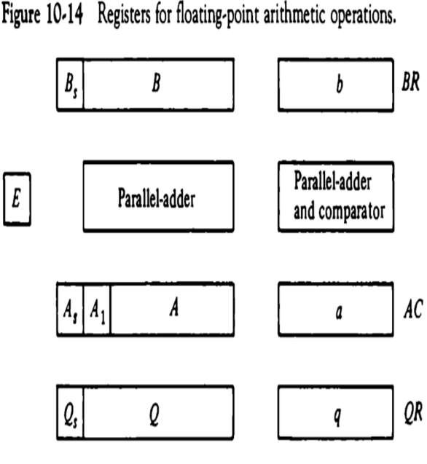
Register organization
There are three registers, BR, AC,and QR. Each register is subdivided into two parts. The mantissa part has same upper case letters, the exponent part uses the corres- ponding lower case letters.
A parallel adder adds the two mantissas and transfers the sum into A and the carry into E. A separate parallel adder is used for the exponents. Since the exponents are biased.

Slide 31
Addition and subtraction
◆ During addition and subtraction , the two floating point operands are in AC and BR. The sum of difference is formed in the AC . The algorithm can be divided into four consecutive parts :
Check for zeros.
Align the mantissa.
Add or subtract the mantissa.
Normalize the result.

Slide 32
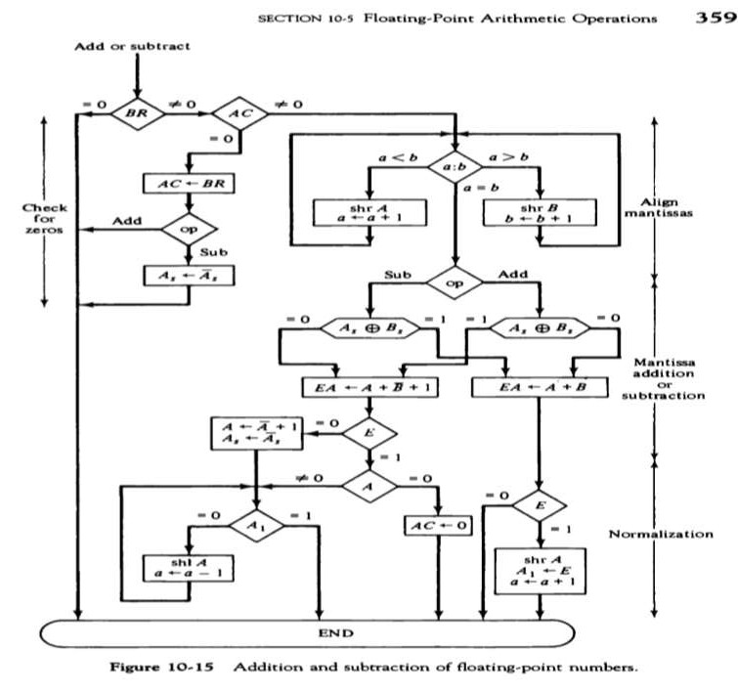

Slide 33
Multiplication
◆ The multiplication of two floating point numbers requires that we multiply the mantissas and add the exponents. No comparison of exponents or alignment of mantissa is necessary.
◆ The multiplication of the mantissa is performed same as fixed point to
provide a double precision product.
◆ The multiplication algorithm can be subdivided into four parts :-
Check for zeros.
Add the exponents.
Multiply the mantissa.
Normalize the product.

Slide 34
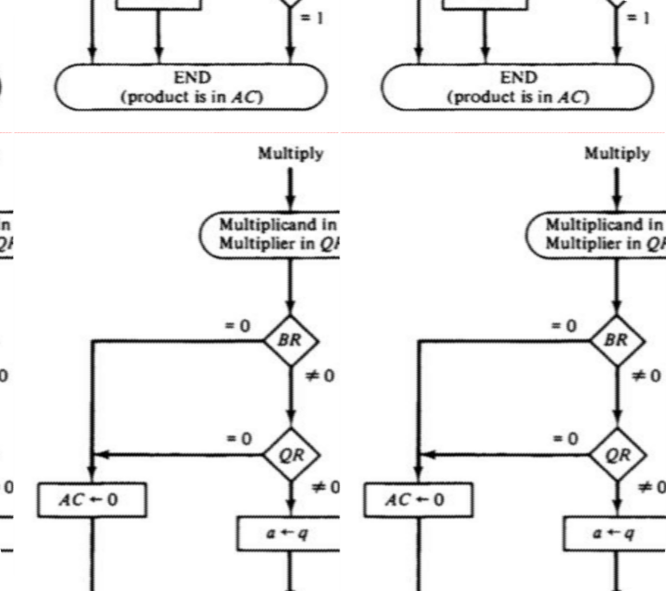
Multiplication of floating point numbers

Slide 35
Division
◆ Floating point division requires that the exponents be subtracted and the mantissa divided. The mantissa division is done as in fixed point except that the dividend has a single precision mantissa that is placed in the AC.
◆ The division algorithm can be divided into five parts..
Check for zeros.
Initialize registers and evaluate the sign.
Align the dividend
Subtract the exponents.
Divide the mantissa.

Slide 36
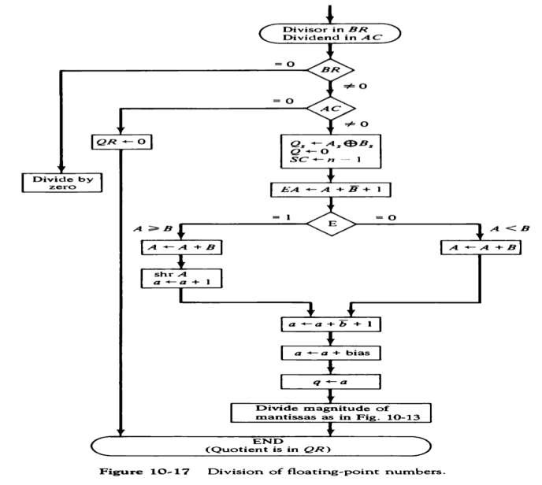
Decimal arithmetic unit

Slide 37

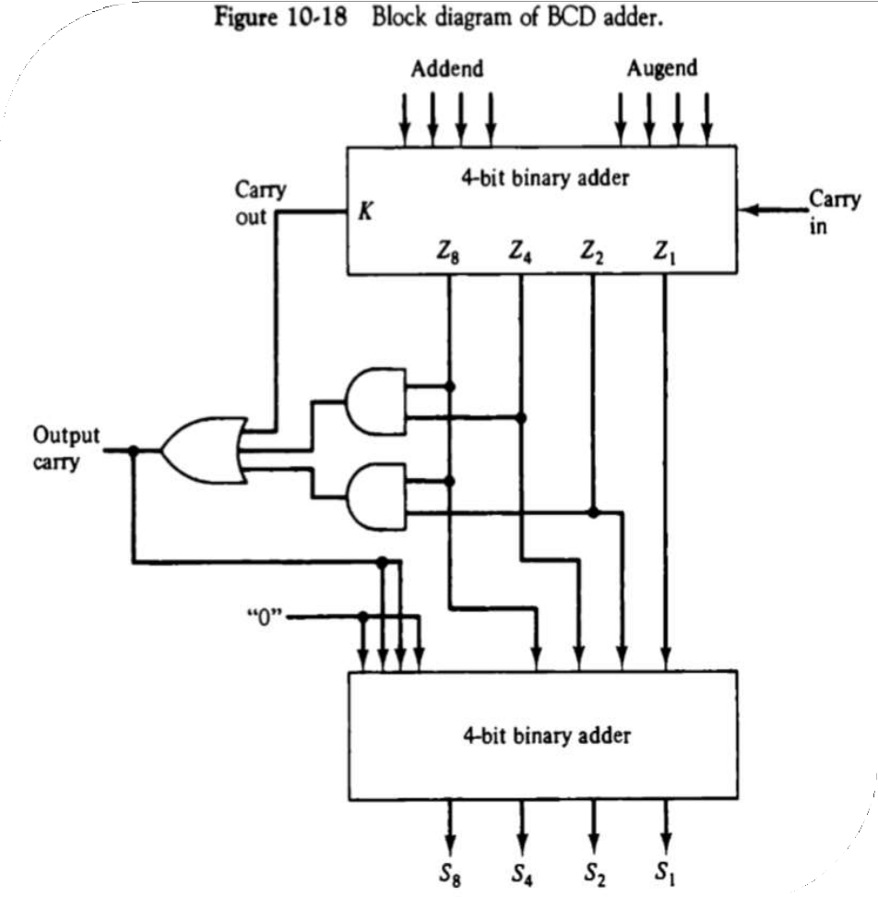
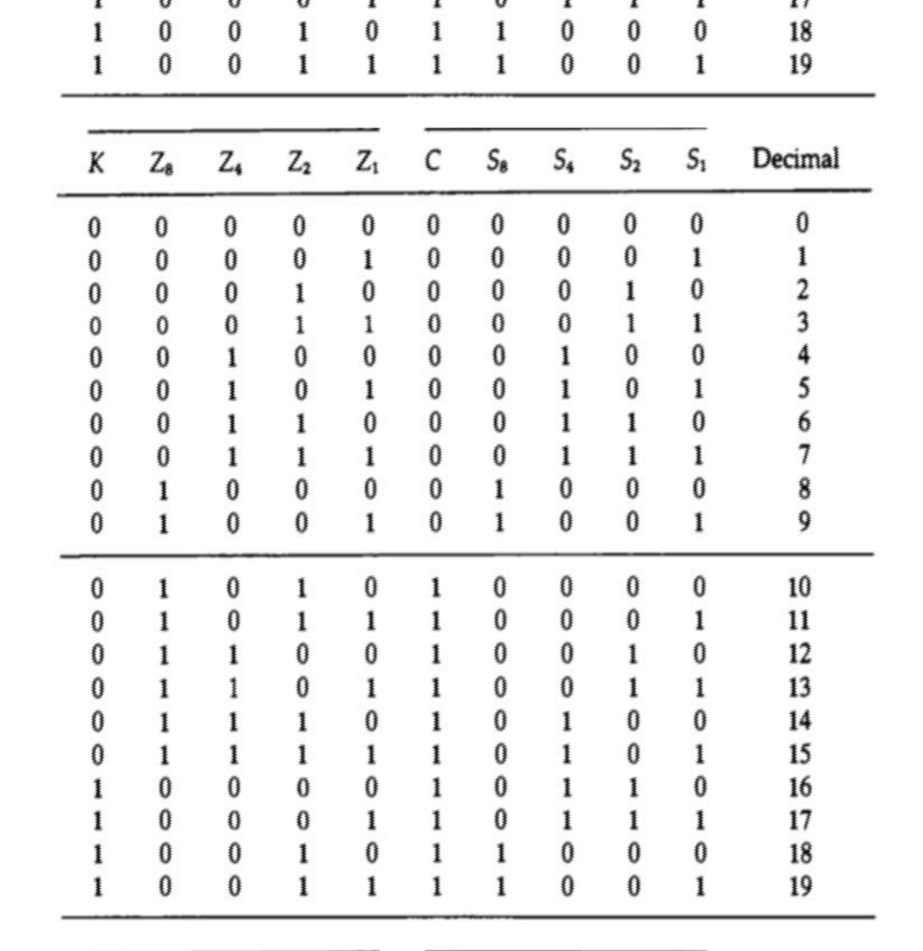
BCD Adder

Slide 38
BCD Subtraction
◆ A straight subtraction of two decimal numbers will require a subtractor circuit that will be somewhat different from a BCD adder.
◆ It is more economical to perform the subtraction by taking the 9’s or 10’s complement of the subtrahend and adding it to the minuend. Since the BCD is not a self-compleme- nting code
◆ The Boolean functions for the 9’s complement circuit are x1 = B1M’+B1’M
x2 = B2
x4 = B4M’ + (B4’B2 + B4B2’)M x8 = B8M’ + B8’B4’B2’M
from these equations we see that x=B when M=0. when M=1,the x output
produce the 9’s compliment of B

Slide 39
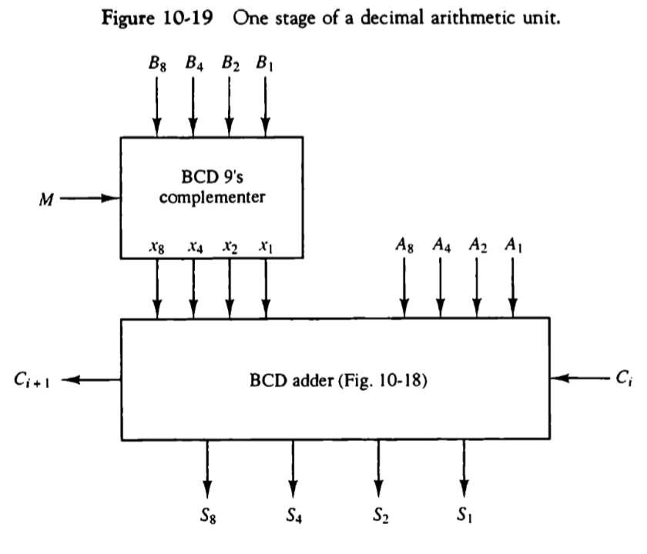
Decimal Arithmetic operation
◆ The algorithms for arithmetic operations with decimal data are similar to the algorithms
for the corresponding operations with binary data.

Slide 40
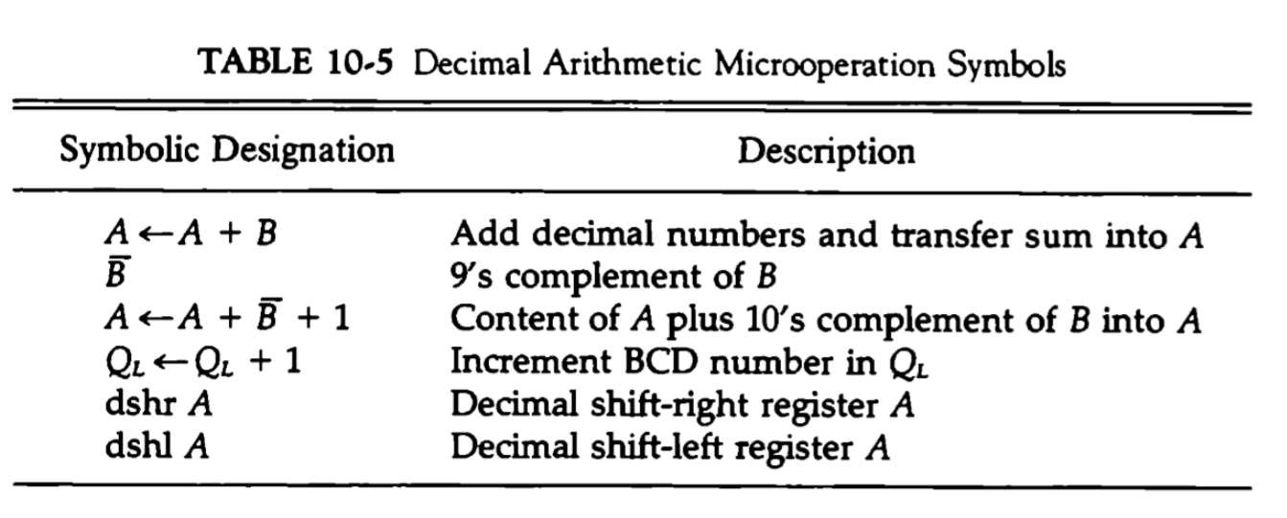
Decimal arithmetic micro operation symbols

Slide 41
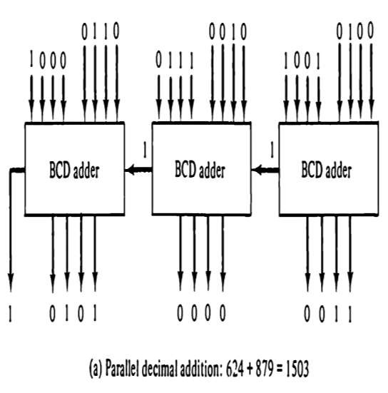
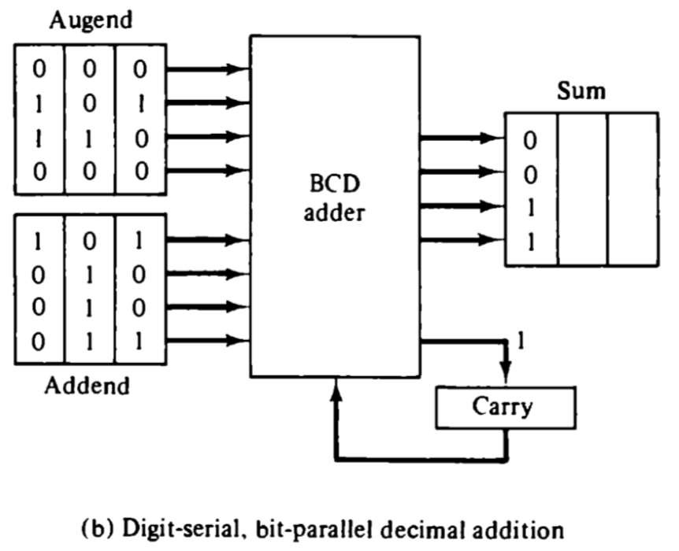
Addition and Subtraction

Slide 42

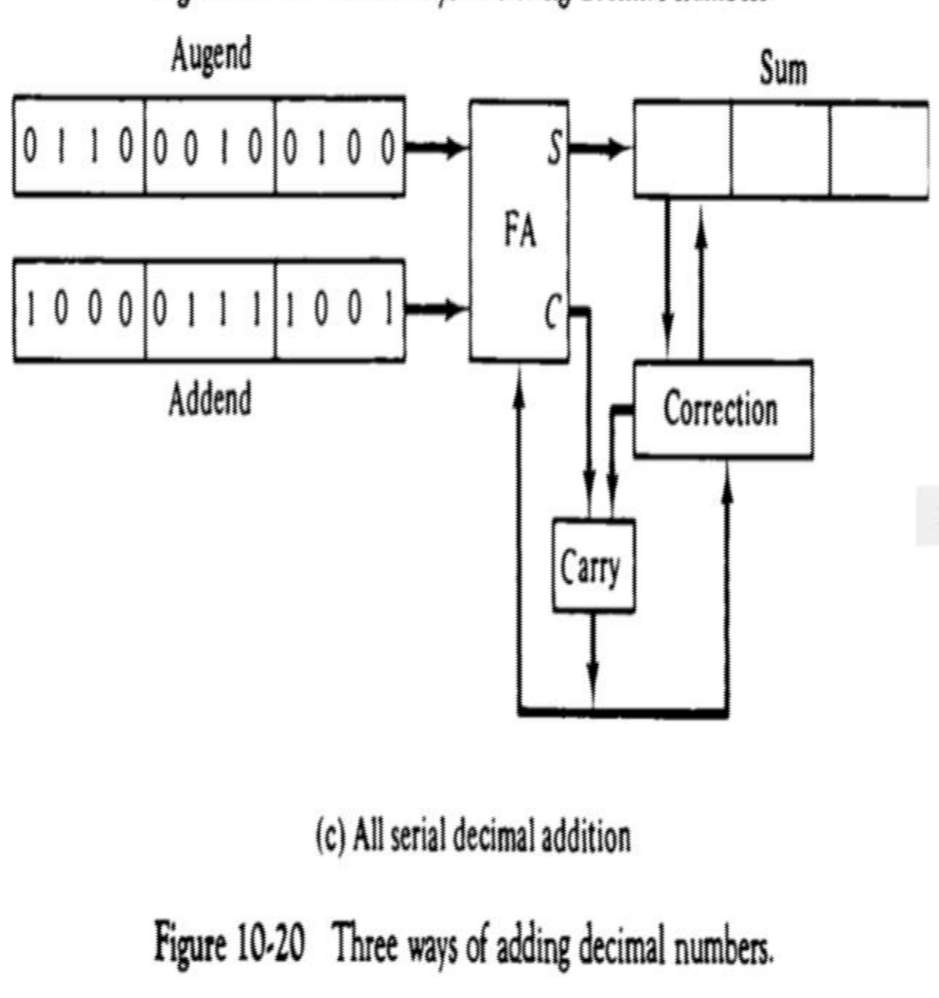
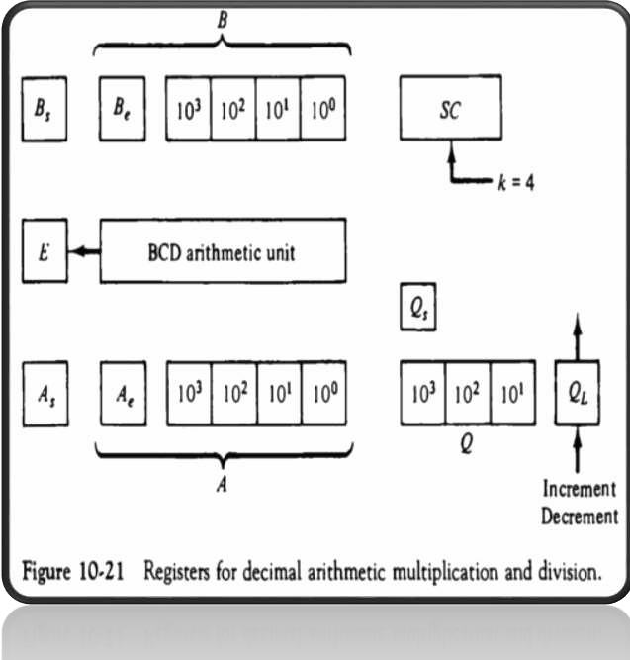

Slide 43


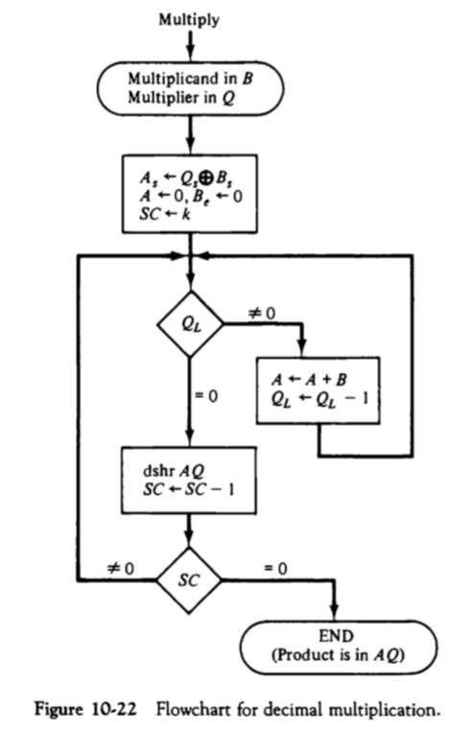

Slide 44


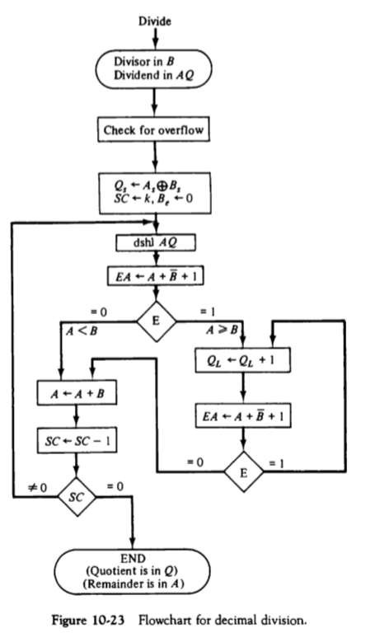

Slide 45
I/O Organization
Presented By:
Navneet Kaur Randhawa Lect. I.T. Deptt.
GPC,Amritsar

Slide 46
Contents
I/O Organization
Input-Output Interface
Asynchronous Data Transfer
Asynchronous Serial Transmission
Modes of Data Transfer
Programmed I/O
Interrupt-Initiated I/O
Direct Memory Access (DMA)

Slide 47
I/O Organization
The Input / output organization of computer depends upon the size of computer and the peripherals connected to it. The I/O Subsystem of the computer,
provides between
an efficient the central
mode of communication system and the outside
environment.

Slide 48
I/O Organization
The most common input output devices are:
Monitor
Keyboard
Mouse
Printer
Magnetic tapes
The devices that are under the direct control of the computer are said to be connected online.

Slide 49
Input - Output Interface
Input Output Interface provides a method for transferring information between internal storage and external I/O devices. Peripherals connected to a computer need special communication links for interfacing them with the central processing unit.

Slide 50
Input - Output Interface
The purpose of communication link is to resolve the differences that exist between the central computer and each peripheral.

Slide 51
The Major Differences are:-
Peripherals are electromechnical and electromagnetic devices and their manner of operation of the CPU and memory, which are electronic devices. Therefore, a conversion of signal values may be needed.
The data transfer rate of peripherals is usually slower than the transfer rate of CPU and consequently, a synchronization mechanism may be needed.

Slide 52
The Major Differences are:-
Data codes and formats in the peripherals differ from the word format in the CPU and memory.
The operating modes of peripherals are different from each other and must be controlled so as not to disturb the operation of other peripherals connected to the CPU.

Slide 53
Input - Output Interface
To Resolve these differences, computer systems include special hardware components between the CPU and Peripherals to supervises and synchronizes all input and out transfers. These components are called Interface Units because they interface between the processor bus and the peripheral devices.

Slide 54
I/O BUS and Interface Module
It defines the typical link between the processor and several peripherals. The I/O Bus consists of data lines, address lines and control lines. The I/O bus from the processor is attached to all peripherals interface. To communicate with a particular device, the processor places a device address on address lines.

Slide 55
I/O BUS and Interface Module
Each Interface decodes the address and control received from the I/O bus, interprets them for peripherals and provides signals for the peripheral controller. It is also synchronizes the data flow and supervises the transfer between peripheral and processor. Each peripheral has its own controller. For example, the printer controller controls the paper motion, the print timing.

Slide 56
I/O BUS and Interface Module
The control lines are referred as an I/O command. The commands are as following:
Control command- A control command is issued to activate the peripheral and to inform it what to do.
Status command- A status command is used to test various status conditions in the interface and the peripheral.

Slide 57
I/O BUS and Interface Module
Output data command- A data output command causes the interface to respond by transferring data from the bus into one of its registers.
Input data command- The data input command is the opposite of the data output. In this case the interface receives on item of data from the peripheral and places it in its buffer register.

Slide 58
I/O BUS and Interface Module
Processor
Data
Address
Control
Interface
Interface
Interface
Keyboard and display terminal
Printer
Magnetic disk
Connection of I/O bus to input-output devices

Slide 59
I/O Versus Memory Bus
To communicate with I/O, the processor must communicate with the memory unit. Like the I/O bus, the memory bus contains data, address and read/write control lines. There are 3 ways that computer buses can be used to communicate with memory and I/O:
Use two Separate buses , one for memory and other for I/O.
Use one common bus for both memory and I/O but separate control lines for each.
Use one common bus for memory and I/O with common control lines.

Slide 60
I/O Processor
In the first method, the computer has independent sets of data, address and control buses one for accessing memory and other for I/O. This is done in computers that provides a separate I/O processor (IOP). The purpose of IOP is to provide an independent pathway for the transfer of information between external device and internal memory.

Slide 61
Asynchronous Data Transfer
This Scheme is used when speed of I/O devices do not match with microprocessor, and timing characteristics of I/O devices is not predictable. In this method, process initiates the device and check its status. As a result, CPU has to wait till I/O device is ready to transfer data. When device is ready CPU issues instruction for I/O transfer. In this method two types of techniques are used based on signals before data transfer.
Strobe Control
Handshaking

Slide 62
Strobe Signal
The strobe control method of Asynchronous data transfer employs a single control line to time each transfer. The strobe may be activated by either the source or the destination unit.

Slide 63
Data Transfer Initiated by Source Unit
Source Unit | Data Bus
 | Strobe
Destination Unit
(a) Block Diagram
Data
Valid data
Strobe
(b) Timing Diagram
Source-Initiated strobe for Data Transfer

Slide 64
Data Transfer Initiated by Source Unit
In the block diagram fig. (a), the data bus carries the binary information from source to destination unit. Typically, the bus has multiple lines to transfer an entire byte or word. The strobe is a single line that informs the destination unit when a valid data word is available.
The timing diagram fig. (b) the source unit first places the data on the data bus. The information on the data bus and strobe signal remain in the active state to allow the destination unit to receive the data.

Slide 65
Data Transfer Initiated by Destination Unit
Source Unit
Data Bus Strobe | Destination Unit
(a) Block Diagram
Data
Valid data
Strobe
(b) Timing Diagram
Destination-Initiated strobe for Data Transfer

Slide 66
Data Transfer Initiated by Destination Unit
In this method, the destination unit activates the strobe pulse, to informing the source to provide the data. The source will respond by placing the requested binary information on the data bus.
The data must be valid and remain in the bus long enough for the destination unit to accept it. When accepted the destination unit then disables the strobe and the source unit removes the data from the bus.

Slide 67
Disadvantage of Strobe Signal
The disadvantage of the strobe method is that, the source unit initiates the transfer has no way of knowing whether the destination unit has actually received the data item that was places in the bus. Similarly, a destination unit that initiates the transfer has no way of knowing whether the source unit has actually placed the data on bus. The Handshaking method solves this problem.

Slide 68
Handshaking
The handshaking method solves the problem of strobe method by introducing a second control signal that provides a reply to the unit that initiates the transfer.

Slide 69
Principle of Handshaking
The basic principle of the two-wire handshaking method of data transfer is as follow:
One control line is in the same direction as the data flows in the bus from the source to destination. It is used by source unit to inform the destination unit whether there a valid data in the bus. The other control line is in the other direction from the destination to the source. It is used by the destination unit to inform the source whether it can accept the data. The sequence of control during the transfer depends on the unit that initiates the transfer.

Slide 70
Source Initiated Transfer using Handshaking
The sequence of events shows four possible states that the system can be at any given time. The source unit initiates the transfer by placing the data on the bus and enabling its data valid signal. The data accepted signal is activated by the destination unit after it accepts the data from the bus. The source unit then disables its data accepted signal and the system goes into its initial state.

Slide 71
Handshaking
Source Unit | Data Bus
 | Data Valid
 | Data accepted
Destination Unit
(a) Block Diagram
Source unit
Destination Unit
Place the data on bus.
Enable data Valid.
Accept data from bus.
Enable data accepted.
Disable data valid.
Invalidate data on bus.
Disable data accepted. Ready to accept data.
(b) Sequence of events

Slide 72
Destination Initiated Transfer Using Handshaking
The name of the signal generated by the destination unit has been changed to ready for data to reflects its new meaning. The source unit in this case does not place data on the bus until after it receives the ready for data signal from the destination unit. From there on, the handshaking procedure follows the same pattern as in the source initiated case.
The only difference between the Source Initiated and the Destination Initiated transfer is in their choice of Initial sate.

Slide 73
Destination Unit
Source Unit | Data Bus
 | Data Valid
 | Ready for data
(a) Block Diagram
Destination Unit
Source unit
Ready to accept data. Enable ready for data.
Place the data on bus.
Enable data Valid.
Accept data from bus. Disable ready for data.
Disable data valid.
Invalidate data on bus.
(b) Sequence of events
Destination-Initiated transfer using Handshaking

Slide 74
Advantage of the Handshaking method
The Handshaking scheme provides degree of flexibility and reliability because the successful completion of data transfer relies on active participation by both units.
¬
If any of one unit is faulty, the data transfer will not be completed. Such an error can be detected by means of a Timeout mechanism which provides an alarm if the data is not completed within time.
¬

Slide 75
Asynchronous Serial Transmission
The transfer of data between two units is serial or parallel. In parallel data transmission, n bit in the message must be transmitted through n separate conductor path. In serial transmission, each bit in the message is sent in sequence one at a time.
Parallel transmission is faster but it requires many wires. It is used for short distances and where speed is important. Serial transmission is slower but is less expensive.

Slide 76
Asynchronous Serial Transmission
In Asynchronous serial transfer, each bit of message is sent a sequence at a time, and binary information is transferred only
when it is available. When there is no information transferred, line remains idle.
In this technique each character consists of three points :
to be
Start bit
Character bit
Stop bit

Slide 77
Asynchronous Serial Transmission
ii. Stop Bit- Last bit, called stop bit is always one and used to indicate end of characters. Stop bit is always in the 1- state and frame the end of the characters to signify the idle or wait state.
Character Bit- Bits in between the start bit and the stop bit are known as character bits. The character bits always follow the start bit.
Start Bit- First bit, called start bit is always zero and used to indicate the beginning character.
i.
iii.

Slide 78
Asynchronous Serial Transmission
 | 0 | 1 | 1 | 0 | 0 | 0 | 1 | 0 | 1
Start
bit
Stop bits
Character bits
Asynchronous Serial Transmission

Slide 79
Asynchronous Serial Transmission
Serial Transmission of Asynchronous is done by two ways:
Asynchronous Communication Interface
First In First out Buffer

Slide 80
Asynchronous Communication Interface
It works as both a receiver and a transmitter. Its operation is initialized by CPU by sending a byte to the control register.
The transmitter register accepts a data byte from CPU through the data bus and transferred to a shift register for serial transmission.
The receive portion receives information into another shift register, and when a complete data byte is received it is transferred to receiver register.
CPU can select the receiver register to read the byte through the data bus. Data in the status register is used for input and output

Slide 81
First In First Out Buffer (FIFO)
A First In First Out (FIFO) Buffer is a memory unit that stores information in such a manner that the first item is in the item first out. A FIFO buffer comes with separate input and output terminals. The important feature of this buffer is that it can input data and output data at two different rates.

Slide 82
First In First Out Buffer (FIFO)
When placed between two units, the FIFO can accept data from the source unit at one rate, rate of transfer and deliver the data to the destination unit at another rate.
If the source is faster than the destination, the FIFO is useful for source data arrive in bursts that fills out the buffer. FIFO is useful in some applications when data are transferred asynchronously.

Slide 83
Modes of Data Transfer
Transfer of data is required between CPU and peripherals or memory or sometimes between any two devices or units of your computer system. To transfer a data from one unit to another one should be sure that both units have proper connection and at the time of data transfer the receiving unit is not busy. This data transfer with the computer is Internal Operation.

Slide 84
Modes of Data Transfer
All the internal operations in a digital system are synchronized by means of clock pulses supplied by a common clock pulse Generator. The data transfer can be
Synchronous or
Asynchronous

Slide 85
Modes of Data Transfer
When both the transmitting and receiving units use same clock pulse then such a data transfer is called Synchronous process. On the other hand, if the there is not concept of clock pulses and the sender operates at different moment than the receiver then such a data transfer is called Asynchronous data transfer.

Slide 86
Modes of Data Transfer
The data transfer can be handled by various modes. some of the modes use CPU as an intermediate path, others transfer the data directly to and from the memory unit and this can be handled by 3 following ways:
Programmed I/O
Interrupt-Initiated I/O
Direct Memory Access (DMA)

Slide 87
Programmed I/O Mode
In this mode of data transfer the operations are the results in I/O instructions which is a part of computer program. Each data transfer is initiated by a instruction in the program. Normally the transfer is from a CPU register to peripheral device or vice-versa.

Slide 88
Programmed I/O Mode
Once the data is initiated the CPU starts monitoring the interface to see when next transfer can made. The instructions of the program keep close tabs on everything that takes place in the interface unit and the I/O devices.
In this technique CPU is responsible for executing data from the memory for output and storing data in memory for executing of Programmed I/O as shown in Flowchart-:

Slide 89
Programmed I/O
CPU issues the read or write command to I/O module
I/O module informs about its status to CPU
Status
Error
Busy
Ready
CPU reads word from I/O module & writes it to memory or CPU reads word from memory & writes it to I/O module
Is transfer
complete
NO
yes
Execute next instruction

Slide 90
Drawback of the Programmed I/O
The main drawback of the Program Initiated I/O was that the CPU has to monitor the units all the times when the program is executing. Thus the CPU stays in a program loop until the I/O unit indicates that it is ready for data transfer. This is a time consuming process and the CPU time is wasted a lot in keeping an eye to the executing of program.
To remove this problem an Interrupt facility and special commands are used.

Slide 91
Interrupt-Initiated I/O
In this method an interrupt facility an interrupt command is used to inform the device about the start and end of transfer. In the meantime the CPU executes other program. When the interface determines that the device is ready for data transfer it generates an Interrupt Request and sends it to the computer.

Slide 92
Interrupt-Initiated I/O
When the CPU receives such an signal, it temporarily stops the execution of the program and branches to a service program to process the I/O transfer and after completing it returns back to task, what it was originally performing.
The Execution process of Interrupt–Initiated I/O is represented in the flowchart:

Slide 93
Interrupt –Initiated I/O
CPU issues the read or write command to I/O module
I/O module informs about its status to CPU
Status
Error
Ready
CPU reads word from I/O module & writes it to memory or CPU reads word from memory & writes it to I/O module
Is transfer
complete
NO
yes
Execute next instruction

Slide 94
Direct Memory Access (DMA)
In the Direct Memory Access (DMA) the interface transfer the data into and out of the memory unit through the memory bus. The transfer of data between a fast storage device such as magnetic disk and memory is often limited by the speed of the CPU. Removing the CPU from the path and letting the peripheral device manage the memory buses directly would improve the speed of transfer. This transfer technique is called Direct Memory Access (DMA).

Slide 95
Direct Memory Access (DMA)
During the DMA transfer, the CPU is idle and has no control of the memory buses. A DMA Controller takes over the buses to manage the transfer directly between the I/O device and memory.

Slide 96
Direct Memory Access (DMA)
Bus Request (BR) Bus Grant (BG)
These two control signals in the CPU that facilitates the DMA
The CPU may be placed in an idle state in a variety of ways. One common method extensively used in microprocessor is to disable the buses through special control signals such as:
ν
ν
transfer. The Bus Request (BR) input is used by the DMA controller to request the CPU. When this input is active, the CPU terminates the execution of the current instruction and places the address bus, data bus and read write lines into a high Impedance state. High Impedance state means that the output is

Slide 97
Direct Memory Access (DMA)
ABUS
Address Bus
Bus Request
BR
DBUS
Data Bus
High Impedance (disable) when BG is enable
RD
Read
Bus Grant
BG
WR
Write
CPU bus Signals for DMA Transfer

Slide 98
Direct Memory Access (DMA)
The CPU activates the Bus Grant (BG) output to inform the external DMA that the Bus Request (BR) can now take control of the buses to conduct memory transfer without processor.

Slide 99
Direct Memory Access (DMA)
When the DMA terminates the transfer, it disables the Bus Request (BR) line. The CPU disables the Bus Grant (BG), takes control of the buses and return to its normal operation.

Slide 100
Direct Memory Access (DMA)
The transfer can be made in several ways that are:
DMA Burst
Cycle Stealing

Slide 101
Direct Memory Access (DMA)
DMA Burst :- In DMA Burst transfer, a block sequence consisting of a number of memory words is transferred in continuous burst while the DMA controller is master of the memory buses.
Cycle Stealing :- Cycle stealing allows the DMA controller to transfer one data word at a time, after which it must returns control of the buses to the CPU.

Slide 102
DMA Controller
The DMA controller needs the usual circuits of an interface to communicate with the CPU and I/O device. The DMA controller has three registers:
Address Register
Word Count Register
Control Register

Slide 103
DMA Controller
Address Register :- Address Register contains an address to specify the desired location in memory.
Word Count Register :- WC holds the number of words to be transferred. The register is incre/decre by one after each word transfer and internally tested for zero.
Control Register :- Control Register specifies the mode of transfer.

Slide 104
DMA Controller
The unit communicates with the CPU via the data bus and control lines. The registers in the DMA are selected by the CPU through the address bus by enabling the DS (DMA select) and RS (Register select) inputs. The RD (read) and WR (write) inputs are bidirectional.
When the BG (Bus Grant) input is 0, the CPU can communicate with the DMA registers through the data bus to read from or write to the DMA registers. When BG =1, the DMA can communicate directly with the memory by specifying an address in the address bus and activating the RD or WR control.

Slide 105
Address Bus
Data bus buffers
Data bus
Address bus buffers
I N T
Address Register
DMA Select
 | DS
 | RS
 | RD
 | WR
 | BR
 | BG Interrupt
E R N A L
B U S
Register Select
Word Count Register
Read
Write
Control Register
Bus Request
Bus Grant
DMA Request
Interrupt
to I/O devices
DMA Acknowledgment
Block Diagram of DMA Controller

Slide 106
DMA Transfer
The CPU communicates with the DMA through the address and data buses as with any interface unit. The DMA has its own address, which activates the DS and RS lines. The CPU initializes the DMA through the data bus. Once the DMA receives the start control command, it can transfer between the peripheral and the memory.
When BG = 0 the RD and WR are input lines allowing the CPU to communicate with the internal DMA registers. When BG=1, the RD and WR are output lines from the DMA controller to the random access memory to specify the read or write operation of data.

