Slide 1
JDBC

Slide 2
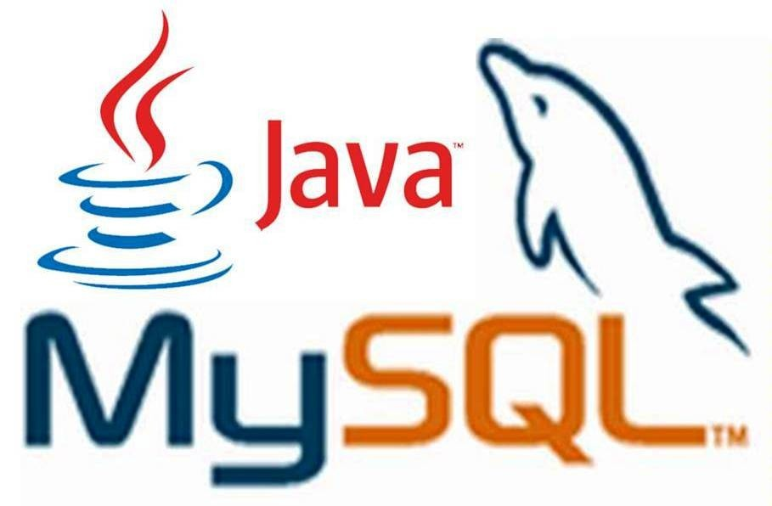
What is JDBC?

Slide 3
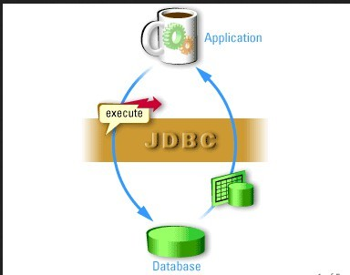
Definition
●
JDBC is a Java-based data access technology (Java Standard Edition platform) from Oracle Corporation.
●
This technology is an API for the Java programming language that defines how a client may access a database.
●
It provides methods for querying and updating data in a database.

Slide 4
JDBC History

Slide 5
JDBC History
●
Before JDBC, ODBC API was used to connect and execute query to the database.
●
But ODBC API uses ODBC driver that is written in C language which is platform dependent and unsecured.
●
That is why Sun Micro System has defined its own API (JDBC API) that uses JDBC driver written in Java language.

Slide 6
JDBC History
●
Sun Microsystems released JDBC as part of JDK 1.1 on February 19, 1997.
●
The JDBC classes are contained in the Java package java.sql and javax.sql
●
The latest version, JDBC 4.2, and is included in Java SE 8.

Slide 7

JDBC - Java Database Connectivity.
JDBC provides API or Protocol to interact with different databases.
With the help of JDBC driver we can connect with different types of databases.
Driver is must needed for connection establishment with any database.
A driver works as an interface between the client and a database server.

Slide 8
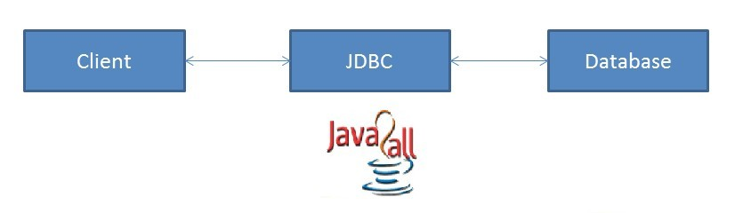
JDBC have so many classes and interfaces that allow a java application to send request made by user to any specific DBMS(Data Base Management System).
JDBC supports a wide level of portability.
JDBC provides interfaces that are compatible with java application

Slide 9
Components of JDBC:
JDBC has four main components as under and with the help of these components java application can connect with database.
The JDBC API - it provides various methods and interfaces for easy communication with database.
The JDBC DriverManager - it loads database specific drivers in an application to establish connection with database.
The JDBC test suite - it will be used to test an operation being performed by JDBC drivers.
The JDBC-ODBC bridge - it connects database drivers to the database
http://www.java2all.com

Slide 10
JDBC Specification:
Different version of JDBC has different specification as under.
JDBC 1.0 - it provides basic functionality of JDBC.
JDBC 2.0 - it provides JDBC API(JDBC 2.0 Core API and JDBC 2.0 Optional Package API).
JDBC 3.0 - it provides classes and interfaces in two packages(java.sql and javax.sql).
JDBC 4.0 - it provides so many extra features like Auto loading of the driver interface.
Connection management.
ROWID data type support.
http://www.java2all.com

Slide 11
What is API

Slide 12
The Java API is the set of classes included with the Java Development Environment. These classes are written using the Java language and run on the JVM. The Java API includes everything from collection classes to GUI classes.
API
●
●
JDBC is also an API.

Slide 13
JDBC Architecture:
As we all know now that driver is required to communicate with database.
JDBC API provides classes and interfaces to handle request made by user and response made by database.
Some of the important JDBC API are as under.
DriverManager Connection PreparedStatement ResultSet ResultSetMetaData
Driver Statement
CallableStatement DatabaseMetaData

Slide 14
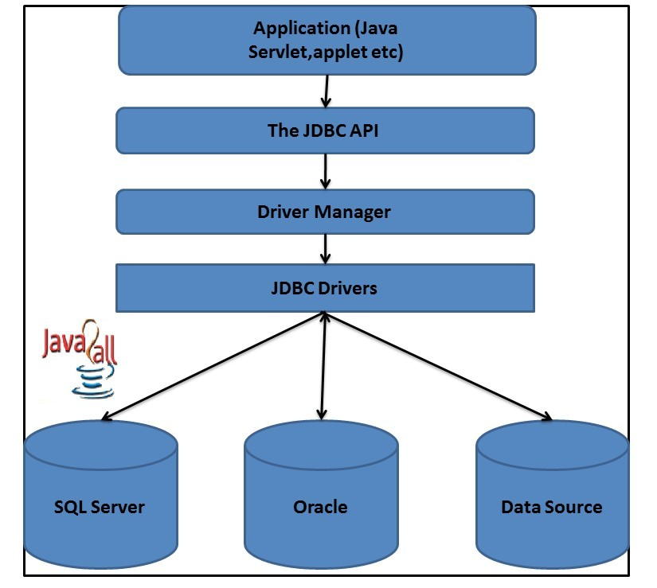
Here The DriverManager plays an important role in JDBC architecture.
It uses some database specific drivers to communicate our J2EE application to database.

Slide 15
JDBC Drivers

Slide 16
JDBC Drivers
●
JDBC Driver is a software component that enables java application to interact with the database.There are 4 types of JDBC drivers:
Type 1: JDBC-ODBC bridge driver
Type 2: Native-API driver (partially java driver) Type 3: Network Protocol driver (fully java driver) Type 4: Thin driver (fully java driver)
–
–
–
–

Slide 17
Type 1:
JDBC-ODBC Bridge Driver
●
The JDBC-ODBC bridge driver uses ODBC driver to connect to the database. This is now discouraged because of thin driver.

Slide 18
Type 2:
Native-API Driver
The Native API driver uses the client-side libraries of the database. It is not written entirely in Java.
●
●

Slide 19
Type 3:
Network Protocol Driver
The Network Protocol driver uses middle ware (application server). It is fully written in Java.
●
●

Slide 20
Type 4: Thin Driver
●
The thin driver converts JDBC calls directly into the vendor-specific database protocol.
That is why it is known as thin driver. It is fully written in Java language.
Better performance than all other drivers.
No software is required at client side or server side.
Disadvantage: Drivers depends on the Database.
●
●
●
●
●

Slide 21
Steps to Connect to the Database in Java

Slide 22
Steps to Connect to
Database
There are 5 steps to connect any java application with the database in java using JDBC. They are as follows:
Register the driver class Creating connection Creating statement Executing queries Closing connection
●
●
●
●
●

Slide 23
Registering the
Driver
●
The forName() method of Class class is used to register the driver class.
●
Class.forName("com.mysql.jdbc.Driver");

Slide 24
Creating
Connection Object
●
The getConnection() method of DriverManager class is used to establish connection with the database.
●
Connection
con=DriverManager.getConnection( "jdbc:mysql://localhost:3306","r oot","password");

Slide 25
Creating Statement
Object
●
The createStatement() method of Connection interface is used to create statement. The object of statement is responsible to execute
queries with the database.
●
Statement stmt=con.createStatement();

Slide 26
Execute Query
●
The executeQuery() method of Statement interface is used to execute queries to the database. This method returns the object of ResultSet that can be used to get all the records of a table.
●
ResultSet rs=stmt.executeQuery("select * from emp");
while(rs.next()){
System.out.println(rs.getInt(1)+" "+rs.getString(2));
}

Slide 27
Closing Connection
●
By closing connection object statement and ResultSet will be closed automatically. The close() method of Connection interface is used to close the connection.
●
con.close();

Slide 28
Connecting to the MySQL Database

Slide 29
Connect to MySQL
Database
Driver class: com.mysql.jdbc.Driver.
Connection URL: jdbc:mysql://localhost:3306/db_name Username: The default username for the mysql database is root.
Password: Given by the user at the time of installing the mysql database
Example:
Connection con=DriverManager.getConnection( "jdbc:mysql://localhost:3306/sonoo","root","root");
●
●
●
●
●

Slide 30
Loading the .jar
Download the MySQL connector.jar from mysql.com
Paste the mysqlconnector.jar in the lib folder of source directory. Set the classpath
●
●
●

Slide 31
DriverManager
class
●
The DriverManager class acts as an interface between user and drivers.
●
It keeps track of the drivers that are available and handles establishing a connection between a database and the appropriate driver.
●
Connection con = null;
con=DriverManager.getConnection( "jdbc:mysql://localhost:3306","r oot","password");
●
DriverManager.registerDriver().

Slide 32
Connection
Interface
A Connection is the session between Java application and database.
The Connection interface is a factory of Statement and PreparedStatement.
Object of Connection can be used to get the object of Statement and PreparedStatement.
●
●
●

Slide 33
Connection
Interface
Methods of Connection interface:
●
public Statement createStatement(): creates a statement object that can be used to execute SQL queries.
●
public void commit(): saves the changes made since the previous commit/rollback permanent.
●
public void close(): closes the connection and Releases a JDBC resources immediately.

Slide 34
Statement Interface
●
The Statement interface provides methods to execute queries with the database.
The statement interface is a factory of ResultSet.
It provides factory method to get the object of ResultSet.
●
●

Slide 35
Statement Interface
Methods of Statement interface:
●
public ResultSet executeQuery(String sql): is used to execute SELECT query. It returns the object of ResultSet.
●
public int executeUpdate(String sql): is used to execute specified query, it may be create, drop, insert, update, delete etc.
●
public boolean execute(String sql): is used to execute queries that may return multiple results.

Slide 36
Statement Interface
Example:
Statement stmt=con.createStatement();
int result=stmt.executeUpdate("delete from table where id=xy"); System.out.println(result+" records affected");
●
con.close();

Slide 37
ResultSet interface
●
The object of ResultSet maintains a cursor pointing to a particular row of data.
●
Initially, cursor points to before the first row.

Slide 38
ResultSet Interface
Methods of ResultSet interface:
●
public boolean next(): is used to move the cursor to the one row next from the current position.
●
public boolean previous():is used to move the cursor to the one row previous from the current position.
public boolean first(): is used to move the cursor to the first row in result set object.
●
●
public boolean last():is used to move the cursor to the last row in result set object.

Slide 39
ResultSet Interface
Methods of ResultSet interface:
●
public int getInt(int columnIndex): is used to return the data of specified column index of the current row as int.
●
public int getInt(String columnName): columnName): is used to return the data of specified column name of the current row as int.
●
public String getString(int columnIndex): is used to return the data of specified column index of the current row as String.
●
public String getString(String columnName): is used to return the data of specified column name of the current row as String.

Slide 40
ResultSet Interface
Example:
ResultSet rs=stmt.executeQuery("select * from table");
//getting the record of 3rd row rs.absolute(3);
System.out.println(rs.getString(1)+" "+rs.getString(2)+" "+rs.getString(3));
●
con.close();

Slide 41
PreparedStatement
Interface
The PreparedStatement interface is a sub interface of Statement. It is used to execute parameterized query.
Example of parameterized query:
– String sql="insert into emp values(?,?,?)";
●
●
●

Slide 42
PreaparedStatement
Interface
Methods of PreparedStatement:
●
public void setInt(int paramIndex, int value): sets the integer value to the given parameter index.
●
public void setString(int paramIndex, String value): sets the String value to the given parameter index.
●
public void setFloat(int paramIndex, float value): sets the float value to the given parameter index.

Slide 43
PreparedStatement
Interface
Methods of PreparedStatement:
●
public void setDouble(int paramIndex, double value): sets the double value to the given parameter index.
●
public int executeUpdate(): executes the query. It is used for create, drop, insert, update, delete etc.
●
public ResultSet executeQuery(): executes the select query. It returns an instance of ResultSet.

Slide 44
PreparedStatement
Interface
Example:
●
PreparedStatement stmt=con.prepareStatement("insert into Emp values(?,?)");
stmt.setInt(1,101);//1 specifies the first parameter in the query stmt.setString(2,"Ratan");
int i=stmt.executeUpdate();
System.out.println(i+" records inserted");

Slide 45
Questions
Write a program to implement CRUD in a table.
Write a program to implement PreparedStatement?

Slide 46
Thank You

