Slide 1


Path Products & expressions - Purpose
PURPOSE: APPLICATIONS
How many paths in a flow-graph?
Maximum, minimum etc.
The probability of getting to a point in a program ? (to a node in a flow graph)
The mean processing time of a routine (a flow graph)
Effect of Routines involving complementary operations : (Push / Pop & Get / Return)
4

Slide 2


Path Products & expressions - Purpose
PURPOSE & APPLICATIONS
Check for data flow anomalies.
Regular expressions are applied to problems in test design & debugging
Electronics engineers use flow graphs to design &
analyze circuits & logic designers.
1. Software development, testing & debugging tools use
flow graph analysis tools & techniques.
1. These are helpful for test tool builders.
5

Slide 3

Path Products & expressions - Motivation
Motivation
Flow graph is an abstract representation of a program.
A question on a program can be mapped on to an equivalent question on an appropriate flow graph.
It will be a foundation for syntax testing & state testing
6

Slide 4


Path Products & expressions - Definitions
Path Expression:
An algebraic representation of sets of paths in a flow
graph.
Regular Expression:
Path expressions converted by using arithmetic
laws & weights into an algebraic function.
7

Slide 5


Path Products & expressions – Path Product
Annotate each link with a name.
The pathname as you traverse a path (segment) expressed as concatenation of the link names is the path product.
c
1
2
3
4
a
b
d
Examples of path products between 1 & 4 are:
a b d a b c b d a b c b c b d ….
8

Slide 6

Path Products & expressions – Path Expression
Path Expression
Simply: Derive using path products.
c
1
2
3
4
a
b
d
Example:
{ a b d , a b c b d, a b c b c b d , ….. } abd + abcbd + abcbcbd + ….
9

Slide 7
Path Products & expressions – Path Expression
Example:
g
h
i
e
f
j
a
b
c
d
{ abcd , abfhebcd , abfigebcd , abfijd }
abcd + abfhebcd + abfigebcd + abfijd
10

Slide 8
Path Products & expressions – Path Expression
Path name for two successive path segments is the
concatenation of their path products.
X = abc | Y = def | XY = abcdef
a X = aabc | X a = abca | XaX = abcaabc
X = ab + cd | Y = ef + gh | XY = abef + abgh + cdef + cdgh
11

Slide 9

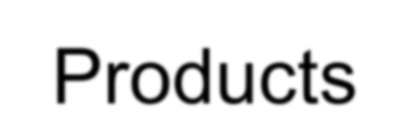
Path Products & expressions – Path Segments &
Products
Loops:
a¹ = a
a² = aa
a³ = aaa
a^{n} = aaaaa … n times
X = abc
X¹ = abc
X² = (abc)² = abcabc
Identity element
a⁰ = 1
X⁰ = 1
(path of length 0)
12

Slide 10
Path Products & expressions – Path Product
Path Product
Not Commutative:
XY ≠ YX in general
Associative
A ( BC ) = ( AB ) C = ABC
: Rule 1
13

Slide 11
Path Products & expressions – Path Product
Denotes a set of paths in parallel between two nodes.
Commutative
X + Y = Y + X
Associative
: Rule 2
( X + Y ) + Z = X + ( Y + Z ) = X + Y + Z
: Rule 3
Distributive
A ( B + C) = A B + A C ( A + B ) C = A C + B C
: Rule 4
14

Slide 12
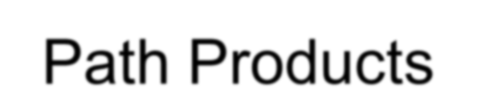
Path Products & expressions – Path Products
Absorption
X + X = X |  |  |  |  |  |  | : | Rule 5
X + any subset of X | = | X
X = a + bc + abcd |  |  | X + a | = | X | + | bc + abcd | = X
15

Slide 13

Path Products & expressions – Path Products
Loop:
b
An infinite set of parallel paths.
a
c
b* =
_{b}0
+ b¹ + b² + b³ + ……
_{X}*
=
_{X}0
+ X¹ + X² + X³ + ……
+ ……
_{X}+
_{X}1
= + X² + X³
X X* = X* X =
_{X}+
_{a}+
a a*
+ X³ + …… + X^{n}
= a* a =
_{X}n
_{X}0
= + X¹ + X²
16

Slide 14

Path Products & expressions – Path products
More Rules…
X^{m} + X^{n} =
=
_{X}n
_{X}m
if | n ≥ m | : Rule 6
if | n < m | : Rule 7
_{X}m _{X}n
_{X}m+n
=
X^{n} X*
= X* X^{n} =
_{X}*
: Rule 8
X^{n} X⁺
= X⁺ X^{n} =
_{X}+
: Rule 9
_{X}* _{X}+
= X⁺ X* =
_{X}+
: Rule 10
17

Slide 15
Path Products & expressions – Path products
Identity Elements ..
1 : Path of Zero Length
1 + 1 | = | 1 |  | : Rule 11
1 X | = | X 1 | = X | : Rule 12
₁n
₁n
₁*
₁+
: Rule 13
=
=
=
= 1
1⁺ + 1 =
₁*
= 1
: Rule 14
18

Slide 16
Path Products & expressions – Path products
Identity Elements ..
0 : empty set of paths
X + 0 = 0 + X = X
: Rule 15
X 0
= 0 X = 0
: Rule 16
₀*
= 1 + 0 + 0² + 0³ + . . . = 1
: Rule 17
19

Slide 17

Path Products & expressions – Reduction Procedure
To convert a flow graph into a path expression that
denotes the set of all entry/exit paths.
Node by Node Reduction Procedure
20

Slide 18
Path Products & expressions – Reduction Procedure
Initialization Steps:
1. Combine all serial links by multiplying their path expressions.
1. Combine all parallel links by adding their path
expressions.
1. Remove all self-loops - replace with links of the
form X*
21

Slide 19
Path Products & expressions – Reduction Procedure
Steps in the Algorithm’s loop
4. Select a non-initial & non-final node.
Replace it with a set of equivalent links, whose path expressions correspond to all the ways you can form a product of the set of in-links with the set of out-links of that node.
5
4
d
e
f
g
1
a
2
3
b
c
22

Slide 20
Path Products & expressions – Reduction Procedure
Steps in the Algorithm’s loop:
Combine any serial links by multiplying their path expressions.
( as in step 1)
Combine any parallel links by adding their path expressions.
( as in step 2)
Remove all the self-loops.
( as in step 3)
IF there’s just one node between entry & exit nodes, path expression for the flow graph is the link’s path expression. ELSE, return to step 4.
23

Slide 21
Path Products & expressions – Reduction Procedure
Path Expression for a Flow Graph
is not unique
depends on the order of node removal.
24

Slide 22

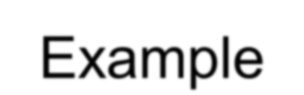



Path Products & expressions – Reduction Procedure
Example
Cross-Term Step (Step 4 of the algorithm)
Fundamental step.
Removes nodes one by one till there’s one entry & one exit node.
Replace the node by path products of all in-links with all out-links
and interconnecting its immediate neighbors.
25

Slide 23


Path Products & expressions – Reduction Procedure
Example
Processing of Loop Terms:
b
a
c
a
b*c
1
2
1
2
d
b*d
26

Slide 24
Path Products & expressions – Reduction Procedure Example
Processing of Loop Terms: a b c f 1 2 _{d} 3 4 5 e a (bd)* bc f 1 2 4 5 e | 1 | a | bd 2 | bc e | 4 | f | 5
27

Slide 25
Path Products & expressions – Reduction Procedure
Example
Processing of Loop Terms:
a
(bd)* bc
f
1
2
4
5
e
a (bd)* bc
f
1
4
5
e (bd)* bc
a (bd)* bc
( e (bd)* bc ) * f
1
4
5
a (bd)* bc ( e (bd)* bc )* f
28

Slide 26

Path Products & expressions – Reduction Procedure Example
Example: |  |  |  |  | b j | 4 g 8 m |  | c k | h a |  |  |  | d l | i b j |  |  | c k |  |  |  | d il
 | 1 | a |  | 3 |  |  |  |  |  | 5 |  |  |  |  | 6 | e |  | 2
 |  |  | f
 |  |  |  | 7 |  |  |  |  |  | 9 |  |  |  |  | 10
 |  |  |  |  |  |  | 1 |  |  |  |  | 3 |  |  | 4 |  |  |  |  | 5 |  | 6 | e | 2
 |  |  |  |  |  |  |  |  |  |  | f |  |  |  | g |  |  |  | h
 |  |  |  |  |  |  |  |  |  |  |  | 7 |  |  | 8 |  |  |  |  | 9
 |  |  |  |  |  |  |  |  |  |  |  |  |  |  | im
29

Slide 27
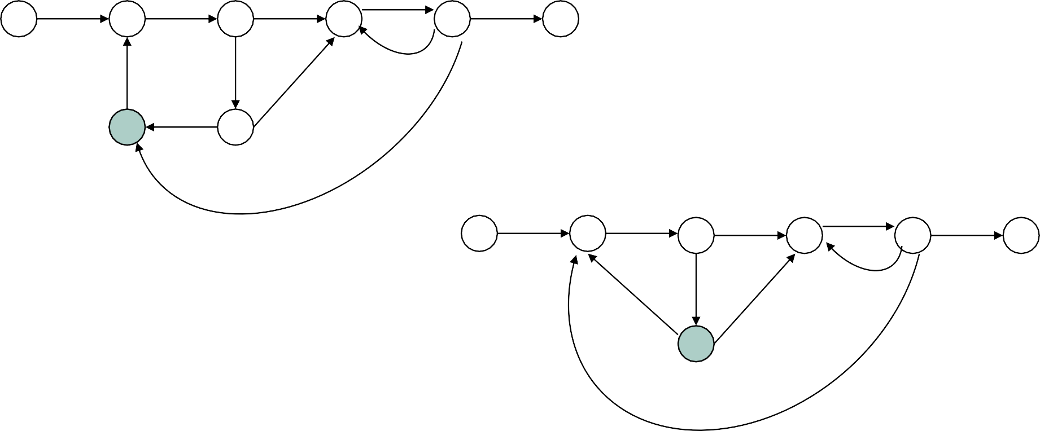
Path Products & expressions – Reduction Procedure
Example
a
b
c
d
e
1
3
4
5
6 2
f
g
ilh
j
kh
7
8
im
a
b
c
d
e
1
3
4
5
6
2
g
ilh
jf
kh
8
imf
a
b
c+gkh
d
e
1
3
4
gif
5
6
2
ilh
imf
30

Slide 28
Path Products & expressions – Reduction Procedure
Example
bgif
a
b(c+gkh)
d
e
1
3
5
6
2
ilh
imf
a
(bgif)*b(c+gkh)
d
e
1
3
5
6
2
ilh
imf
ilhd
a
(bgif)*b(c+gkh)d
e
1
3
6
2
imf
31

Slide 29
Path Products & expressions – Reduction Procedure
Example
a
(bgif)*b(c+gkh)d
(ilhd)*e
1
3
6
2
(ilhd)*imf
a(bgif)*b(c+gkh)d
(ilhd)*e
1
6
2
(ilhd)*imf(bgif)*b(c+gkh)d
32

Slide 30

Path Products & expressions – Reduction Procedure
Example
a(bgif)*b(c+gkh)d
{(ilhd)*imf(bgif)*b(c+gkh)d}* (ilhd)*e
1
6
2
Flow Graph Path Expression :
a(bgif)*b(c+gkh)d {(ilhd)*imf(bgif)*b(c+gkh)d}* (ilhd)*e
33

Slide 31


Path Products & expressions – Before going into
Applications
Before that, we learn:
Identities
Structured Flow Graphs (code/routines) Unstructured Flow graphs (routines)
34

Slide 32

Path Products & expressions – Identities / Rules
( A + B ) * | = | ( A* + B* ) * | : I1
 | = | ( A* B* )* | : I2
 | = | ( A* B )* A* | : I3
 | = | ( B* A )* B* | : I4
 | = | ( A* B + A )* | : I5
 | = | ( B* A + B )* | : I6
( A + B + C + . . . ) * | = | ( A* + B* + C* + . . . )* | : I7
 | = | ( A* B* C* . . . )* | : I8
Derived by removing nodes in different orders & applying the
series-parallel-loop rules.
35

Slide 33


Path Products & expressions – Structured Flow
Graphs
Reducible to a single link by successive application of the
transformations shown below.
A
B
A, B
Process
A
B
A
B
IF THEN .. ELSE ..
A
B
WHILE .. DO ..
36

Slide 34

Path Products & expressions – Structured Flow
Graphs
Structured flow graph transformations
A
B
A, B
REPEAT .. UNTIL ..
Properties:
No cross-term transformation.
No GOTOs.
No entry into or exit from the middle of a loop.
37

Slide 35
Path Products & expressions – Structured Flow
Graphs
Some examples:
f
d
b
a
b
e
c
d
h j
e
a
c
g
i
38

Slide 36

Path Products & expressions – UNstructured Flow
Graphs
Some examples – unstructured flow graphs/code:
X
Jumping into loops
X
Jumping out of loops
X
X
Branching into Decisions
Branching out of Decisions
39

Slide 37
Questions from the previous year’s exams
Write short notes on: path products, path expressions, path sums,
loops.
Define structured code. Explain lower path count Arithmetic.
What is the looping probability of a path expression. Write arithmetic rules. Explain with an example.
Write the steps involved in Node Reduction Procedure. Illustrate all
the steps with the help of neatly labeled diagrams.
40

Slide 38
Logic based testing: Overview
Logic is used in a program by programmers. Boolean algebra is the way to work with logic – simplification & calculation.
Hardware logic testing – hardware logic test design tools and methods use logic & Boolean algebra. Hardware design language compilers/translators use logic & Boolean algebra.
Impact of errors in specifications of a software is high as these are first in and last out. So, higher level language for specs is desired to reduce the number of errors. Higher order logic systems are used for formal specifications. The tools to simplify, transform and check specs use Boolean algebr
a.

Slide 39
Logic based testing: Overview
Knowledge based systems:
Knowledge based systems and artificial intelligence systems use high level logic languages which are based on rule bases consisting of rules. Rules are predicate expressions containing domain knowledge related elements combined with logical connectives. The answers to queries (problems) are derived based on Boolean algebraic operations performed on the rule bases. Such programs are called inference engines.

Slide 40
Modeling Logic with Decision Tables
A matrix representation of the logic of a
decision
Specifies the possible conditions and the
resulting actions
Best used for complicated decision logic

Slide 41
Modeling Logic with Decision Tables
Consists of three parts
  Condition stubs
    Lists condition relevant to decision
  Action stubs
    Actions that result from a given set of conditions
  Rules
    Specify which actions are to be followed for a
given set of conditions

Slide 42
Modeling Logic with Decision Tables
Indifferent Condition
  Condition whose value does not affect which action is
taken for two or more rules
Standard procedure for creating decision tables
  Name the condition and values each condition can assume
  Name all possible actions that can occur
  List all rules
  Define the actions for each rule
  Simplify the table

Slide 43
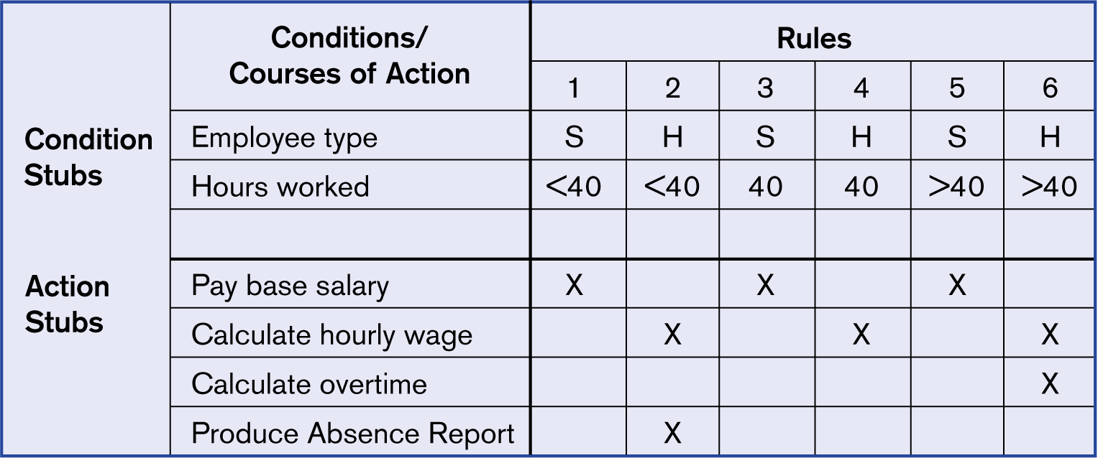


Complete decision table for payroll system
example
9.9

Slide 44
Constructing a Decision Table
PART 1. FRAME THE PROBLEM.
  Identify the conditions (decision criteria). These are
the factors that will influence the decision.
    E.g., We want to know the total cost of a student‟s
tuition. What factors are important?
  Identify the range of values for each condition or
criteria.
    E.g. What are they for each factor identified
above?
  Identify all possible actions that can occur.
    E.g. What types of calculations would be
necessary?

Slide 45
Constructing a Decision Table
PART 2. CREATE THE TABLE.
  Create a table with 4 quadrants.
    Put the conditions in the upper left quadrant. One
row per condition.
    Put the actions in the lower left quadrant. One row
per action.
  List all possible rules.
    Alternate values for first condition. Repeat for all values of second condition. Keep repeating this process for all conditions.
    Put the rules in the upper right quadrant.
  Enter actions for each rule
    In the lower right quadrant, determine what, if any,
appropriate actions should be taken for each rule.
  Reduce table as necessary.

Slide 46
Example
Calculate the total cost of your tuition this
quarter.
  What do you need to know?
    Level. (Undergrad or graduate)
    School. (CTI, Law, etc.)
    Status. (Full or part time)
    Number of hours
  Actions?

Slide 47
Actions?
  Consider CTI only (to make the problem smaller):
    U/G
      Part Time (1 to 11 hrs.): $335.00/per hour
– Full Time (12 to 18 hrs.): $17,820.00
      * Credit hours over 18 are charged at the part-time rate
    Graduate:
      Part time (1 to 7 hrs.): $520.00/per hour
      Full time (>= 8 hrs.): $520.00/per hour
Create a decision table for this problem. In my solution I was able to reduce the number of rules from 16 to 4.

Slide 48
Boolean Algebra
A Boolean algebra consists of:
a set B={0, 1},
2 binary operations on B (denoted by + & ×),
a unary operation on B (denoted by '), such
that :
0 + 0 = 0
1 + 0 = 1
0 + 1 = 1
1 + 1 = 1
0‟=1 and 1‟=0.
0 × 0 = 0
0 × 1 = 0
1 × 0 = 0
1 × 1 = 1
14

Slide 49
Rules of a Boolean Algebra
The following axioms („rules‟) are satisfied for all
elements x, y& z of B:
(1) x + y = y + x
x× y = y × x
(2) x + (y + z) = (x + y) + z x × (y × z) = (x × y) × z
(commutative axioms)
(associative axioms)
(3) x × (y + z) = (x × y) + (x × z)
x + (y × z) = (x + y) × (x + z) (distributive axioms)
(4) x + 0 = x
(5) x + x' = 1
x × 1 = x x × x' = 0
(identity axioms) (inverse axioms)
15

Slide 50
Laws of Boolean Algebra
In addition to the laws given by the axioms of
Boolean Algebra, we can show the following laws
x'' = x
x + x = x
(x + y)' = x' × y'
x + 1 = 1
x + (x × y) = x
0' = 1
(double complement)
(idempotent )
x× x = x
(x × y)' = x' + y' (de Morgan‟s laws)
x × 0 = 0 (annihilation)
x× (x + y) = x (absorption)
1' = 0 (complement)
16

Slide 51
Exercise
Simplify the Boolean expression (x' × y) + (x × y)
Solution: (x' × y) + (x × y)
= (y × x') + (y × x) (commutative)
= y × (x' + x)
= y × (x + x')
= y × 1
= y
Thus (x' ×
(distributive) (commutative) (inverse) (identity)
y
y) + (x × y) =
17

Slide 52
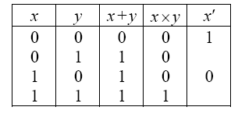
Boolean Notation
This means that in effect we‟ll be employing
Boolean Algebra notation.
The truth tables can be rewritten as
18

Slide 53
Notational Short-cuts
We will employ short-cuts in notation:
In „multiplication‟ we‟ll omit the symbol ×, &
write xy for x × y (just as in ordinary algebra)
The associative law says that
x + (y + z) = (x + y) + z
So we‟ll write this as simply x + y + z, because
the brackets aren‟t necessary.
19

Slide 54
Notational Short-cuts
Similarly, write the product of 3 terms as xyz
(3) In ordinary algebra, the expression
x + y × z means x + (y × z), because of the convention that multiplication takes precedence over addition.
e.g. x + yz means x + (y × z), and not (x + y) × z
Similarly, ab + cd means (a × b) + (c × d)
20

Slide 55
Reducing Boolean Expressions
Is this the smallest possible implementation
of this expression? No!
G = xyz + xyz’ + x’yz
Use Boolean Algebra rules to reduce
complexity while preserving functionality.
Step 1: Use idempotent law (a + a = a). So xyz + xyz‟ + x‟yz = xyz + xyz + xyz‟ + x‟yz
21

Slide 56
Reducing Boolean Expressions
Step 2: Use distributive law a(b + c) = ab + ac. So xyz + xyz + xyz‟ + x‟yz = xy(z + z‟) + yz(x + x‟)
Step 3: Use Inverse law (a + a‟ = 1). So xy(z + z‟) + yz(x + x‟) = xy.1 + yz.1
Step 4: Use Identity law (a . 1 = a). So
xy + yz = xy.1 + yz.1 = xyz + xyz‟ + x‟yz
22

Slide 57
Karnaugh maps
Alternate way of representing Boolean function
  All rows of truth table represented with a square
  Each square represents a minterm
y
0
1
x y F
x
0 1
x | y | 0 | 1 | 0 | 0 | 1
 | 0 |  |  | 0 | 1 | 1
1 |  |  |  | 1 1 | 0 1 | 0 0
x’y’ | x’y
xy’ | xy
1 | 1
0 | 0
23

Slide 58
Karnaugh maps
Easy to convert between truth table, K-map,
and SOP.
– Unoptimized form: number of 1‟s in K-map equals number of minterms (products) in SOP.
– Optimized form: reduced number of
F(x,y) = x’y + x’y’ = x’
minterms
24

Slide 59
Karnaugh Maps
A Karnaugh map is a graphical tool for assisting in the
general
simplification procedure.
TwoBvariable maps.
0 1
B
_{A} 0 1
A
0
0 | 1
1 | 0
F=AB ′+A’B
0
0 | 1
1 | 1
F=AB +A′B +AB ′
1
1
Three variable maps.
BC
A B C | F
0 0 0 0 0 1 0 1 0 0 1 1 1 0 0 1 0 1 1 1 0 1 1 1 | 0 1 1 0 1 1 1 1
A
00 01 11 10
0
0 | 1 | 0 | 1
1 | 1 | 1 | 1
1
+
F=AB’C’ +AB ′C +ABC +ABC ′ + A’B’C + A’BC’
25

Slide 60
Rules for K-Maps
We can reduce functions by circling 1‟s in
the K-map.
Each circle represents minterm reduction.
Following circling, we can deduce minimized and-or form.
_{x} y
0
1
0 1
1 | 1
0 | 0
F(x,y) = x‟y + x‟y‟ = x‟
26

Slide 61
Rules for K-Maps
Rules to consider
Every cell containing a 1 must be
included at
least once.
The largest possible “power of 2
rectangle”
must be enclosed.
27

Slide 62
Karnaugh Maps
A Karnaugh map is a graphical tool for assisting in the
general simplification procedure.
Two variable maps.
B
_{A} 0 1
B
_{A} 0 1
0
0 | 1
1 | 0
0
0
1
F=AB +A′B +AB ′
F=A+B
F=AB ′+A’B
1
1
1
1
Three variable maps.
BC
A
00 01 11 10
0 0 1 0 1
1 1 1 1 1
F=A+B ′C +BC ′
F=AB’C’ +AB ′
C +ABC +ABC ′ + A
’B’C + A’BC’
28

Slide 63
More Karnaugh Map Examples
Examples
a
0 1
a
0 1
b
b
0
1
0 | 1
0 | 1
0
1
1 | 1
0 | 0
f = a
g = b'
ab
ab
c 00 01 11 10
c 00 01 11 10
0 0 0 1 0
1 0 1 1 1
0
1
0 | 0 | 1 | 1
0 | 0 | 1 | 1
cout = ab + bc + ac
f = a
Circle the largest groups possible.
Group dimensions must be a power of 2.
Remember what circling means
29

Slide 64
Specifications
Specification validation procedure / steps
Rewrite the specifications using consistent
terminology.
Identify the predicates on which the cases are based.
Name them with
suitable letters, such as A, B, C.
Rewrite the specification in English that uses only the
logical connectives
AND, OR, and NOT, however stilted it may seem.
Convert the rewritten specifications into an equivalent
set of Boolean expressions.
Identify the default action and cases, if any are
specified.

Slide 65
Specifications Continue
Enter the Boolean expressions in a KV chart and check
for consistency. If
the specifications are consistent, there will be no overlaps, except for the
cases that result in multiple actions.
Enter the default cases, and check for consistency.
If all boxes are covered, the specification is complete.
If the specification is incomplete or inconsistent, translate
the
corresponding boxes of the KV chart back into English
and get a
clarification, explanation, or revision.
If the default cases were not specified explicitly, translate
the default cases
back into Eng mation.
lish and get a confir

Slide 66


Questions from the previous exams
What is decision table? How is it useful in testing? Explain it with an example.
Are the predicates are restricted to Binary truth value or not?
Explain.
Illustrate the applications of Decision Tables.
Minimize the function using Karnaugh map method.
5. F(A,B,C,D) = Σ (1,2,3,8,9,10,11,14)+Σ (7, 15)
Demonstrate by means of truth tables the validity of the following
theorems of Boolean Algebra:
  Associative laws
  Demorgan‟s theorems for three variables
  Distributive law of + over ⋅ .

