Slide 1



Slide 2
Events
and
Signals

Slide 3
Terms and Concepts
An event is the specification of a significant occurrence that has a location in time and space.
In the context of state machines, an event is an occurrence of a stimulus that can trigger a state transition.
A signal is a kind of event that represents the specification of an asynchronous stimulus communicated between instances.

Slide 4
Kinds of Events
Events may be external or internal.
External events are those that pass between the system and its actors.
the pushing of a button and an interrupt from a collision sensor are both examples of external events.
Internal events are those that pass among the objects that live inside the system.
An overflow exception is an example of an internal event.

Slide 5
In the UML, you can model four kinds of events
signals
calls
the passing of time, and
a change in state

Slide 6
Signals
A signal represents a named object that is dispatched (thrown) asynchronously by one object and then received (caught) by another.
Exceptions are supported by most contemporary programming languages and are the most common kind of internal signal that you will need to model.

Slide 7
Signals have a lot in common with plain classes.
For example, signals may have instances,
although you don't generally need to model them explicitly.
Signals may also be involved in generalization relationships, permitting you to model hierarchies of events.
some of which are general and some of which are specific.
signals may have attributes and operations.

Slide 8
A signal may be sent as the action of a state transition in a state machine or the sending of a message in an interaction.
The execution of an operation can also send signals.
In fact, when you model a class or an interface, an important part of specifying the behavior of that element is specifying the signals that its operations can send.
In the UML, you model the relationship between an operation and the events that it can send by using a dependency relationship, stereotyped as send.

Slide 9
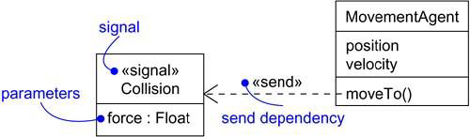
Signals

Slide 10
Call Events
Just as a signal event represents the occurrence of a signal.
a call event represents the dispatch of an operation.
In both cases, the event may trigger a state transition in a state machine.
Whereas a signal is an asynchronous event.
a call event is, synchronous.

Slide 11
This means that when an object invokes an operation on another object that has a state machine.
Control passes from the sender to the receiver, the transition is triggered by the event, the operation is completed, the receiver transitions to a new state, and control returns to the sender.

Slide 12
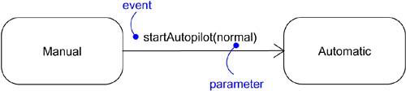
Call Events

Slide 13
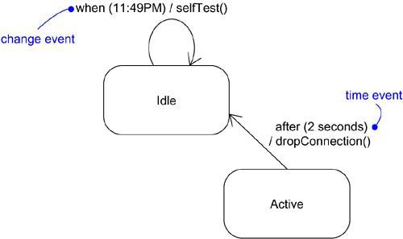
Time and Change Events
A time event is an event that represents the passage of time
A change event is an event that represents a change in state or the satisfaction of some condition.

Slide 14
Sending and Receiving Events
Signal events and call events involve at least two objects:
The object that sends the signal or invokes the operation, and the object to which the event is directed.
Because signals are asynchronous, and because asynchronous calls are themselves signals.
The semantics of events interact with the semantics of active objects and passive objects.

Slide 15
Instance of any class can send a signal to or invoke an operation of a receiving object.
When an object sends a signal, the sender dispatches the signal and then continues along its flow of control, not waiting for any return from the receiver.
Instance of any class can receive a call event or a signal. If this is a synchronous call event,
Then the sender and the receiver are in a rendezvous (agreement or time) for the duration of the operation.

Slide 16
This means that the flow of control of the sender is put in lock step with the flow of control of the receiver until the activity of the operation is carried out.
If this is a signal, then the sender and receiver do not rendezvous:
The sender dispatches the signal but does not wait for a response from the receiver.
In either case, this event may be lost or it may just invoke a normal method call.

Slide 17
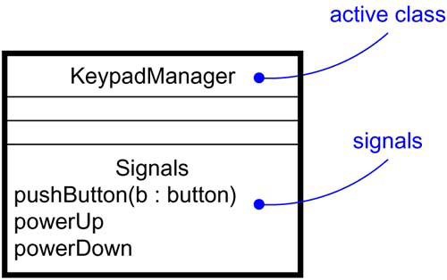
Signals and Active Classes

Slide 18
Common Modeling Techniques
Modeling a Family of Signals
Modeling Exceptions

Slide 19
Modeling a Family of Signals
Consider all the different kinds of signals to which a given set of active objects may respond.
Look for the common kinds of signals and place them in a generalization/specialization hierarchy using inheritance. Elevate more general ones and lower more specialized ones.
Look for the opportunity for polymorphism in the state machines of these active objects.
Where you find polymorphism, adjust the hierarchy as necessary by introducing intermediate abstract signals.

Slide 20
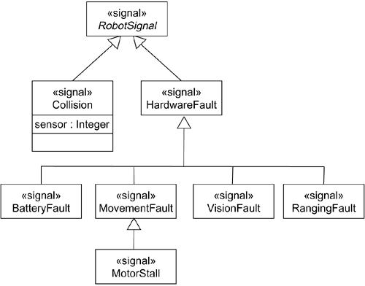
Modeling Families of Signals

Slide 21
Modeling Exceptions
For each class and interface, and for each operation of such elements, consider the exceptional conditions that may be raised.
Arrange these exceptions in a hierarchy. Elevate general ones, lower specialized ones, and introduce intermediate exceptions, as necessary.
For each operation, specify the exceptions that it may raise. You can do so explicitly (by showing send dependencies from an operation to its exceptions) or you can put this in the operation's specification

Slide 22
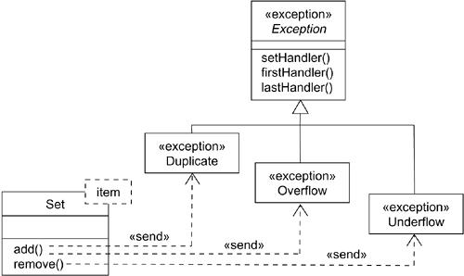
Modeling Exceptions

Slide 23
State Machines

Slide 24
State Machines
A state machine is a behavior that specifies the sequences of states an object goes through during its lifetime in response to events, together with its responses to those events.
A state is a condition or situation during the life of an object during which it satisfies some condition, performs some activity, or waits for some event.
222

Slide 25
Terms and Concepts
A transition is a relationship between two states indicating that an object in the first state will perform certain actions and enter the second state when a specified event occurs and specified conditions are satisfied.
An activity is ongoing nonatomic execution within a state machine. An action is an executable atomic computation that results in a change in state of the model or the return of a value. Graphically, a state is rendered as a rectangle with rounded corners. A transition is rendered as a solid directed line
223

Slide 26
States
A state is a condition or situation during the life of an object during which it satisfies some condition, performs some activity, or waits for some event. An object remains in a state for a finite amount of time.
224

Slide 27
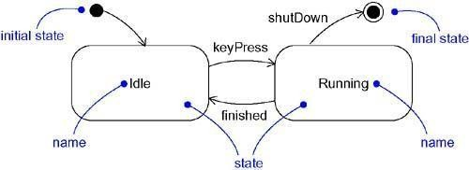
States
225

Slide 28
Transitions
A transition is a relationship between two states indicating that an object in the first state will perform certain actions and enter the second state when a specified event occurs and specified conditions are satisfied.
226

Slide 29
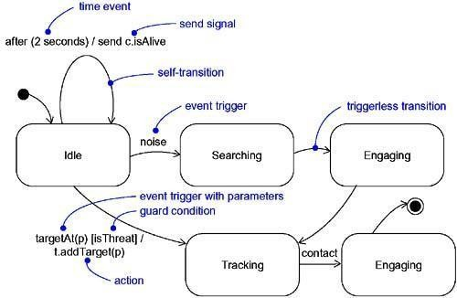
Transitions
227

Slide 30
Common Modeling Techniques
Modeling the Lifetime of an Object
To model the lifetime of an object,
Set the context for the state machine, whether it is a class, a use case, or the system as a whole.
Establish the initial and final states for the object. To guide the rest of your model, possibly state the pre- and postconditions of the initial and final states, respectively.
228

Slide 31
Decide on the events to which this object may
respond.
Starting from the initial state to the final state, lay out the top-level states the object may be in. Connect these states with transitions triggered by the appropriate events. Continue by adding actions to these transitions.
Identify any entry or exit actions (especially if you find that the idiom they cover is used in the state machine).
229

Slide 32
Expand these states as necessary by using
substates.
Check that all actions mentioned in the state machine are sustained by the relationships, methods, and operations of the enclosing object.
230

Slide 33
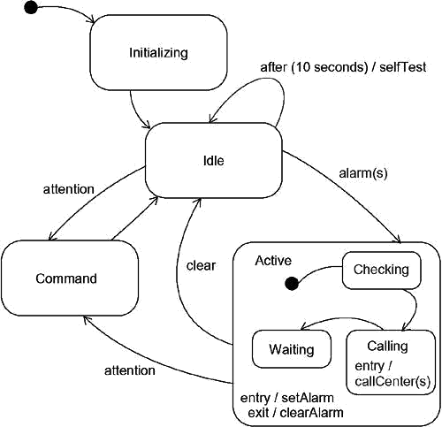
Modeling the Lifetime of An
Object
231

Slide 34
Processes and Threads

Slide 35
Terms and Concepts
A process is a heavyweight flow that can
execute concurrently with other processes.
A thread is a lightweight flow that can execute concurrently with other threads within the same process.
Processes and threads are rendered as stereotyped active classes (and also appear as sequences in interaction diagrams).
232

Slide 36
Flow of Control
In a purely sequential system, there is one flow of control.
When a sequential program starts, control is rooted at the beginning of the program and operations are dispatched one after another.
Even if there are concurrent things happening among the actors outside the system, a sequential program will process only one event at a time, queuing or discarding any concurrent external events.
233

Slide 37
Synchronization
Visualize for a moment the multiple flows of control that weave through a concurrent system.
When a flow passes through an operation, we say that at a given moment, the locus of control is in the operation.
If that operation is defined for some class, we can also say that at a given moment, the locus of control is in a specific instance of that class.
234

Slide 38
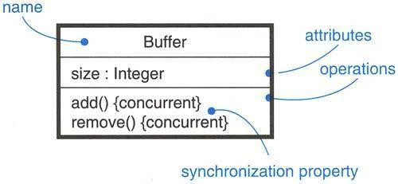
Synchronization
235

Slide 39
Common Modeling Techniques
Modeling Multiple Flows of Control
To model multiple flows of control,
Identify the opportunities for concurrent action and reify each flow as an active class. Generalize common sets of active objects into an active class.
Capture these static decisions in class diagrams, explicitly highlighting each active class.
236

Slide 40
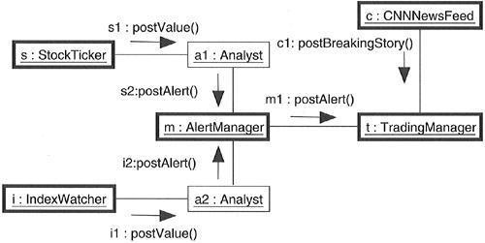
Modeling Flows of Control
237

Slide 41
Modeling Interprocess Communication
To model interprocess communication,
Model the multiple flows of control.
Consider which of these active objects represent processes and which represent threads.
Model messaging using asynchronous communication.
Informally specify the underlying mechanism for communication by using notes, or more formally by using collaborations.
238

Slide 42
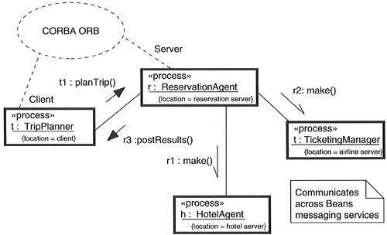
Modeling Interprocess
Communication
239

Slide 43
Time and Space

Slide 44
Terms and Concepts
A time expression is an expression that evaluates
to an absolute or relative value of time.
A timing constraint is a semantic statement about the relative or absolute value of time. Graphically, a timing constraint is rendered as for any constraint
Location is the placement of a component on a node. Graphically, location is rendered as a tagged value
240

Slide 45
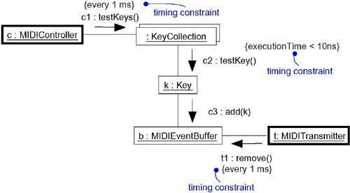
Time
241

Slide 46
Common Modeling Techniques
Modeling Timing Constraints
To model timing constraints,
For each event in an interaction, consider whether it must start at some absolute time. Model that real time property as a timing constraint on the message.
•
For each interesting sequence of messages in an interaction, consider whether there is an associated maximum relative time for that sequence. Model that real time property as a timing constraint on the sequence.
•
For each time critical operation in each class, consider its time complexity. Model those semantics as timing constraints on the operation
242

Slide 47
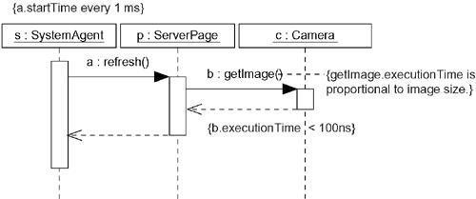
Modeling Timing Constraint
243

Slide 48
Modeling the Distribution of Objects
•
To model the distribution of objects,
For each interesting class of objects in your system, consider its locality of reference. In other words, consider all its neighbors and their locations. A tightly coupled locality will have neighboring objects close by
•
Next consider patterns of interaction among related sets of objects. Co- locate sets of objects that have high degrees of interaction, to reduce the cost of communication. Partition sets of objects that have low degrees of interaction.
•
Next consider the distribution of responsibilities across the system.
Redistribute your objects to balance the load of each node.
•
Consider also issues of security, volatility, and quality of service, and
redistribute your objects as appropriate.
244

Slide 49
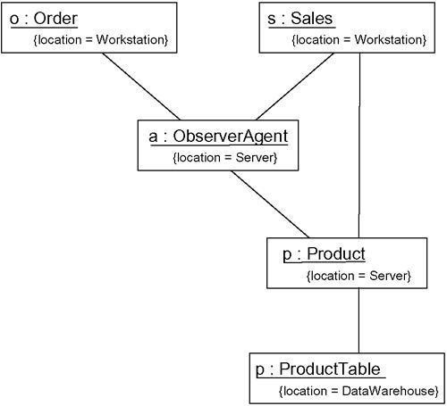
Modeling the Distribution of
Objects
245

Slide 50
Modeling Objects that Migrate
To model the migration of objects,
Select an underlying mechanism for physically
transporting objects across nodes.
Render the allocation of an object to a node by
explicitly indicating its location as a tagged value.
Using the become and copy stereotyped messages,
render the allocation of an object to a new node.
Consider the issues of synchronization (keeping the state of cloned objects consistent) and identity (preserving the name of the object as it moves).
246

Slide 51
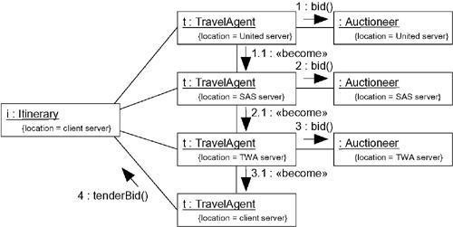
Modeling Objects that Migrate
247

Slide 52
Statechart Diagrams

Slide 53
Terms and Concepts
A statechart diagram shows a state machine, emphasizing the flow of control from state to state.
A state machine is a behavior that specifies the sequences of states an object goes through during its lifetime in response to events, together with its responses to those events. A
state is a condition or situation in the life of an object during which it satisfies some condition, performs some activity, or waits for some event.
248

Slide 54
Contents
Statechart diagrams commonly contain
Simple states and composite states
Transitions, including events and actions
A statechart diagram is basically a projection of the elements found in a state machine. This means that statechart diagrams may contain branches, forks, joins, action states, activity states, objects, initial states, final states, history states,
249

Slide 55
Common Modeling Technique
Modeling Reactive Objects
Choose the context for the state machine, whether it is a
class, a use case, or the system as a whole.
Choose the initial and final states for the object. To guide the rest of your model, possibly state the pre- and postconditions of the initial and final states, respectively.
Decide on the stable states of the object by considering the conditions in which the object may exist for some identifiable period of time. Start with the high-level states of the object and only then consider its possible substates.
250

Slide 56
Decide on the meaningful partial ordering of stable states over the lifetime of the object.
Decide on the events that may trigger a transition from state to state. Model these events as triggers to transitions that move from one legal ordering of states to another.
Attach actions to these transitions (as in a Mealy machine)
and/or to these states (as in a Moore machine).
Consider ways to simplify your machine by using substates,
branches, forks, joins, and history states.
251

Slide 57
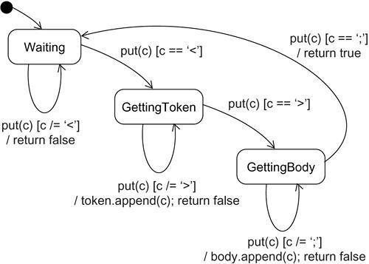
Modeling Reactive Objects
252

Slide 58
Forward and Reverse Engineering
Forward engineering(the creation of code from a model) is possible for statechart diagrams, especially if the context of the diagram is a class.
253

Slide 59
The forward engineering tool must generate the necessary private attributes and final static constants.
•Reverse engineering (the creation of a model from code) is theoretically possible, but practically not very useful. The choice of what constitutes a meaningful state is in the eye of the designer.
•
Reverse engineering tools have no capacity for abstraction and therefore
cannot automatically produce meaningful statechart diagrams.
254

Slide 60
More interesting than the reverse engineering of a model from code is the animation of a model against the execution of a deployed system. For example, given the previous diagram, a tool could animate the states in the diagram as they were reached in the running system. Similarly, the firing of transitions could be animated, showing the receipt of events and the resulting dispatch of actions
254

