Slide 1
UNIT - V File System Interface and Operations

Slide 2
FILE
Definition of a File:
A file is a named collection of related information that is recorded on secondary storage.
(or)
A file is the smallest allotment of logical secondary storage.
(or)
A file is a sequence of bits, bytes, lines, or records, the meaning of which is defined by the file’s creator and user. Many different types of information may be stored in a file.

Slide 3
File System
File system : A file is a collection of correlated information which is recorded on secondary or non-volatile storage like magnetic disks, optical disks, and tapes.
It is a method of data collection that is used as a medium for giving input and receiving output from that program.
In general, a file is a sequence of bits, bytes, or records whose meaning is defined by the file creator and user.
Every File has a logical location where they are located for storage and retrieval.

Slide 4
File Attributes
File Attributes gives the Operating System information about the file and how it is intended to use.
A file’s attributes vary from one operating system to another but typically consist of the following.
Name: The symbolic file name is the only information kept in human readable form.
Identifier: This unique tag, usually a number, identifies the file within the file system; it is the non-human-readable name for the file.
Type: This information is needed for systems that support different types of files.
Location: This information is a pointer to a device and to the location of the file on that device.

Slide 5
Size: The current size of the file (in bytes, words, or blocks) and possibly the maximum allowed size are included in this attribute.
Protection: Access-control information determines who can do reading, writing, executing, and so on.
Time, date, and user identification: This information may be kept for creation, last modification, and last use. These data can be useful for protection, security, and usage monitoring.

Slide 6
File Types
It refers to the ability of the operating system to differentiate various types of files like text files, binary, and source files. However, Operating systems like MS_DOS and UNIX has the following type of files.
1. Character Special File:
It is a hardware file that reads or writes data character by character, like mouse, printer, and more.
2.Ordinary files:
These types of files stores user information.
It may be text, executable programs, and databases.
It allows the user to perform operations like add, delete, and modify.

Slide 7
3. Directory Files:
Directory contains files and other related information about those files. Its basically a folder to hold and organize multiple files.
4.Special Files:
These files are also called device files. It represents physical devices like printers, disks, networks, flash drive, etc.
Functions of File:
1.Create file, find space on disk, and make an entry in the directory.
2.Write to file, requires positioning within the file
3.Read from file involves positioning within the file
4.Delete directory entry, regain disk space.
5.Reposition: move read/write position.

Slide 8
Commonly used terms in File systems
Field: This element stores a single value, which can be static or variable length.
DATABASE: Collection of related data is called a database. Relationships among elements of data are explicit.
FILES: Files is the collection of similar record which is treated as a single entity.
RECORD: A Record type is a complex data type that allows the programmer to create a new data type with the desired column structure. Its groups one or more columns to form a new data type. These columns will have their own names and data type.

Slide 9
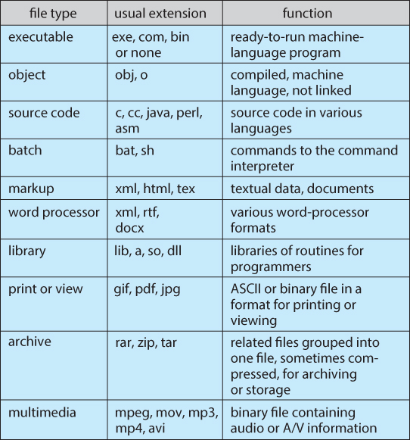
Common file types

Slide 10
File Structure
A File Structure should be according to a required format that the operating system can understand.
A file has a certain defined structure according to its type.
A text file is a sequence of characters organized into lines.
A source file is a sequence of procedures and functions.
An object file is a sequence of bytes organized into blocks that are understandable by the machine.

Slide 11
File Structure
Internal File Structure
Block Structure : Disk systems typically have a well-defined block size determined by the size of a sector. All disk I/O is performed in units of one block (physical record), and all blocks are the same size.
Record Structure: Files contain a sequence of fixed length records. Physical records may or may not get exact match with the logical record. Logical records even vary in length.

Slide 12
Access Methods
Files store information. When it is used, this information must be accessed and read into computer memory.
The information in the file can be accessed in the following ways
Sequential Access
Direct Access (or Relative Access)
Indexed Access
1.Sequential Access :The simplest access method is sequential access. Information in the file is processed in order, one record after the other. It is based on a tape model of a file and works as well on sequential-access devices.
Example: Editors and Compilers usually access files in this fashion.

Slide 13
Operations
A read operation—read next ()—reads the next portion of the file and automatically advances a file pointer, which tracks the I/O location.
Similarly, the write operation—write next ()—appends to the end of the file and advances to the end of the newly written material (the new end of file). On some systems, a program may be able to skip forward or backward n records for some integer n— perhaps only for n = 1.

Slide 14
2. Direct Access (or Relative Access)
Another method is direct access (or relative access). Here, a file is made up of fixed length logical records that allow programs to read and write records rapidly in no particular order. The direct-access method is based on a disk model of a file, since disks allow random access to any file block.
Examples: On an airline-reservation system, we might store all the information about a particular flight (for example, flight 713) in the block identified by the flight number. Thus, the number of available seats for flight 713 is stored in block 713 of the reservation file. To store information about a larger set, such as people, we might compute a hash function on the people’s names or search a small in memory index to determine a block to read and search.

Slide 15
3. Indexed Access
It involves the construction of an index for the file. The index, like an index in the back of a book, contains pointers to the various blocks. To find a record in the file, we first search the index and then use the pointer to access the file directly and to find the desired record.
Example: A retail-price file might list the universal product codes (UPCs) for items, with the associated prices. Each record consists of a 10-digit UPC and a 6-digit price, for a 16- byte record. If our disk has 1,024 bytes per block, we can store 64 records per block. A file of 120,000 records would occupy about 2,000 blocks (2 million bytes). By keeping the file sorted by UPC, we can define an index consisting of the first UPC in each block. This index would have 2,000 entries of 10 digits each, or 20,000 bytes, and thus could be kept in memory. To find the price of a particular item, we can make a binary search of the index

Slide 16
Directory Overview
A file system can be created on each of these parts of the disk. Any entity containing a file system is generally known as a volume.
Each volume that contains a file system must also contain information about the files in the system.
This information is kept in entries in a device directory or volume table of contents.
The device directory (or directory) records information—such as name, location, size, and type—for all files on that volume.
The directory can be viewed as a symbol table that translates file names into their directory entries

Slide 17
The following are the operations that are to be performed on a directory
Search for a file
Create a file
Delete a file
List a directory
Rename a file
Traverse the file system

Slide 18
Directory Structure
Single-Level Directory
Two-Level Directory
Tree-Structured Directories
Acyclic-Graph Directories
1.Single-Level Directory : The simplest directory structure is the single level directory.
All files are contained in the same directory, which is easy to support and understand.

Slide 19
Limitations
All files are in the same directory, they must have unique names. If two users call their data file test.txt, then the unique-name rule is violated.
Even a single user on a single-level directory may find it difficult to remember the names of all the files as the number of files increases. Keeping track of so many files is a problem.
Single level directory

Slide 20
Advantages :
All files It is very simple to Implement
Disadvantages :
1.Naming Protection
2. Grouping problem

Slide 21
2.Two-Level Directory
The standard solution to eliminate confusion of file names among different users is to create a separate directory for each user.
So the two level directory structure contains 2 directories
Master File Directory (MFD) at the top level.
User File Directory (UFD) at the second level
Actual files are at the third level.
Each user has his own user file directory (UFD). When a user job starts or a user logs in, the system’s master file directory (MFD) is searched. The MFD is indexed by user name or account number, and each entry points to the UFD for that user.

Slide 22
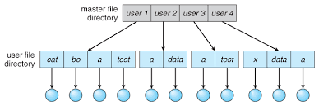
To create a file for a user, the operating system searches only that user’s UFD to ascertain whether another file of that name exists.
To delete a file, the operating system confines its search to the local UFD; thus, it cannot accidentally delete another user’s file that has the same name.
Two level directory

Slide 23
Advantages :
It can have same file name for different users.
Disadvantages :
2. Grouping problem .

Slide 24
3. Tree-Structured Directories
A tree is the most common directory structure. The tree has a root directory, and every file in the system has a unique path name.
A directory (or subdirectory) contains a set of files or subdirectories. A directory is simply another file, but it is treated in a special way. All directories have the same internal format.
One bit in each directory entry defines the entry as a file (0) or as a subdirectory (1). Special system calls are used to create and delete directories.
Current Directory:
Each process has a current directory. The current directory should contain most of the files that are of current interest to the process.

Slide 25
When reference is made to a file, the current directory is searched. If a file is needed that is not in the current directory, then the user usually must either specify a path name or change the current directory (using change directory () system call) to be the directory holding that file.
Path Names :
It describes the path the OS must take to get to some point.
Path names can be of two types: absolute and relative.
An absolute path name begins at the root and follows a path down to the specified file, giving the directory names on the path.
A relative path name defines a path from the current directory.
If the current directory is root/spell/mail, then the relative path name prt/first refers to the same file as does the absolute path name root/spell/mail/prt/first.

Slide 26
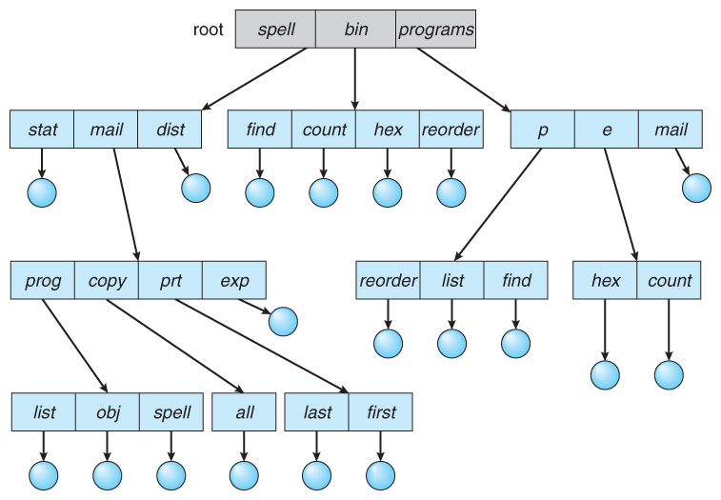
Tree-Structured Directories

Slide 27
Deletion of a directory:
If a directory is empty, its entry in the directory that contains it can simply be deleted.
However, suppose the directory to be deleted is not empty but contains several files or subdirectories.
One of two approaches can be taken. Some systems will not delete a directory unless it is empty.
Thus, to delete a directory, the user must first delete all the files in that directory.
An alternative approach, such as that taken by the UNIX rm command, is to provide an option: when a request is made to delete a directory, all that directory’s files and subdirectories are also to be deleted.

Slide 28
Advantages :
Efficient searching
Grouping capability
Disadvantages :
It cant share the subdirectories and files

Slide 29
4. Acyclic-Graph Directories
A tree structure prohibits the sharing of files or directories. An acyclic graph i.e., a graph with no cycles which allows directories to share subdirectories and files.
The same file or subdirectory may be in two different directories. An acyclic-graph directory structure is more flexible than a simple tree structure, but it is also more complex.

Slide 30
Acyclic-Graph Directories

Slide 31
Implementation
Link: A common way is to create a new directory entry called a link.
A link is effectively a pointer to another file or subdirectory.
A link may be implemented as an absolute or a relative path name. When a reference to a file is made, we search the directory.
If the directory entry is marked as a link, then the name of the real file is included in the link information.
We resolve the link by using that 8 path name to locate the real file.
b) Duplication: Shared files duplicate all information about them in both sharing directories. Thus, both entries are identical and equal.
A major problem with duplicate directory entries is maintaining consistency when a file is modified.

Slide 32
Protection
When information is stored in a computer system, we want to keep it safe from physical damage (the issue of reliability) and improper access (the issue of protection).
Reliability is generally provided by duplicate copies of files.
File systems can be damaged by hardware problems (such as errors in reading or writing), power surges or failures, head crashes, dirt, temperature extremes, and vandalism, accidental deletion , Bugs in the file-system software etc.
Protection can be provided in many ways. For a single-user laptop system, we might provide protection by locking the computer.

Slide 33
1. Types of Access
Several different types of operations may be controlled:
Read : Read from the file.
Write : Write or rewrite the file.
Execute : Load the file into memory and execute it.
Append : Write new information at the end of the file.
Delete : Delete the file and free its space for possible reuse.
List : List the name and attributes of the file. Other operations, such as renaming, copying, and editing the file, may also be controlled

Slide 34
2. Access Control
Different users may need different types of access to a file or directory.
The most general scheme to implement identity dependent access is to associate with each file and directory an access-control list (ACL) specifying user names and the types of access allowed for each user.
When a user requests access to a particular file, the operating system checks the access list associated with that file.
If that user is listed for the requested access, the access is allowed. Otherwise, a protection violation occurs, and the user job is denied access to the file.

Slide 35
To condense the length of the access-control list, many systems recognize three classifications of users in connection with each file:
Owner : The user who created the file is the owner.
Group : A set of users who are sharing the file and need similar access is a group, or work group.
Universe : All other users in the system constitute the universe.

Slide 36
3. Other Protection Approaches
Another approach to the protection problem is to associate a password with each file. Just as access to the computer system is often controlled by a password, access to each file can be controlled in the same way.
If the passwords are chosen randomly and changed often, this scheme may be effective in limiting access to a file. The use of passwords has a few disadvantages, however…
First, the number of passwords that a user needs to remember may become large, making the scheme impractical.
Second, if only one password is used for all the files, then once it is discovered, all files are accessible; protection is on an all-or-none basis.
Some systems allow a user to associate a password with a subdirectory, rather than with an individual file, to address this problem.

Slide 37
File System Structure
Disks provide most of the secondary storage on which file systems are maintained.
Two characteristics make them convenient for this purpose are
1. A disk can be rewritten.
2. A disk can access directly any block of information it contains. File systems provide efficient and convenient access to the disk by allowing data to be stored, located, and retrieved easily.
Design Problems in a File System :
How the file system should look to the user i.e. file, and the directory structure for organizing files.
Creating algorithms and data structures to map the logical file system onto the physical secondary-storage devices.

Slide 38
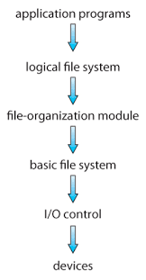
File System Structure

Slide 39
File system organized in many layers :
1.Application Programs :It contains user code that is making a request.
2.Logical file system : It manages metadata information about a file . It includes all details about a file except the actual contents of file. It also maintains via file control blocks. File control block (FCB) has information about a file – owner, size, permissions, location of file contents.
3.File organization Module : It has information about files, location of files and their logical and physical blocks. Physical blocks do not match with logical numbers of logical block numbered from 0 to N. It also has a free space which tracks unallocated blocks.

Slide 40
4.Basic file system : It Issues general commands to device driver to read and write physical blocks on disk. It manages the memory buffers and caches. A block in buffer can hold the contents of the disk block and cache stores frequently used file system metadata.
5.I/O Control level : Device drivers acts as interface between devices and OS, they help to transfer data between disk and main memory. It takes block number a input and as output it gives low level hardware specific instruction.
6. Devices : These are the actual hardware devices like disk.

Slide 41
File system Implementation
On-disk Structures : Generally they contain information about total number of disk blocks, free disk blocks, location of them and etc. Below given are different on-disk structures
1.Boot Control Block : It is usually the first block of volume and it contains information needed to boot an operating system. In UNIX it is called boot block and in NTFS it is called as partition boot sector.
2.Volume Control Block : It has information about a particular partition ex:- free block count, block size and block pointers etc. In UNIX it is called super block and in NTFS it is stored in master file table.
3.Directory Structure : They store file names and associated node numbers. In UNIX, includes file names and associated file names and in NTFS, it is stored in master file table.
4.Per-File FCB : It contains details about files and it has a unique identifier number to allow association with directory entry. In NTFS it is stored in master file table.

Slide 42
In-Memory Structure : They are maintained in main-memory and these are helpful for file system management for caching. Several in-memory structures given below :
1.Mount Table : It contains information about each mounted volume.
2.Directory-Structure cache : This cache holds the directory information of recently accessed directories.
3.System wide open-file table : It contains the copy of FCB of each open file.
4.Per-process open-file table : It contains information opened by that particular process and it maps with appropriate system wide open-file.

Slide 43
File System Structure

Slide 44
Allocation methods
1.Contiguous Allocation
2. Linked Allocation
3. Indexed Allocation
1.Contiguous Allocation : Contiguous allocation requires that each file occupy a set of contiguous blocks on the disk. Disk addresses define a linear ordering on the disk.
Contiguous allocation of a file is defined by the disk address and length (in block units) of the first block.
The directory entry for each file indicates the address of the starting block and the length of the area allocated for this file .

Slide 45
Accessing a file
Accessing a file that has been allocated contiguously is easy.
It supports both sequential and random access. For sequential access, the file system remembers the disk address of the last block referenced and, when necessary, reads the next block.
For direct access to block i of a file that starts at block b, we can immediately access block b + i.

Slide 46
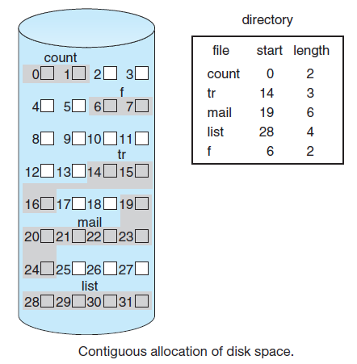
Contiguous Allocation

Slide 47
Advantages
Both the Sequential and Direct Accesses are supported by this. For direct access, the address of the k th block of the file which starts at block b can easily be obtained as (b+k).
This is extremely fast since the number of seeks are minimal because of contiguous allocation of file blocks.
Disadvantages
This method suffers from both internal and external fragmentation. This makes it inefficient in terms of memory utilization.
Increasing file size is difficult because it depends on the availability of contiguous memory at a particular instance.

Slide 48
Disadvantages
Finding space for a new file. The system chosen to manage free space determine show this task is accomplished.
First fit and best fit are the most common strategies used to select a free hole from the set of available holes.
External Fragmentation
As files are allocated and deleted, the free disk space is broken into little pieces. External fragmentation exists whenever free space is broken into chunks.
It becomes a problem when the largest contiguous chunk is insufficient for a request; storage is fragmented into a number of holes, none of which is large enough to store the data.
Solution to external fragmentation : Compaction

Slide 49
2. Linked Allocation
In this scheme, each file is a linked list of disk blocks which need not be contiguous. The disk blocks can be scattered anywhere on the disk.
The directory entry contains a pointer to the starting and the ending file block. Each block contains a pointer to the next block occupied by the file.
To create a new file, we simply create a new entry in the directory. With linked allocation, each directory entry has a pointer to the first disk block of the file. This pointer is initialized to null
To read a file, we simply read blocks by following the pointers from block to block .

Slide 50
Linked Allocation

Slide 51
Advantages
There is with linked allocation, and any free block on the no external fragmentation space list can be used to satisfy a request.
The size of a file need not be declared when the file is created. A file can continue to grow as long as free blocks are available .
Disadvantages
Because the file blocks are distributed randomly on the disk, a large number of seeks are needed to access every block individually. This makes linked allocation slower.
It does not support random or direct access. We can not directly access the blocks of a file. A block k of a file can be accessed by traversing k blocks sequentially (sequential access ) from the starting block of the file via block pointers.
Pointers required in the linked allocation incur some extra overhead.

Slide 52
3. Indexed Allocation
In this scheme, a special block known as the Index block contains the pointers to all the blocks occupied by a file.
Indexed allocation solves this problem by bringing all the pointers together into one location: the index block.
Each file has its own index block, which is an array of disk-block addresses. The ith entry in the index block points to the ith block of the file. The directory contains the address of the index block.
To find and read the ith block, we use the pointer in the ith index-block entry.

Slide 53
Indexed Allocation

Slide 54
Advantages
This supports direct access to the blocks occupied by the file and therefore provides fast access to the file blocks.
It overcomes the problem of external fragmentation.
Disadvantages
The pointer overhead for indexed allocation is greater than linked allocation.
For very small files, say files that expand only 2-3 blocks, the indexed allocation would keep one entire block (index block) for the pointers which is inefficient in terms of memory utilization. However, in linked allocation we lose the space of only 1 pointer per block.
Indexed allocation does suffer from wasted space .

Slide 55
Mechanisms for implementing Index Block
1.Linked scheme : An index block is normally one disk block. Thus, it can be read and written directly by itself.
To allow for large files, we can link together several index blocks.
For example, an index block might contain a small header giving the name of the file and a set of the first 100 disk-block addresses.
The next address (the last word in the index block) is null (for a small file) or is a pointer to another index block (for a large file).
2.Multilevel index : A variant of linked representation uses a first-level index block to point to a set of second-level index blocks, which in turn point to the file blocks.
To access a block, the operating system uses the first-level index to find a second-level index block to find the desired data block .

Slide 56
3.Combined scheme : Another alternative, used in UNIX-based file systems, is to keep the first, say, 15 pointers of the index block in the file’s node.
The first 12 of these pointers point to direct blocks; that is, they contain addresses of blocks that contain data of the file.
Thus, the data for small files (of no more than 12 blocks) do not need a separate index block. If the block size is 4 KB, then up to 48 KB of data can be accessed directly .
The first points to a single indirect block, which is an index block containing not data but the addresses of blocks that do contain data.
The second points to a double indirect block, which contains the address of a block that contains the addresses of blocks that contain pointers to the actual data blocks.
The last pointer contains the address of a triple indirect block

Slide 58
Free-space Management
To keep track of free disk space, the system maintains a free-space list. The free-space list records all free disk blocks—those not allocated to some file or directory.
The following are implementations of free space list.
1. Bit Vector or Bit map
2. Linked List
3. Grouping
4. Counting
5. Space Maps

Slide 59
1. Bit Vector or Bit map
Free-space list is frequently implemented as a bit map or bit vector. Each block is represented by 1 bit. If the block is free, the bit is 1; if the block is allocated, the bit is 0.
For example, consider a disk where blocks 2, 3, 4, 5, 8, 9, 10, 11, 12, 13, 17, 18, 25, 26, and 27 are free and the rest of the blocks are allocated.
The free-space bit map would be 001111001111110001100000011100000...

Slide 60
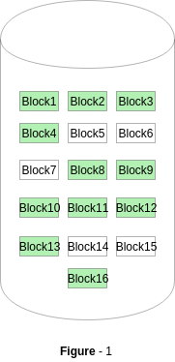
Bit vector or Bit map

Slide 61
Advantages
Simple to understand.
Finding the first free block is efficient. It requires scanning the words (a group of 8 bits) in a bitmap for a non-zero word. (A 0-valued word has all bits 0). The first free block is then found by scanning for the first 1 bit in the non-zero word.
Disadvantages
Bit vectors are inefficient unless the entire vector is kept in main memory (and is written to disk occasionally for recovery needs). Keeping it in main memory is possible for smaller disks but not necessarily for larger ones.

Slide 62
2. Linked List
In this approach, the free disk blocks are linked together i.e. a free block contains a pointer to the next free block.
The block number of the very first disk block is stored at a separate location on disk and is also cached in memory.
For example, blocks 2, 3, 4, 5, 8, 9, 10, 11, 12, 13, 17, 18, 25, 26, and 27 were free and the rest of the blocks were allocated.
In this situation, we would keep a pointer to block 2 as the first free block. Block 2 would contain a pointer to block 3, which would point to block 4, which would point to block 5, which would point tom block 8, and so on .

Slide 63
Linked List

Slide 64
3. Grouping
A modification of the free-list approach stores the addresses of n free blocks in the first free block.
The first n−1 of these blocks are actually free. The last, block contains the addresses of another n free block, and so on.
The addresses of a large number of free blocks can now be found quickly.
An advantage of this approach is that the addresses of a group of free disk blocks can be found easily.

Slide 65
4.Counting
Several contiguous blocks may be allocated or freed simultaneously, particularly when space is allocated with the contiguous-allocation algorithm or through clustering.
Thus, rather than keeping a list of n free disk addresses, we can keep the address of the first free block and the number (n) of free contiguous blocks that follow the first block.
Each entry in the free-space list then consists of a disk address and a count
Every entry in the list would contain:
Address of first free disk block
A number n

Slide 66
5. Space Maps
Oracle’s ZFS file system was designed to encompass huge numbers of files, directories, and even file systems.
In its management of free space, ZFS creates metaslabs to divide the space on the device into chunks of manageable size. Each metaslab has an associated space map.
The space map is a log of all block activity (allocating and freeing), in time order, in counting format.
When ZFS decides to allocate or free space from a metaslab, it loads the associated space map into memory in a balanced-tree structure (for very efficient operation), indexed by offset, and replays the login to that structure.
The in-memory space map is then an accurate representation of the allocated and free space in the metaslab.

Slide 67
System calls for file operations - open (), read (), write (), close (), seek (), unlink () (File Operations)
create () : This is used to create a file. Two steps are necessary to create a file. First, space in the file system must be found for the file. Second, an entry for the new file must be made in the directory.
open () : Many systems require that an open () system call be made before a file is first used. When a file has been opened its entry is added in the open file table. It also contains open count associated with each file to indicate how many processes have the file open.
read () : To read from a file, we use a system call that specifies the name of the file and read pointer to the location in the file where the next read is to take place. Once the read has taken place, the read pointer is updated.

Slide 68
write () : To write a file, we make a system call specifying both the name of the file and the information to be written to the file. Given the name of the file, the system searches the directory to find the file’s location.
The system must keep a write pointer to the location in the file where the next write is to take place. The write pointer must be updated whenever a write occurs.
close () : This closes a file. Each close () decrements the open count and when the count reaches zero, the file is no longer in use so it can be closed.
delete () : To delete a file, we search the directory for the named file. Having found the associated directory entry, we release all file space, so that it can be reused by other files, and erase the directory entry.

Slide 69
truncate () : The user may want to erase the contents of a file but keep its attributes. Rather than forcing the user to delete the file and then recreate it, this function allows all attributes to remain unchanged—except for file length—but lets the file be reset to length zero and its file space released.
seek () : It is also called as Reposition. The directory is searched for the appropriate entry, and the current-file-position pointer is repositioned to a given value. Repositioning within a file need not involve any actual I/O.
unlink () : Deletes a name from the file system. If that name was the last link to a file and no processes have the file open the file is deleted and the space it was using is made available for reuse.

