Slide 1
Divide and Conquer Technique

Slide 2
General Method:
D&C Technique splits n inputs into k subsets , 1< k ≤ n, generating k sub problems.
These sub problems will be solved and then combined by using a separate method to get solution to the whole problem.
If the sub problems are large, then the D&C Technique will be reapplied.
Often sub problems getting from the D&C Technique are of the same type as the original problem.

Slide 3
The reapplication of the D&C Technique is naturally expressed by a recursive algorithm.
Now smaller and smaller problems of the same kind are generated until subproblems that are small enough to solve without splitting further.

Slide 4
Control Abstraction / General Method for Divide and Conquer Technique
Algorithm DAndC(p)
{
if Small(p) then return s(p);
else
{
Divide p into smaller problems p1,p2,…….,pk, k≥1;
Apply D&C to each of these subproblems;
return Combine(DAndC(p1), DAndC(p2),……,DAndC(pk));
}
}

Slide 5
If the size of p is n and the sizes of the k subproblems are n₁,n₂,….,n_{k}, then the computing time of D&C is described by the recurrence relation
T(n)= g( n) n small
T(n₁)+T(n₂)+……+T(n_{k})+f(n) Otherwise
Where T(n) is the time for D&C on any input of size n and g(n) is the time to compute the answer directly for small inputs.
The function f(n) is the time for dividing p and combining the solutions of subproblems.

Slide 6
The Time Complexity of many D&C algorithms is given by recurrences of the form
c n small
aT(n/b)+f(n) Otherwise
Where a , b and c are known constants, and n is a power of b (i.e n=b^{k} )
T(n)=

Slide 7
Applications
1.Binary search Algorithm
2. Merge Sort.
3. Quick Sort.
4. Strassen Matrix Multiplication

Slide 8
Merge Sort
The Merge sort algorithm can be used to sort a collection of objects.
Merge sort is also called as divide and conquer algorithm.

Slide 9
Merge Sort
Base Case, solve the problem directly if it is small enough(only one element).
Divide the problem into two or more similar and smaller subproblems.
Recursively solve the subproblems.
Combine solutions to the subproblems.

Slide 10
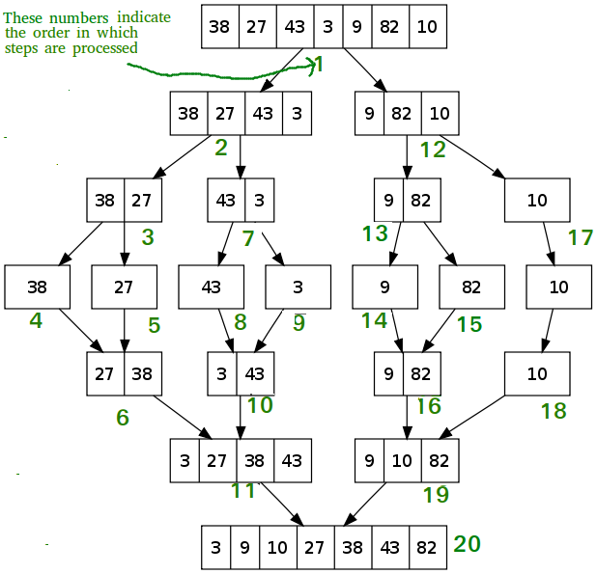
Merge Sort Example

Slide 11
Pseudo code
MergeSort ( low,high)
// sorts the elements a[low],…,a[high] which are in the global array
//a[1:n] into ascending order ( increasing order ).
// Small(p) is true if there is only one element to sort. In this case the list is already sorted.
{ if ( low<high ) then // if there are more than one element
{ mid ← (low+high)/2;
MergeSort(low,mid); // recursion
MergeSort(mid+1, high);
Merge(low, mid, high); } }

Slide 12
Algorithm Merge(low,mid,high)
// a[low:high] is a global array containing two sorted subsets in a[low:mid]
// and in a[mid+1:high]. The goal is to merge these two sets into a single
// set residing in a [low:high]. b[ ] is a temporary global array.
{
h:=low; i:=low; j:=mid+1;
while( h ≤ mid ) and ( j ≤ high ) do
{
if( a[h] ≤ a[j] ) then
{
b[i]:=a[h]; h:=h+1;
}
else
{
b[i]:=a[j]; j:=j+1;
}
i:=i+1;
}

Slide 13
if( h > mid ) then
for k:=j to high do
{
b[i] := a[k]; i:= i+1;
}
else
for k:=h to mid do
{
b[i] := a[k]; i:= i+1;
}
for k:= low to high do a[k]:=b[k];
}

Slide 14
Merge-Sort Time Complexity
If the time for the merging operation is proportional to n, then the computing time for merge sort is described by the recurrence relation
c₁
n=1, c₁ is a constant
T(n) =
2T(n/2) + c₂n
n>1, c₂ is a constant
Assume n=2^{k}, then
T(n) =2T(n/2) + c₂n
=2(2T(n/4)+c2n/2)+cn
=4T(n/4)+2c₂n
…..
…..
=2^{k} T(1)+ kc₂n
= c₁n+c₂nlogn = = O(nlogn)

Slide 15
Time complexities:
Merge-Sort
Most of the work done in combining the solutions.
Best case takes o(n log(n)) time
Average case takes o(n log(n)) time
Worst case takes o(n log(n)) time

Slide 16
Applications for merge sort in real time
Merge sort is useful for sorting linked lists .
Inversion count problem
Used in external sorting- in tape drivers
e commerce applications

