Slide 1
Dynamic Programming

Slide 2
Dynamic Programming is also used in optimization problems.
Like divide-and-conquer method, Dynamic Programming solves problems by combining the solutions of subproblems.
Moreover, Dynamic Programming algorithm solves each sub-problem just once and then saves its answer in a table, thereby avoiding the work of re-computing the answer every time..
For greedy algorithms (bottom up), we can always choose the "right" subproblem by a greedy choice.

Slide 3
-Two main properties of a problem suggest that the given problem can be solved using Dynamic Programming.
1.Overlapping sub-problems.
2.Optimal substructure.
-> In Dynamic programming every problem solved using “bellman’s principle of optimality” i.e “ the output of stage ‘1’ will be given as to stage ‘2’, the output of stage ‘2’ will be given as to stage ‘3’,…………..

Slide 4
1.Overlapping Sub-Problems
Similar to Divide-and-Conquer approach, Dynamic Programming also combines solutions to sub-problems.
It is mainly used where the solution of one sub-problem is needed repeatedly.
The computed solutions are stored in a table, so that these don’t have to be re-computed.

Slide 5
Hence, this technique is needed where overlapping sub-problem exists.
For example, Binary Search does not have overlapping sub-problem. Whereas recursive program of Fibonacci numbers have many overlapping sub-problems.

Slide 6
2.Optimal Sub-Structure
A given problem has Optimal Substructure Property, if the optimal solution of the given problem can be obtained using optimal solutions of its sub-problems.
For example, the Shortest Path problem has the following optimal substructure property −

Slide 7
If a node x lies in the shortest path from a source node u to destination node v, then the shortest path from u to v is the combination of the shortest path from u to x, and the shortest path from x to v.
The standard All Pair Shortest Path algorithms like Floyd-Warshall and Bellman-Ford are typical examples of Dynamic Programming.

Slide 8
Steps of Dynamic Programming Approach
Dynamic Programming algorithm is designed using the following four steps −
1.Characterize the structure of an optimal solution.
2.Recursively define the value of an optimal solution.
3.Compute the value of an optimal solution, typically in a bottom-up fashion.
4.Construct an optimal solution from the computed information.

Slide 9
Applications of Dynamic Programming Approach
1.Optimal Binary search tree(OBST).
2. 0/1 knapsack problem.
3. All-Pairs shortest paths.
4.Travelling sales person problem.
5. Reliability Design.

Slide 10
1.All-Pairs shortest paths.
Let G = (V, E) be a Directed graph with n vertices. Let cost be a cost Adjacency matrix for G such that
-- cost(i , i)=0, 1≤ i ≤n.
Then cost(i, j)is the length (or cost) of edge
(i, j) if (i, j) Є E(G).
And cost(i, j)= ∞ and if i≠ j and (i,j) ∉ E(G).

Slide 11
The all-pairs shortest-path problem is to determine .
a matrix ‘A’ such that A(i, j)is the length of a shortest path from i to j.
The matrix ‘A’ can be obtained by solving n single-source problems using the algorithm Shortest Paths.
Since each application of this procedure requires 0(n²) time.
The matrix ‘A’ can be obtained in 0(n³)time.
We obtain an alternate 0(n³) solution to this problem using the principle of optimality.

Slide 12
Let us examine a shortest i to j path in G, i≠ j
This path originates at vertex i and goes through some intermediate vertices (possibly none) and terminates at vertex j.
We can assume that this path contains no cycles for if there is a cycle, then this can be deleted without increasing the path length(no cycle has negative length)

Slide 13
If ‘k’ is an intermediate vertex on this Shortest path, then the sub paths from i to k and from k to j must be shortest paths from i to k and k to j, respectively.
Otherwise, the i to j path is not of minimum length. So, the principle of optimality holds.
This alerts us to the prospect of using dynamic programming.

Slide 14
If ‘k’ is the intermediate vertex with highest index , then the i to k path is a shortest i to k path in G going through no vertex with index greater than k -1.
Similarly the k to j path is a shortest k to j path in G going through no vertex of index greater than k-1.

Slide 15
We can regard the construction of a shortest i to j path as first requiring a decision as to which is the highest indexed intermediate vertex k.
Once this decision has been made, we need to find two shortest paths,
One from i to k and the other from k to j.
Neither of these may go through a Vertex with index greater than k -1.

Slide 16
Using A^{k} (i, j) to represent the length of a shortest path from i to j going through no vertex of index greater than k, we obtain
A(i, j)= min{ min_{1≤ k ≤n}{A^{K-1}(i, k) +A^{K-1} (k, j)},cost(i, j)}
Clearly, A⁰(i, j) = cost(i, j), 1≤ i ≤n , 1≤ j ≤n.
We can obtain a recurrence for A^{k}(i, j) using an argument similar to that used before.

Slide 17
A shortest path from i to j going through no vertex higher than ‘k’ either goes through vertex k or it does not.
If it does, A^{k}(i, j) = A^{k-1}(i, k) + A^{k-1}(k, j)
If it does not, then no intermediate vertex has index greater than k-1.
- Hence A^{k}(i, j) = A^{k-1}(i, j)
Combining we get,
A^{k}(i, j)=min{A^{K-1}(i, j) , A^{K-1}(i, k) +A^{K-1} (k, j)} k≥1

Slide 18
Pseudo code:

Slide 20
2. Travelling Sales person Problem(TSP)
Problem Statement:
- A traveler needs to visit all the cities from a list, where distances between all the cities are known and each city should be visited just once. What is the shortest possible route that he visits each city exactly once and returns to the origin city?

Slide 21
Solution:
Travelling salesman problem is the most notorious computational problem.
We can use brute-force approach to evaluate every possible tour and select the best one. For n number of vertices in a graph, there are (n - 1)! number of possibilities.
Instead of brute-force using dynamic programming approach, the solution can be obtained in lesser time, though there is no polynomial time algorithm.

Slide 22
Let G = (V,E) be a directed graph with edge costs C_{ij}.
The variable C_{ij} is defined such that
Cij > 0 for all i and j and C_{ij} = ∞ if (i, j) ∉ E.
Let |V| = n and assume n > 1.
A tour of G is a directed simple cycle that includes every vertex in V.
The cost of a tour is “the sum of the cost of the edges on the tour”.
The traveling sales person problem is to find a tour of minimum cost.

Slide 23
The traveling sales person problem finds application in a variety of situations.
Example 1:
-Suppose we have to route a postal van to pick up mail from mail boxes located at ‘n’ different sites.
-An ‘n + 1’ vertex graph can be used to represent the situation.
-One vertex represents the post office from which the Postal van starts and to which it must return.
-Edge(i, j)is assigned a cost equal to the distance from site ‘i’ to site ‘j’.
-The route taken by the postal van is a tour, and we are interested in finding a tour of minimum length.

Slide 24
Example2:
-suppose we wish to use a robot arm to tighten
the nuts on some piece of machinery on an assembly line.
-The arm will start from its initial position (which is over the first nut to be tightened), successively move to each of the remaining nuts, and return to the initial position.

Slide 25
The path of the arm is clearly a tour on a graph in which vertices represent the nuts.
A minimum-cost tour will minimize the time needed for the arm to complete its task (note that only the total arm movement time is variable; the nut tightening time is independent of the tour).

Slide 26
Example 3:
-From a production environment in which several
commodities are manufactured on the same set of machines.
-The manufacture proceeds in cycles. In each production cycle, ‘n’ different commodities are produced.
-When the machines are changed from production of commodity ‘i’ to commodity ‘j’, a change over cost C_{ij} is incurred.
-It is desired to find a sequence in which to manufacture these commodities.

Slide 27
-This sequence should minimize the sum of changeover costs(the remaining production costs are sequence independent).
- Since the manufacture proceeds cyclically, It is necessary to include the cost of starting the next cycle.
-This is just the change over cost from the last to the first commodity.
-Hence, this problem can be regarded as a traveling sales person problem on an ‘n’ vertex graph with edge
cost C_{ij}'s being the change over cost from commodity ‘i’ to commodity ’j’.

Slide 28
In the following discussion we shall, without loss of generality, regard a tour to be a simple path that starts and ends at vertex ‘1’.
- Every tour consists of an edge (i, k) for some
k ∈V-{1}. and a path from vertex ‘k’ to vertex ‘1’.
The path from vertex ‘k’ to vertex ‘1’ goes through each vertex in V-{1,k} exactly once.

Slide 29
It is easy to see that if the tour is optimal, then the path from ‘k’ to ‘1’ must be a shortest ‘k’ to ‘1’ path going through all vertices in V-{1,k} .
Hence, the principle of optimality holds.
Let g(i, S) be the length of a shortest path starting at vertex ‘i’ ,going through all vertices in ‘S’, and terminating at vertex ‘1’.

Slide 30
The function g(1 ,V-{1}) is the length of an optimal sales person tour.
From the principal of optimality it follows that
Generalizing (from Eq.1) , we obtain(for i∉S)
g(1,V-{1})=min_{2≤k ≤ n}{c_{1k}+ g(k,V -{1,k})}
Eq.1
g(i , S) = min_{j∈S}{c _{i j}+ g( j , S -{ j})}
Eq.2

Slide 31
- Eq.1 can be solved for g(1,V-{1}) if we know g(k, V -{1, k}) for all choices of ‘k’.
- The ‘g’ values can be obtained by using Eq.2
- Clearly ,
- Hence, we can use (Eq.2) obtain g(i , S) for all S
of size 1.
Then we can obtain g(i ,S) for ‘S’ with |S|= 2, and so on.
When |S| < n -1, the values of ‘i’ and ‘S’ for which g(i , S) is needed are such that i≠1,1 ∉ S and i ∉ S.
g(i, Ø) = C_{i1},1≤ i ≤ n.
Eq.3

Slide 32
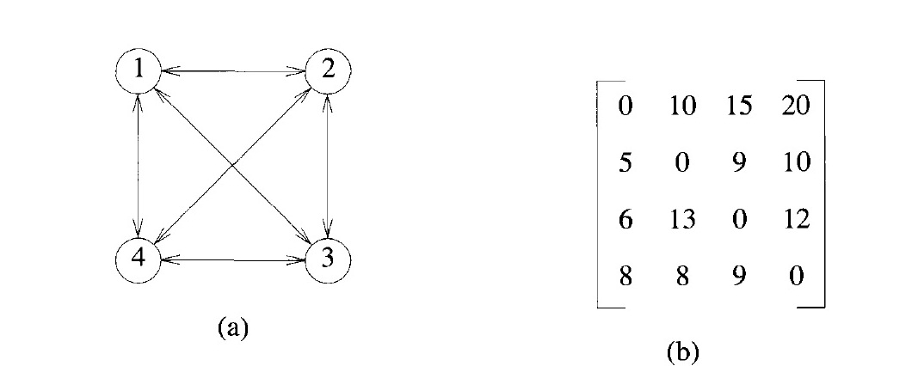
Example: Consider the directed graph of Figure (a). The edge lengths are given by matrix c of Figure (b). we will illustrate the steps to solve the travelling salesman problem.

Slide 33
From the above graph following table prepared.
->S = Φ
-using Eq.3
g(2, Φ)= C₂₁= 5.
g(3, Φ)= C₃₁= 6.
g(4, Φ)= C₄₁= 8.
 | 1 | 2 | 3 | 4
1 | 0 | 10 | 15 | 20
2 | 5 | 0 | 9 | 10
3 | 6 | 13 | 0 | 12
4 | 8 | 8 | 9 | 0

Slide 34
->S=1
Using EQ.2
g(2,{3})= C₂₃+g(3, Φ)= 9+6=15.
g(2,{4})= C₂₄+g(4, Φ)= 10+8=18.
g(3,{2})= C₃₂+g(2, Φ)= 13+5=18
g(3,{4})= C₃₄+g(4, Φ)= 12+8=20
g(4,{2})= C₄₂+g(2, Φ)= 8+5=13
g(4,{3})= C₄₃+g(3, Φ)=9+6=15
g(i , S) = min_{j∈S}{c _{i j}+ g( j , S -{ j})}

Slide 35
Next, we compute g(i,S) with |S|=2, i≠1,1 ∉ S and i ∉ S.
g(2,{3,4})= min{C₂₃+g(3,{4}) , C₂₄+g (4,{3}}
=min {9+20,10+15}
=min{29,25}
=25.
g(3,{2,4})=min{C₃₂+g(2,{4}), C₃₄+g(4,{2})}
=min {13+18,12+13}
=min{31,25}
=25.
g(4,{2,3})= min {c42+g(2,{3}),c43+g(3,{2})}
min {8+15,9+18}
=min{23,27}
=23.

Slide 36
-Finally, from Eq.1 we obtain
g(1,{2,3,4})=min{C₁₂+g(2,{3,4}),C₁₃+g(3,{2,4}), C₁₄+g(4,{2,3})}
= min {10+25,15+25,20+23}
=min{35,40,43}
=35.
An optimal tour of the graph of Figure(a) has length 35.
A tour of this length can be constructed if we retain with each g(i, S) the value of j that minimizes the right-hand side of Eq.1.
Let J(i, S) be this value.

Slide 37
Then J(1,{2,3,4})=2
Thus the tour starts from 1 and goes to 2.
The remaining tour can be obtained from g(2,{3,4}). So J(2,{3,4})= 4.
Thus the next edge is <2,4>.
The remaining tour is for g(4, {3}).
So J(4,{3})=3.
The optimal tour is 1,2,4, 3, 1
Analysis:
There are at the most 2^{n}.n sub-problems and each one takes linear time to solve.
Therefore, the total running time is O(2^{n}. n²).

Slide 38
3. 0/1 KNAPSACK
A solution to the knapsack problem can be obtained by making a sequence of decisions on the variables x_{1,} x_{2,}x_{3…….} x_{n}.
A decision on variable x_{i} involves determining which of the values 0 or 1is to be assigned to it.
Let us assume that decisions on the x_{i} are made in the order x_{n ,} x_{n-1},…, x_{1.}

Slide 39
Following a decision on x_{n} , we may be in one of two possible states:
The capacity remaining in the knapsack is ‘m’ and no profit has accrued or
The capacity remaining is m- w_{n} and a profit of p_{n} has accrued.
It is clear that the remaining decisions x_{n-1,…..} x₁ must be optimal with respect to the problem state resulting from the decision on x_{n.}
Otherwise x_{n,…..,} x₁ will not be optimal.
Hence , the principle of optimality holds.

Slide 40
Let f_{j}(y) be the value of an optimal solution to KNAP(1,j,y).
Since the Principle of optimality holds, we obtain
For arbitrary f_{j}(y) ,i >0, Eq.1 generalizes to
f_{n}(m) = max{f_{n-1} (m), f_{n-1} (m-w_{n})+p_{n}}
Eq.1
f_{n}(y) = max{f_{n-1} (y), f_{n-1} (y- w_{i})+p_{i}}
Eq.2

Slide 41
Eq.2 can be solved for fn(m) by beginning with the knowledge f₀ (y) = 0 for all y
and f_{i}(y) =-∞,y<0.then f_{1,} f_{2…..,} f_{n} can be successfully computed using Eq.2 .
So, we need to compute only f_{i}(y_{j}) ,1≤j ≤k.
We use the ordered set
S^{i}= {(f_{i} (y_{j}), y_{j}) | 1≤j ≤k.}to represent f_{i}(y) .

Slide 42
Each member of S^{i} is a pair(P,W), where P= f_{i}(y_{j}) and W = y_{j .}
Notice that
We can compute S^{i+1} from S^{i} by first computing
Note : S^{i} +1 can be computed by merging the pairs in S^{i} and S₁^{i} together.
S⁰ = {(0,0)}.
S₁^{i} = {(P,W)|(P- p_{i},W - w_{i}) ∈ S^{i} }
Eq.3

Slide 43
Note that if S^{i} +1 contains two pairs (p _{j,} w_{j}) and (p_{k ,}w_{k}) with the property that p_{j ≤} p_{k} and
w_{j} ≥w_{k} then the pair(p _{j,} w_{j}) can be discarded because of Eq.2.
Discarding or purging rules such as this one are also known as dominance rules.
Dominated tuples get purged. In the above,
(p _{k,} w_{k}) dominates(p _{j,} w_{j}) .

Slide 44
Let S^{i} represent the possible states resulting from the 2^{i} decision sequences for x_{1,} x_{2,}x_{3…….} x_{i}.
A state refers to a pair (p _{j,} w_{j}) , w_{j} being the total weight of objects included in the Knapsack and p _{j} being the corresponding profit.
To obtain S^{i +1},we note that the possibilities x_{i+1} =0 or x_{i+1} =1.
When x_{i+1} =0 the resulting states are the same as for S^{i .}
When x_{i+1} =01 the resulting states are obtained by adding((p _{i+1,} w_{i+1} ) to each state in S^{i} .

Slide 45
Call the set of these additional states S₁^{i .}
The S₁^{i} is the same as in Eq.3 .
Now, S^{i+1} can be computed by merging the states in S^{i} and S₁^{i} together.
S⁰ = {(0,0)}.
Adding an item into the bag.
S₁^{i} = S^{i-1} + (p_{i,} w_{i})
S^{i} = S^{i-1} + S₁^{i}
Merge operation
Total no.of profits &weights

Slide 47
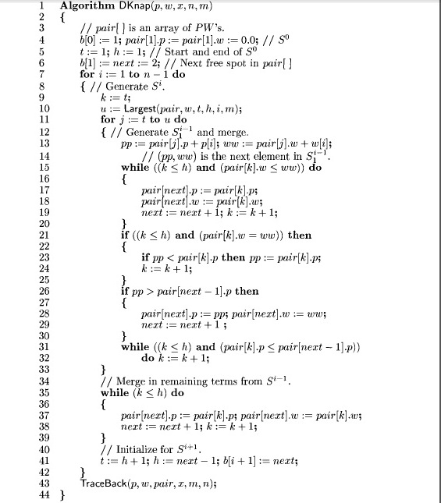

Slide 48
Example: Consider the knapsack instance n = 3,(w1,w2,w3)= (2,3,4), (P1,P2,P3)= (1,2,5) and m = 6.
Sol:
S⁰ = {(0,0)};
S₁^{i} = S^{i-1} + (p_{i,} w_{i})
i=1
S₁¹ = S⁰ + (p_{1,} w₁)
S₁¹ ={(0,0)+(1,2)}
S₁¹ ={(1,2)}
S^{i} = S^{i-1} + S₁^{i}
S¹ = S⁰ + S₁¹
S¹ = {(0,0)}+{(1,2)}
S¹ ={(0,0),(1,2)}

Slide 49
i=2
S₁² = S¹ + (p_{2,} w₂)
S₁² ={(0,0) (1,2)} +(2,3)}
S₁² ={(2,3),(3,5)}
S^{i} = S^{i-1} + S₁^{i}
S² = S¹ + S₁²
S² = {(0,0),(1,2)}+ {(2,3),(3,5)}
S² ={(0,0),(1,2),(2,3),(3,5}

Slide 50
i=3
S₁³ = S² + (p_{3,} w₃)
S₁³={(0,0),(1,2),(2,3),(3,5)} +(5,4)}
S₁³ ={(5,4),(6,6),(7,7),(8,9)}
S^{i} = S^{i-1} + S₁^{i}
S³ = S² + S₁³
S³ ={(0,0),(1,2),(2,3),(3,5} + {(5,4),(6,6),(7,7),(8,9)}
S³ ={(0,0),(1,2),(2,3),(3,5), (5,4),(6,6),(7,7),(8,9)}

Slide 51
Purging rule: if one of S^{i-1} and S₁^{i} has a pair (p_{j,} w_{j}) and other has a pair (p_{k,} w_{k}) and p_{j} ≤p_{k}
while w_{j} ≤w_{k} then the pair of (p_{j,} w_{j}) is discarded.
After applying purging rule ,we will check following condition in order to find the solution.
i.e (p_{i,} w_{i}) ∈ S^{n} and (p_{i,} w_{i}) ∉ S^{n-1} then x_{n} =1 other wise x_{n} =0

Slide 52
In the above example we have M=6 so the values of f₃ (6) is give b y tuple (6,6) in S^{3 .}
^{Therefore} (6,6) ∈ S³ where as (6,6) ∉ S²
_{So ,} _{X3=1}
The pair (6,6) came from the pair
(6-p3,6-w3)=(6-5,6-4)=(1,2).
Now
(1,2) ∈ S² similarly (1,2) ∈ S¹
^{so} _{X2=0}

Slide 53
Now (1,2) ∈ S¹ similarly (1,2) ∉ S⁰
^{So} x1=1.
The solution is (x1,x2,x3)=(1,0,1).
Maximum Profit
Ʃ p_{i} x_{i=} p₁ x₁ + p₂ x₂ + p₃ x₃
_{=1*1+2*0+5*1}
₌₆

Slide 54
4.OBST(OPTIMAL BINARY SEARCH TREES)
A Binary Search Tree (BST) is a tree where the key values are stored in the internal nodes.
The external nodes are null nodes.
The keys are ordered lexicographically, i.e. for each internal node all the keys in the left sub-tree are less than the keys in the node, and all the keys in the right sub-tree are greater.

Slide 55
When we know the frequency of searching each one of the keys, it is quite easy to compute the expected cost of accessing each node in the tree.
An optimal binary search tree is a BST, which has minimal expected cost of locating each node.
Search time of an element in a BST is O(n), whereas in a Balanced-BST search time is O(log n).
Again the search time can be improved in Optimal Cost Binary Search Tree, placing the most frequently used data in the root and closer to the root element, while placing the least frequently used data near leaves and in leaves.

Slide 56
Fig (a) & (b)Two possible binary search trees

Slide 57
Given a fixed set of identifiers, we wish to create a binary search tree organization.
We may expect different binary search trees for the same identifier set to have different performance characteristics.
The tree of Figure(a) in, the worst case, requires four comparisons to find an identifier, where as the tree of Figure(b) requires only three.
On the average the two trees need 12/5 and 11/5 comparisons respectively.

Slide 58
For example in the case of tree(a), it takes 1,2,2,3 and 4 comparisons, respectively,
to find the identifiers for, do, while, int & if.
Thus the average number of comparisons is
(1+2+2+3+4)/5=12/5.
This calculation assumes that Each identifier is searched for with equal probability and that no unsuccessful searches(i.e.searches for identifiers not in the tree) are made.

Slide 59
In a general situation, we can expect different identifiers to be searched for with different frequencies (or probabilities).
In addition, we can expect unsuccessful searches also to be made.
Let us assume that the given set of identifiers is {a1,a2,……,an} with a1 < a2 < ……< an.
Let p(i) be the probability with which we search for a_{i.}

Slide 60
Let q(i) be the probability that the identifier ‘x’ being searched for is such that a_{i}< x < a_{i+1},
where 0 ≤ i ≤ n.
Then, Ʃ_{0 ≤ i ≤ n} q(i) the probability of an unsuccessful search.
Clearly,
Ʃ_{0 ≤ i ≤ n} p(i)+ Ʃ_{0 ≤ i ≤ n} q(i) =1.
Given this data, we wish to construct an optimal binary search tree for {a1,a2,….. a_{n},}.

Slide 61
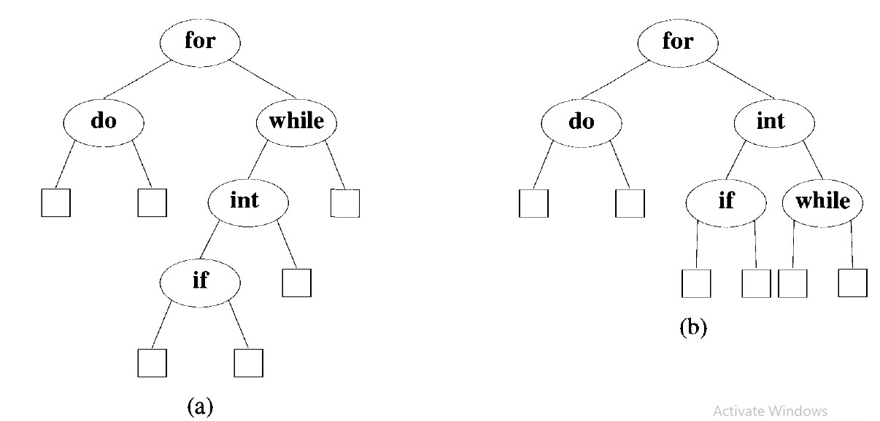
In obtaining a cost function for binary search trees, it is useful to add a ‘’fictitious’’ node in place of every empty sub tree in the search tree. Such nodes, called “External nodes”. All other nodes are internal nodes.
In Fig. Square boxes indicates External Nodes.

Slide 62
If a binary search tree represents n identifiers, then there will be exactly ‘n’ internal nodes and n+1
( fictitious) external nodes.
Every internal node represents a point where a successful search may terminate.
Every external node represents a point where an unsuccessful search may terminate.
The expected cost contribution from the internal node for a_{i} is →p(i) * level(a _{i} ).
The expected cost contribution from the External node for E_{i} is →q(i) * level((E _{i} ) -1).

Slide 63
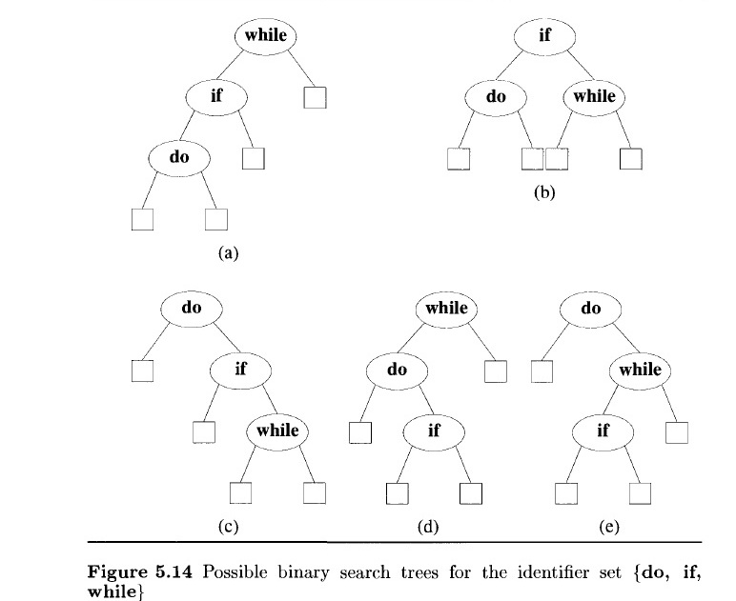
The preceding discussion leads to the following formula for the expected Cost of a binary search tree
Example: The possible binary search trees for the identifier set (a1,a2,a3)= (do, if, while) are given if Figure5.1
Ʃ_{1 ≤ i ≤ n} p(i) * level(a _{i})+Ʃ_{0 ≤ i ≤ n} q(i) * level((E _{i} ) -1)=1.

Slide 64
With p(1)= 0.5,p(2) = 0.1,p(3) = 0.05,
q(0)= 0.15, q(1) =0.1,q(2)= 0.05 and q(3)=0.05
For instance ,cost (tree a) can be computed as follows.
The contribution from successful searches(internal nodes) is
=3 * 0.5+2*0.1+1*0.05
=1.75.
the contribution from unsuccessful searches(external nodes) is
= 3 * 0.15+3 * 0.1+2 * 0.05+1*0.05
= 0.90.
Cost (tree ‘a’)=1.75+0.90=2.65.

Slide 65
All the other costs can also be calculated in a similar manner
Cost (tree ‘a’)=1.75+0.90=2.65.
Cost (tree ‘b’)=1.9
Cost (tree ‘c’)=1.5.
Cost (tree ‘d’)=2.05.
Cost (tree ‘e’)=1.6.
Tree ‘c’ is optimal with this assignment of p's and q's.

Slide 66
To apply dynamic programming to the problem of obtaining an optimal binary search tree, we need to view the construction of such a tree as the result of a sequence of decisions and then observe that the principle of optimality holds when applied to the problem state resulting from a decision.
A possible approach to this would be to make a decision as to which of the ‘a_{i}’s’ should be assigned to the root node of the tree.

Slide 67
If we choose a_{k} , then it is clear that the internal nodes for a_{1,} a_{2,} a_{3,……,} a_{k-1} .
as well as the external nodes for the classes E_{0,}E_{1,…….} E_{k-1} will lie in the left sub tree ‘l’ of the root.
The remaining nodes will be in the right sub tree ‘r’.
In both cases the level is measured by regarding the root of the respective subtree to be at level 1.
Cost(l)=Ʃ_{1 ≤ i < k} p(i) * level(a _{i})+Ʃ_{0 ≤ i < k} q(i) * level((E _{i} ) -1)
Cost(r)=Ʃ_{k <i ≤ n} p(i) * level(a _{i})+Ʃ_{k < i ≤ n} q(i) * level((E _{i} ) -1)

Slide 68
_{ak}
l
r
Figure-An optimal binary search tree with root a_{k.}
Using w(I , j) to represent the
sum q(i)+ Ʃ_{l=i+1} ^{j} (q(l)+p(l)) the following as the expected cost of the search tree (Figure)
=P(k)+cost(l)+cost(r)+w(0,k-1)+w(k,n)

Slide 69
If the tree is optimal, then above equation must be minimum.
Hence, cost(l) must be minimum over all binary search trees containing a_{1,} a_{2,……..} a_{k-1 And} E₁,E_{2,……..} E_{k-1.}
Similarly cost(r)must be minimum. If we use c(I , j) to represent the cost of an optimal binary search tree t_{ij} containing a_{i+1,….}a_{j And} E_{i},,…….. E_{j.}
then for the tree to be optimal ,we must have
->cost(l) =c(0,k-1) & cost(r)= c(k , n).
In addition, k must be chosen such that
p(k) + c(0,k -1)+c(k,n) +w(0,k -1)+w(k,n) is minimum.

Slide 70
Hence, for c(0,n) we obtain
C(0,n)= min_{1 ≤ k≤n} {c(0,k-1)+c(k,n)+p(k)+w(0,k-1) +w(k,n)}.
We can generalize above equation to obtain for any c(i, j)
C(i, j)= min_{1 ≤ k≤j} {c(i,k-1)+c(k,j)+p(k)+w(0,k-1) +w(k,j)}
C(i, j)= min_{1 ≤ k≤j} {c(i,k-1)+c(k,j)}+w(i,j), where i ≠j
w(i, j)=P(j)+q(j)+w(i,j-1), where i ≠j
c(i, i)= 0 , if i=j
w(i, i)= q(i), if i=j

Slide 71
Above Equation can be solved for c(0,n) by first computing all c(i, j)such that j-i = 1.
Next we can compute all c(i, j) such that j-i =2, then all c(i, j) with j-i = 3, and so on.
If during this computation we record the root r(i,j) of each tree t_{ij}, then an optimal binary search tree can be constructed from these r(i, j).
Note: r(i, j)is the value of ‘k’ that minimize, if ≠j

Slide 72
Example: Let n = 4 and (a1,a2,a3,a4)=(do, if, int, while). Let p(1:4) = (3,3,1,1) and
q(0:4) = (2,3,1,1,1)The p's and q's have been
multiplied by 16 for convenience Initially, we have w(i, i)= q(i) and c(i, i)=0 and r(i, i)= 0,
0 ≤i ≤ 4. Using above equation and the observation w(i, j)=P(j)+q(j)+w(i,j-1),we get
Sol:
compute W,C,R for j-i=1,j-i=2,j-i=3 & j-i=4
p1=3,p2=3,p3=1 and p4=1
Q0=2,Q1=3,Q2=1,Q3=1 AND Q4=1

Slide 73
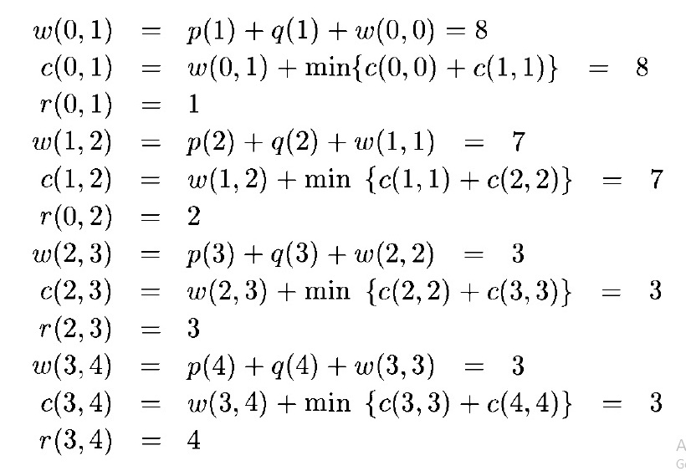
Compute W,C,R for j-i=1

Slide 74
Knowing W(i, i +1) and C(i, i + 1),0≤i <4, we can again use equations compute w(i,i+2), c(i,i+2), and r(i,i+2), 0≤i <3.
This process can be repeated until w(0,4), c(0,4) and r(0,4)are obtained.

Slide 75
Computation of c(0,4)w, (0,4)and r(0,4)

Slide 76
Optimal Binary search of above example
if
do
int
while

Slide 78
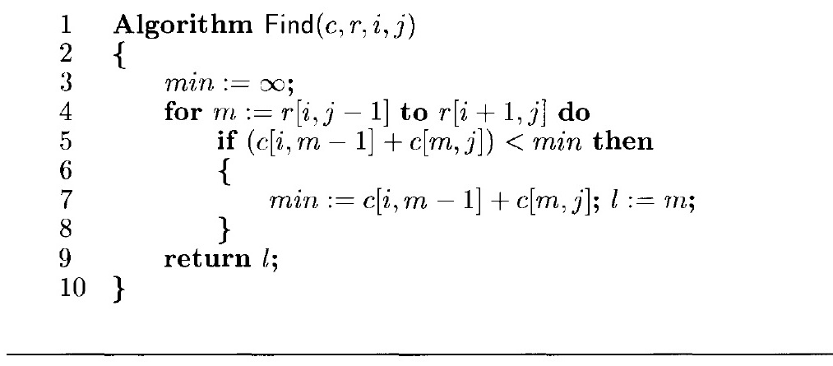
-The computation of each of these c(i,j)‘s Requires us to find the minimum of ‘m’ quantities.
Hence, each such c(i,j) can be computed in time O(m).
The total time for all c(i,j) with j-i= m is therefore O(nm- m²).
The total time to evaluate all the c(i,j)'s and r(i,j)'s is therefore
Ʃ_{1≤m≤n} (nm- m²)=O(n³).

Slide 79
5.RELIABILITYDESIGN
In this section we look at an example of how to use dynamic programming to solve a problem with a multiplicative optimization function.
The problem is to design a system that is composed of several devices connected in series.
Let ‘r_{i}’ be the reliability of device ‘D’ (that is r_{i} is the probability that device i will function properly).
Then, the reliability of the entire system is ∏r_{i}

Slide 81
Even if the individual devices are very reliable (the ‘r_{i} 's are very close to one), the reliability of the system may not be very good.
Multiple copies of the same device type are connected in parallel(Figure 5.20) through the use of switching circuits.
The switching circuits determine which devices in any given group are functioning properly.
They then make use of one such device at each stage.

Slide 82
If stage ‘i’ contains m_{i} copies of device D_{i} ,then the probability that all m_{i} have a malfunction is (1-r_{i})^{mi}
Hence the reliability of stage ‘i’ becomes
In any practical situation, the stage reliability is a little less than 1-(1-r_{i})^{mi} because the switching circuits themselves are not fully reliable.
Also, failures of copies of the same device may not be fully independent.(if failure is due to design defect).
1-(1-r_{i})^{mi}

Slide 83
Let us assume that the reliability of stage ‘i’ is given by a function Фi(mi).
The reliability of the system of stages is
Our problem is to use device duplication to maximize reliability.
This maximization is to be carried out under a cost constraint.
Let C_{i}, be the cost of each unit of device d_{i} and let ‘c’ be the maximum allowable cost of the system being designed.
∏_{1≤m≤n} Фi(mi)

Slide 84
We wish to solve the following maximization problem
subject to
mi > 1and integer, 1≤i≤n
A dynamic programming solution can be obtained in a manner similar to that used for the knapsack problem.
maximize ∏_{1≤m≤n} Фi(mi)
Ʃ _{1≤m≤n} c_{i} m_{i <=C}

Slide 85
Since, we can assume each c_{i} >0,each m_{i} must be in the range 1≤ m_{i} ≤ u_{i} where
Here ‘u’ is the upper bound function.
u_{i=} (C+ C_{i} - Ʃ _{j=1}^{n} C _{j} / C_{i} )

Slide 86
Problem: We are to design a three stage system with device types D₁D_{2 and} D₃ The costs are $30,$15,and $20 respectively. The cost of the system is to be no more than $105.
The reliability of each device type is 0.9,0.8 and 0.5 respectively.

