Slide 1
Quick sort

Slide 2
Like Merge Sort, QuickSort is a Divide and Conquer algorithm.
It picks an element as pivot and partitions the given array around the picked pivot.
There are many different versions of quick Sort that pick pivot in different ways.
->Always pick first element as pivot.
->Always pick last element as pivot
->Pick a random element as pivot.
->Pick median as pivot.

Slide 3
The key process in quick Sort is partition().
Target of partitions is, given an array and an element x of array as pivot,
put x at its correct position in sorted array and put all smaller elements (smaller than x) before x, and put all greater elements (greater than x) after x.
All this should be done in linear time.

Slide 4
Quick Sort
Divide:
Pick any element as the pivot, e.g, the last element
Partition the remaining elements into
FirstPart, which contains all elements < pivot
SecondPart, which contains all elements > pivot
Recursively sort First Part and Second Part.
Combine: no work is necessary since sorting is done in place.
Notes:
since sorting is done in place

Slide 5
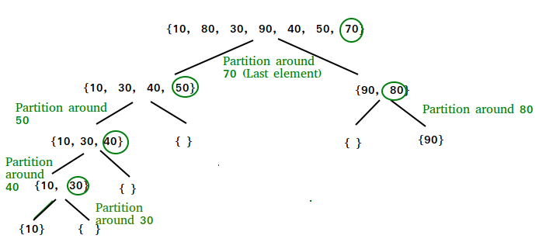
Quick Sort Example

Slide 6
Pseudo Code for Quick Sort:
Algorithm QuickSort(low,high)
//Sorts the elements a[low],…..,a[high] which resides
//in the global array a[1:n] into ascending order;
// a[n+1] is considered to be defined and must ≥ all the
// elements in a[1:n].
{
if( low< high ) // if there are more than one element
{ // divide p into two subproblems.
j :=Partition(low,high);
// j is the position of the partitioning element.
QuickSort(low,j-1);
QuickSort(j+1,high);
// There is no need for combining solutions.
}
}

Slide 7
Algorithm Partition(l,h)
{
pivot:= a[i] ; i:=l; j:= h+1;
while( i < j ) do
{
i++;
while( a[ i ] < pivot ) do
i++;
j--;
while( a[ j ] > pivot ) do
j--;
if ( i < j ) then Interchange(i, j ); // interchange i^{th} and
} // j^{th} elements.
Interchange(l, j ); return j; // interchange pivot and j^{th} element.
}

Slide 8
Algorithm interchange (x,y )
{
temp=a[x];
a[x]=a[y];
a[y]=temp;
}

Slide 9
Time complexity analysis
The time required to sort n elements using quicksort involves 3 components.
Time required for partitioning the array, which is roughly proportional to n.
Time required for sorting lower subarray.
Time required for sorting upper subarray.
Assume that there are k elements in the lower subarray.
Therefore,
c₁
n=1, c₁ is a constant
T(n) =
T(k) + T(n-k-1) +c₂n
n>1, c₂ is a constant

Slide 10
A worst/bad case It occurs if the list is already in sorted order
1
2
3
4
5
6
7
8
9
1
2
3
4
5
6
7
8
9
2
3
4
5
6
7
8
9
3
4
5
6
7
8
9
4
5
6
7
8
9
O(n²)
5
6
7
8
9
6
7
8
9
7
8
9
8
9
9

Slide 11
Worst/bad Case
n
cn
n-1
c(n-1)
n-2
c(n-2)
3c
3
2
2c
1c
1

Slide 12
contd...
In the worst case, the array is always partitioned into two subarrays in which one of them is always empty. Thus , for the worst case analysis,
T(n) =
T(n-1) +c₂n
n>1, c₂ is a constant
=
T(n-1) +c₂n
=
T(n-2) + c₂ ( n -1)+ c₂n
=
T(n-3) + c₂ ( n -2) + c₂( n -1)+c₂n
…..
…..
= n(n+1)/2 = ( n²+n)/2= O(n²)

Slide 13
Time complexties:
Quick-Sort
Most of the work done in partitioning
Best case takes O(n log(n)) time
Average case takes O(n log(n)) time
Worst case takes O(n²) time

