Slide 1
Unit-I

Slide 2
Algorithm
Definition:
‘Algorithm ‘ has come to refer to a method that can be used by a computer for the solution of the problem.
An algorithm is a finite set of instructions that accomplishes a particular task.
All algorithms must satisfy the following criteria
.

Slide 3
Criteria:
Input: Zero or more quantities are externally supplied.
Output : At least one quantity is produced.
Definiteness: Each instruction is clear and unambiguous of an algorithm.
Example: Statements such as “add 6 or 7 to x” or “Compute 5/0” are not permitted”
4. Finiteness: If we trace out the instructions of an algorithm for all cases, then the algorithm should terminate after a finite number of steps.
5. Effectiveness: Instruction is basic enough to be carried out.

Slide 4
Pseudo code for expressing algorithms
We present the algorithms using pseudo code that looks like C and Pascal code.
Comments begin with // and continue until end of the line.
Blocks are indicated with braces: { }.
A compound statement.
Body of a function.

Slide 5
3.
i). The data types of variables are not explicitly declared.
ii). The types will be clear from the context.
iii). Whether a variable is global or local to a function will also be clear from the context.
iv). We assume simple data types such as integer, float, char, boolean, and so on.
v). Compound data types can be formed with records.

Slide 6
node = record
{
datatype_1 data_1;
:
datatype_n data_n;
node *link
}
data items of a record can be accessed
with → and period( . )
C style :-
struct node
{
datatype_1 data_1;
:
datatype_n data_n;
struct node *link
}

Slide 7
4. Assignment statement.
< variable > := < expression >
5. Boolean values are true and false. Logical operators are and, or and not and the relational operators are <, ≤, =, ≠, ≥ and >.
6. Elements of arrays are accessed using [ and ]. For example the (i,j)th element of the array A is denoted as A[i,j].
7. The following looping statements are used: for, while, and repeat until.

Slide 8
The general form of a while loop:
while( condition ) do
{
statement_1;
:
statement_n;
}

Slide 9
The general form of a for loop:
for variable := value1 to value2 step step do
{
statement_1;
:
statement_n;
}
Here value1, value2, and step are arithmetic expressions.
The clause “step step” is optional and taken as +1 if it does not occur.
step could be either positive or negative.
Ex: 1: for i:= 1 to 10 step 2 do // increment by 2, 5 iterations
2: for i:= 1 to 10 do // increment by 1, 10 iterations

Slide 10
The for loop can be implemented as a
while loop as follows:
variable:=value1;
incr:=step;
while( ( variable – value2)*step ≤ 0 ) do
{
<statement 1>
:
<statement n>
variable :=variable+incr;
}

Slide 11
The general form of a repeat-until loop:
repeat
<statement 1>
:
<statement n>
until ( condition )
The statements are executed as long as condition is false.
Ex: number:=10 ; sum:=0;
repeat
sum := sum + number;
number := number - 1;
until number = 0;

Slide 12
8. A conditional statement has the following
forms:
if< condition > then < statement >
if< condition > then < statement 1> else
< statement 2>
9. Input and output are done using the instructions read and write.

Slide 13
10. Procedure or function starts with the word
Algorithm.
General form :
Algorithm Name( <parameter list> )
{
body
}
where Name is the name of the procedure.
Simple variables to functions are passed by value.
Arrays and records( structure or object ) are passed by reference.

Slide 14
Ex:-Algorithm that finds and returns the maximum of n given numbers.
Algorithm max(a,n)
// a is an array of size n
{
Result:=a[1];
for i:=2 to n do
if a[i]>Result then Result:=a[i];
return Result;
}

Slide 15
Ex:-Write an algorithm to sort an array of n integers using bubble sort.
Algorithm sort(a,n)
// a is an array of size n
{
for i:=1 to n-1 do
{
for j:=1 to n-1-i do
{
if( a[j] >a[j+1] ) then
t=:a[j]; a[j]:=a[j+1]; a[j]:=t;
}
}
}

Slide 16
Performance Analysis (machine independent)
There are many things upon which the performance will depend.
Does the program efficiently use primary and Secondary storage?
Is the program's running Time acceptable for the task?
Does it do what we want it to do?
Does it work correctly according to the specifications of the task?
Does the program contain documentation that shows how to use it and how it works?
Is the program's code readable?

Slide 17
Space Complexity
The space required by an algorithm is called a space complexity
The space required by an algorithm has the following components
1.Instruction space
2.Data space
3.Environmental stack space
1.Instruction space:
Instruction space is the space needed to store the compiled version of the program instructions.
The amount of instruction space that is needed depends on the compiler used to compile the program into machine code

Slide 18
2.Data space
Data space is the space needed to store all constant and variable values.
Data space has two components.
Space needed by constants
( ex; 1 and 2 in max of n num algorithm) and
simple variables( such as i, j, n etc).
Space needed by a dynamically allocated objects such as arrays and class instances.
Space taken by the variables and constants varies from language to language and platform to platform.

Slide 19
3.Environmental stack space
The environmental stack is used to save information needed to resume execution of partially completed functions.
Each time a function is invoked the following data are saved on the environment stack.
The return address .
The values of all local variables and formal parameters in the function being invoked( necessary for recursive functions only).

Slide 20
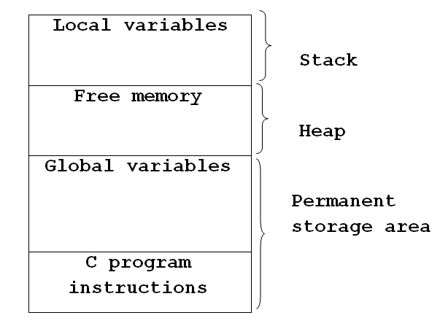
Memory allocation process
The following figure shows the storage of a program in memory.
Return addresses

Slide 21
Recursive algorithm
Algorithm rfactorial(n)
// n is an integer
{ fact=1;
if(n=1 or n=0) return fact;
else
fact=n*rfactorial(n-1);
return fact;
}
Each time the recursive function rfactorial is invoked,
the current values of n and fact and the program location to return to on completion are saved in the environment stack.

Slide 22
Summary of space complexity:
The space needed by a program depends on several factors.
We cannot make an accurate analysis of the space requirements of a program unless we know the computer or compile that will be used.
However, we can determine the components that depend on the characteristics of the problem instance
(e.x., the number of inputs and outputs or magnitude of the numbers involved ) to be solved.
Ex:-1. Space requirements of a program that sorts n elements can be expressed as a function of n.
2. Space requirements of a program that adds two m×n matrices can be expressed as a function of m, n.
Contd…

Slide 23
The size of the instruction space is independent of the problem instance to be solved.
The contribution of the constants and simple variables to the data space is also independent of the problem instance to be solved.
Most of the dynamically allocated memory( ex., arrays, class instances etc) depends on problem instance to be solved.
The environmental stack space is generally independent of the problem instance unless recursive functions are in use.
contd…

Slide 24
Therefore, We can divide the total space needed by a
program into two parts:
i) Fixed Space Requirements (C) Independent of the characteristics of the problem instance ( I )
instruction space
space for simple variables and constants.
ii) Variable Space Requirements (S_{P}(I)) depend on the characteristics of the problem instance ( I )
Number of inputs and outputs associated with I
recursive stack space ( formal parameters, local variables, return address ).
Contd..

Slide 25
Therefore, the space requirement of any problem P can be written as
S(p)=C +S_{p}( Instance characteristics )
Note:
When analyzing the space complexity of an algorithm, we concentrate only on estimating
S_{p} (Instance characteristics ).
We do not concentrate on estimating fixed part c .
We need to identify the instance characteristics of the problem to measure S_{P}

Slide 26
Example1
Algorithm abc(a,b,c)
{
return a+b+b*c+(a+b-c)/(a+b)+4.0;
}
Problem instance characterized by the specific values of a,b,and c.
If we assume one word (4 bytes) is adequate to store the values of each a, b, and c , then the space needed by abc is independent of the instance characteristics.
Therefore, S_{abc}( instance characteristics)=0

Slide 27
Example2
Algorithm sum(a,n)
{
s:=0;
for i:=1 to n do
s:=s+a[i];
return s;
}
Problem instance characterized by n.
The amount of space needed does not depend on the value of n.
Therefore, S_{sum}(n)=0
Recall: Address of the
first element of the array will be passed .

Slide 28
Example3
Algorithm RSum(a,n)
{
if(n ≤ 0) then return 0;
else return RSum(a,n-1)+a[n];
}
Type | Name | Number of bytes
formal parameter: int | a | 2
formal parameter: int | n | 2
return address ( used internally) |  | 2
Total per one recursive call |  | 6
Total no.of recursive calls n, therefore S_{RSum} (n)=6(n+1)

Slide 29
Time Complexity:
T(P)=C+T_{P}(I)
The time, T(P), taken by a program, P, is the sum of its compile time C and its run (or execution) time, T_{P}(I).
The compile time does not depend on the instance characteristics.
We will concentrate on estimating run time T_{p}(I).

Slide 30
If we know the characteristics of the compiler to be used, we can determine the
No. of additions , subtractions, multiplications, divisions, compares, and so on.
Then we can obtain an expression for T_{p}(n) Of the form
T_{P}(n)=c_{a}ADD(n)+c_{s}SUB(n)+c_{m}MUL(n)+c_{d}DIV(n)+……..
where,
n denotes the instance characteristics.
c_{a}, c_{s}, c_{m}, c_{d} and so on denote the time needed for an addition , subtraction, multiplication, division and so on.
ADD, SUB, MUL, DIV, and so on are functions whose values are the no.of additions, subtractions, multiplications, divisions, and so on.

Slide 31
Obtaining such an exact formula is an impossible task, since time needed for an addition, subtraction, and so on, depends an numbers being added, subtracted, and so on.
The value of Tp(n) for any given n can be obtained only experimentally.
Even with the experimental approach, one could face difficulties.
In a multiuser system the execution time of a program p depends on the number of other programs running on the computer at the time program p is running.

Slide 32
As there were some problems in determining the execution time using earlier methods, we will go one step further and count only the number of program steps.
Program step
-Program step is loosely defined as a syntactically or semantically meaningful program segment whose execution time is independent of the instance characteristics.
Example:
result = a + b + b * c + (a + b - c) / (a + b) + 4.0;
sum = a + b + c;

Slide 33
The number of steps assigned to any program statement depends on the kind of statement.
Comments are counted as zero number of steps.
An assignment statement which does not involve any calls to other functions counted as one step.
For loops, such as the for, while, and repeat-until, we consider the step counts only for the control part of the statement.
The control parts for for and while statements have the following forms:
for i:= <expr1> to <expr2> do
while ( <expr> ) do

Slide 34
Each execution of the control part of a while statement is one, unless <expr> is a function of instance characteristics.
The step count for each execution of the control part of a for statement is one, unless <expr1> and <expr2> are functions of the instance characteristics.
The step count for each execution of the condition of a conditional statements is one, unless condition is a function of instance characteristics.
If any statement ( assignment statement, control part, condition etc.) involves function calls, then the step count is equal to the number of steps assignable to the function plus one.

Slide 35
Methods to compute the step count
1) Introduce global variable count into programs with initial value zero.
Statements to increment count by the appropriate amount are introduced into the program.
The value of the count by the time program terminates is the number steps taken by the program.
2) Tabular method
Determine the total number of steps contributed by each statement per execution × frequency
Add up the contribution of all statements

Slide 36
Method-I: Introduce variable count into programs
EX:- Iterative sum of n numbers
Algorithm sum(a, n) { s:=0;
count:=count+1; // for assignment statement
for i:=1 to n do
{ count:=count+1; // For for
s:=s+a[i];
count:=count+1; // for assignment statement
}
count:=count+1; // for last time of for
return s;
count:=count+1; // for return
}
2n + 3 steps
Note : Step count tells us how the run time for a program changes with
changes in the instance characteristics.

Slide 37
Ex:- Addition of two m×n matrices
Algorithm Add(a,b,c,,m,n)
{
for i:=1 to m do
{
for j:=1 to n do
{
c[i,j]:=a[i,j]+b[i,j];
}
}
}
2mn + 2m+1 steps

Slide 38
EX:- Recursive sum of n numbers
Algorithm RSum(a,n)
{
count:=count+1; // for the if conditional
if(n ≤ 0) then
{
return 0;
count:=count+1; // for the return
}
else
{
return RSum(a,n-1)+a[n];
count:=count+1; // For the addition, function invocation and return
}
}

Slide 39
When analyzing a recursive program for its step count, we often obtain a recursive formula for the step count.
We obtain the following recursive formula for above (RSum) algorithm.
t_{RSum} (n)=
2
If n=0
2+ t_{RSum}(n-1)
If n>0

Slide 40
One way of solving such recursive formula is by repeated substitutions for each occurrence of the function t_{RSum} on the right side until all such occurrences disappear:
t_{RSum} (n) = 2+t_{RSum}(n-1)
= 2+2+t_{RSum}(n-2)
= 2(2)+t_{RSum}(n-2)
:
:
= n(2) +t_{RSum}(n-n)
=2n+t_{RSum}(0)
= 2n+2
The step count for Rsum is 2n+2

Slide 41
Method-II: Tabular method(steps for execution (s/e))
EX:- Iterative sum of n numbers
Statement | s/e | frequency | Total steps
Algorithm sum(a, n) { s:=0 ; for i:=1 to n do s:=s+a[i]; return s; } | 0 0 1 1 1 1 0 | -- -- 1 n+1 n 1 -- | 0 0 1 n+1 n 1 0
Total |  |  | 2n+3

Slide 42
EX:- Addition of two m×n matrices
Statement | s/e | frequency | Total steps
Algorithm Add(a,b,c,m, n) { for i:=1 to m do for j:=1 to n do c[i,j]:=a[i,j]+b[i,j] ; } | 0 0 1 1 1 0 | -- -- m+1 m(n+1) mn -- | 0 0 m+1 mn+m mn 0
Total |  |  | 2mn+2m+1

Slide 43
EX:- Recursive sum of n numbers
Statement | s/e | Frequency n=0 n>0 | Total steps n=0 n>0
Algorithm RSum(a,n) { if( n ≤ 0 ) then return 0; else return Rsum(a,n-1)+a[n] ; } | 0 0 1 1 1+x 0 | -- -- -- -- 1 1 1 0 0 1 -- -- | 0 0 0 0 1 1 1 0 0 1+x 0 0
Total |  |  | 2 2+x
x=t_{RSum}(n-1)

Slide 44
Best, Worst, Average Cases
Not all inputs of a given size take the same number of program steps.
Sequential search for K in an array of n integers:
Begin at first element in array and look at each element in turn until K is found.
Best-Case Step count:-
Minimum number of steps executed by the algorithm for the given parameters.
2. Worst-Case Step count:-
Maximum number of steps executed by the algorithm for the given parameters.
3. Average-Case Step count:-
Average number of steps executed by an algorithm.
Notes:
Best: Find at first position. Cost is 1 compare.
Worst: Find at last position. Cost is n compares.
Average: (n+1)/2 compares IF we assume the element with value K is equally likely to be in any position in the array.

Slide 45
5 ms
Worst -case time
Running
Time
4 ms
3 ms
Best-case time
2 ms
1 ms
A
B
C
D
E
F
G
Input
Average-case time =
A time + B time+ ………..+G time
----------------------------------------------------
7 ( total number of possible inputs )

Slide 46
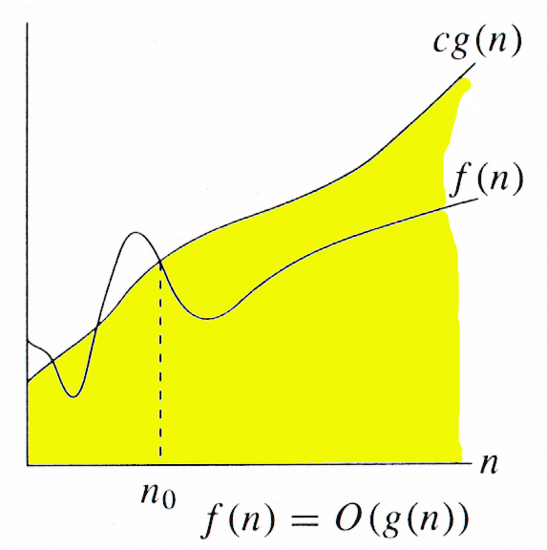
Asymptotic Notations
Running
Time
->Asymptotic notation describes the behavior of functions for the large inputs.
1.Big Oh(O) notation:
The big oh notation describes an upper bound on the asymptotic growth rate of the function f.
Definition: [Big “oh’’]
f(n) = O(g(n))
(read as “f of n is big oh of g of n”) iff there exist positive constants ‘c’ and n₀ such that
f(n) ≤ cg(n) for all n, n ≥ n₀.

Slide 47
The definition states that the function f(n) is at most c times the function g(n) except when n is smaller than n₀.
In other words, f(n) grows slower than or same rate as g(n).
When providing an upper –bound function g for f, we normally use a single term in n.
Examples
f(n) = 3n+2
3n + 2 <= 4n, for all n >= 2, ∴3n + 2 = Ο (n)
f(n) = 10n²+4n+2
10n²+4n+2 <= 11n², for all n >= 5, ∴ 10n²+4n+2 = Ο (n²)
f(n)=6*2^{n}+n²=O(2^{n}) /* 6*2^{n}+n² ≤7*2^{n} for n≥4 */

Slide 48
It also possible to write 10n²+4n+2 = O(n³) since 10n²+4n+2 <=7n³ for n>=2
Although n³ is an upper bound for 10n²+4n+2, it is not a tight upper bound; we can find a smaller function (n²⁾ that satisfies big oh relation.

Slide 49
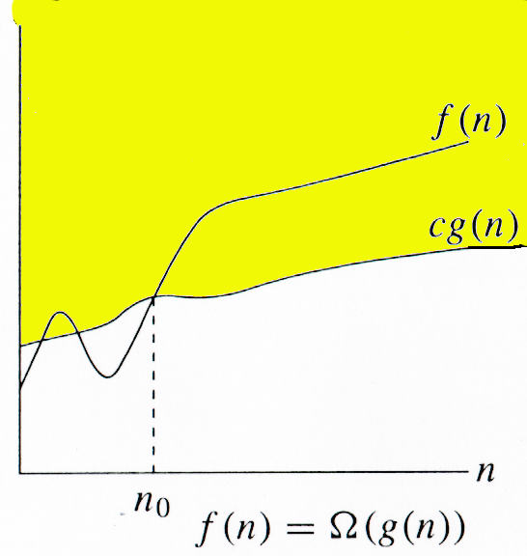
2.Omega (Ω) notation:
The omega notation describes a lower bound on the asymptotic growth rate of the function f.
Definition: [Omega]
f(n) = Ω(g(n))
(read as “f of n is omega of g of n”)
iff there exist positive constants c and n₀ such that
f(n) ≥ cg(n) for all n,
n ≥ n₀.
Running
Time

Slide 50
The definition states that the function f(n) is at least c times the function g(n) except when n is smaller than n₀.
In other words , f(n) grows faster than or same rate as” g(n).
Examples
f(n) = 3n+2
3n + 2 >= 3n, for all n >= 1, ∴3n + 2 = Ω (n)
f(n) = 10n²+4n+2
10n²+4n+2 >= n², for all n >= 1, ∴ 10n²+4n+2 = Ω (n²)
It also possible to write 10n²+4n+2 = Ω(n) since 10n²+4n+2 >=n for n>=0
Although n is a lower bound for 10n²+4n+2, it is not a tight lower bound; we can find a larger function (n²⁾ that satisfies omega relation.
But, we can not write 10n²+4n+2 = Ω(n³), since it does not satisfy the omega relation for sufficiently large input.

Slide 51
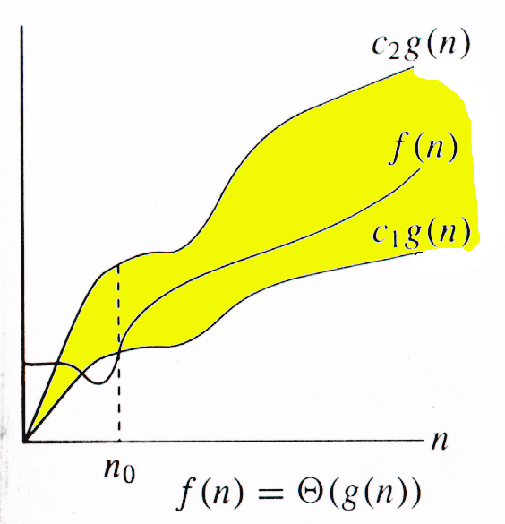
3.Theta (Θ) notation:
The Theta notation describes a tight bound on the asymptotic growth rate of the function f.
Definition: [Theta]
f(n) = Θ(g(n))
(read as “f of n is theta of g of n”) ]
iff there exist positive constants c₁, c₂, and n₀ such that
c₁g(n) ≤ f(n) ≤ c₂g(n) for all n,
n ≥ n₀.
Running
Time

Slide 52
The definition states that the function f(n) lies between c1 times the function g(n) and c2 times the function g(n) except when n is smaller than n₀.
In other words, f(n) grows same rate as” g(n).
Examples:-
f(n) = 3n+2
3n <= 3n + 2 <= 4n, for all n >= 2, ∴ 3n + 2 = Θ (n)
f(n) = 10n²+4n+2
n²<= 10n²+4n+2 <= 11n², for all n >= 5, ∴ 10n²+4n+2 = Θ (n²)
But, we can not write either 10n²+4n+2= Θ(n) or 10n²+4n+2= Θ(n³), since neither of these will satisfy the theta relation.

Slide 53
4.Little Oh(O) notation:
The big oh notation describes a strict upper bound on the asymptotic growth rate of the function f.
Definition: [Little “oh’’]
f(n) = o(g(n)) (read as “f of n is little oh of g of n”) iff f(n) <cg(n) for all non negative values of ‘n’,where n ≥n₀.
Lim
n->∞
f(n)
= 0
g(n)

Slide 54
The definition states that the function f(n) is less than c times the function g(n) except when n is smaller than n₀.
In other words, f(n) grows slower than” g(n).
Examples
f(n) = 3n+2=o(n²)
Since
However, 3n+2 ≠ o(n)
Lim
n->∞
3n+2
= 0
n²

Slide 55
Big-Oh, Theta, Omega and Little-oh
Tips :
Think of O(g(n)) as “less than or equal to” g(n)
Upper bound: “grows slower than or same rate as” g(n)
Think of Ω(g(n)) as “greater than or equal to” g(n)
Lower bound: “grows faster than or same rate as” g(n)
Think of Θ(g(n)) as “equal to” g(n)
“Tight” bound: same growth rate
Think of o(g(n)) as “less than to” g(n)
Strict Upper bound: “grows slower than ” g(n)
(True for large N)

Slide 56
Functions ordered by growth rate
Function | Name
1 | Growth is constant
logn | Growth is logarithmic
n | Growth is linear
nlogn | Growth is n-log-n
n² | Growth is quadratic
n³ | Growth is cubic
2^{n} | Growth is exponential
n! | Growth is factorial
1 < logn < n < nlogn < n² < n³ < 2^{n} < n!

Slide 57
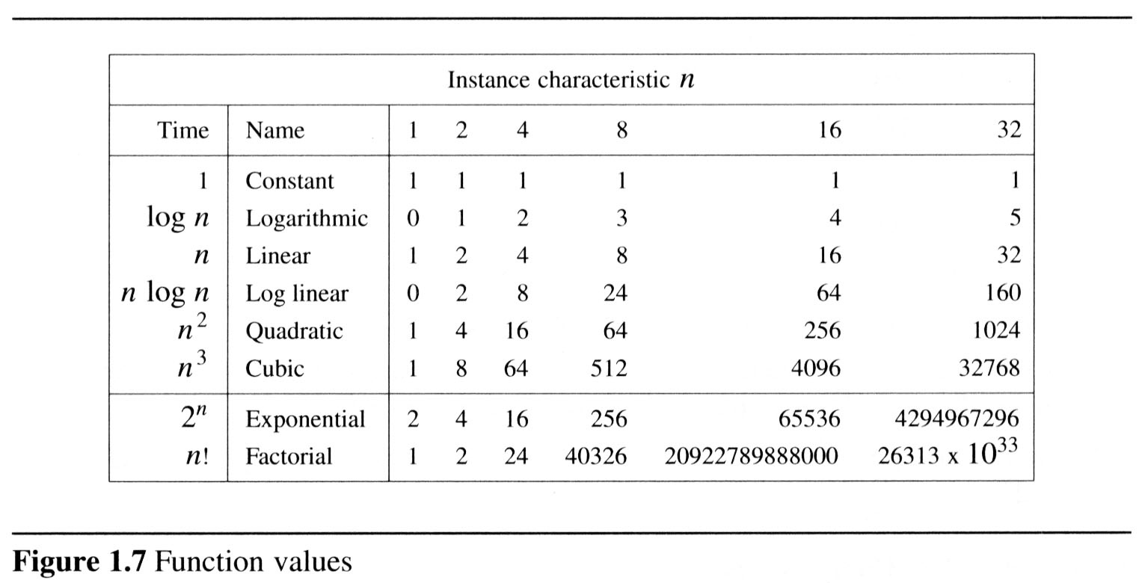
To get a feel for how the various functions grow with n, you are advised to study the following figs:

Slide 58
2

Slide 59
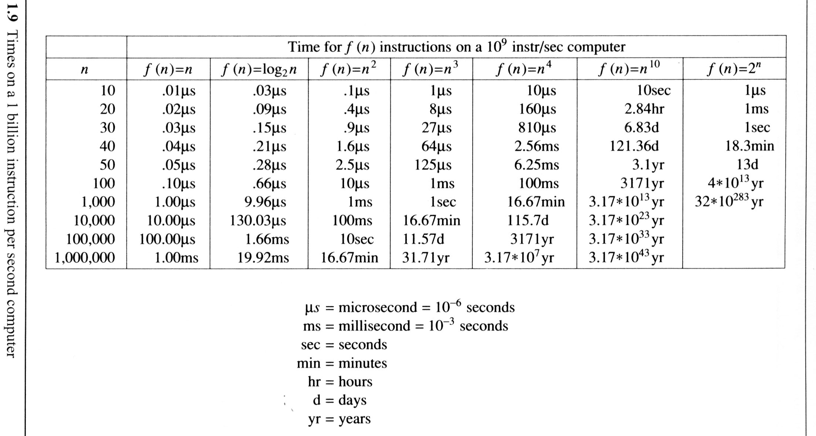
The following fig gives the time needed by a 1 billion instructions per second computer to execute a program of complexity f(n) instructions.

